Slide 1
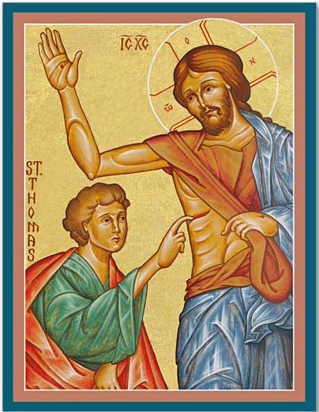
Newness of Life (1)
New Sunday

Slide 2
Newness of Life
Therefore we were buried with Him through baptism into death, that just as Christ was raised from the dead by the glory of the Father, even so we also should walk in newness of life. Rom 6:4

Slide 3
New Creation
21 So Jesus said to them again, “Peace to you! As the Father has sent Me, I also send you.” 22 And when He had said this, He breathed on them, and said to them, “Receive the Holy Spirit. 23 If you forgive the sins of any, they are forgiven them; if you retain the sins of any, they are retained.” Jn 20:21-23

Slide 4
Old Creation
And the Lord God formed man of the dust of the ground, and breathed into his nostrils the breath of life; and man became a living being. Gen 2:7

Slide 5
St Maximus the Confessor
Since we have been baptized in the name of the Lord Jesus Christ by the Holy Spirit (in other words, we have participated in His death and resurrection), we have been granted our first liberation from the corrupt flesh in the name of the Lord and through His Spirit. However, we look forward to the final liberation…as spiritual beings.

Slide 6
New Peace
Then, the same day at evening, being the first day of the week, when the doors were shut where the disciples were assembled, for fear of the Jews, Jesus came and stood in the midst, and said to them, “Peace be with you.” Jn 20:19

Slide 7
Peace to You
And after eight days His disciples were again inside, and Thomas with them. Jesus came, the doors being shut, and stood in the midst, and said, “Peace to you!” Jn 20:26

Slide 8
It is a Blessing
The Lord will give strength to His people; The Lord will bless His people with peace. Ps 29:11

Slide 9
St. Mark the Ascetic
When a person remains in the city of revelation, feeling secure, and overcome by holy meditation- while in fear of evil spirits, and enclosing his senses, that person welcomes the word of God. Then it is revealed to him in a mysterious manner rather than through the senses. It proclaims peace to him, while granting calmness and freedom from lusts

Slide 10
New Mission
21 So Jesus said to them again, “Peace to you! As the Father has sent Me, I also send you.” 22 And when He had said this, He breathed on them, and said to them, “Receive the Holy Spirit. 23 If you forgive the sins of any, they are forgiven them; if you retain the sins of any, they are retained.” Jn 20:21-23

Slide 11
St Ambrose Concerning Repentance,1:2:8
The task of the priest is to grant the Holy Spirit, to exercise his right to forgive - through the Holy Spirit- and to retain sins.

Slide 12
New Blessedness
Jesus said to him, “Thomas, because you have seen Me, you have believed. Blessed are those who have not seen and yet have believed.” Jn 20:29

Slide 13
St Augustine Hom. 25. Forty Gospel Homilies, 206-207
When the doubting disciple touched the wounds in His Master’s Body, the wounds inflicted by his unbelief were healed. ..When Thomas regained faith by touching the Lord, our minds were released of all doubt, and have become steadfast in the faith…What the Lord declared was a reference to what would happen concerning the faith of the Gentiles: “Blessed are those who have not seen, and yet have believed.”

Slide 14
Application
New Creation
New Peace
New Mission
New Blessedness

Slide 15
Father Theophlactius
The eyes are opened to those who receive the holy bread so that they know Christ, because the Lord’s body bears tremendous strength, quite unutterable.

