Slide 1
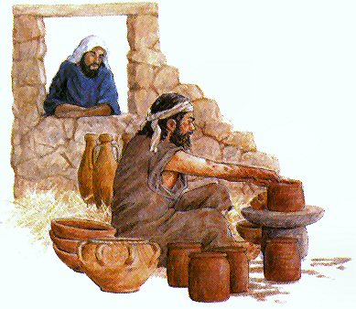
A Year of Remolding
New Year’s Message 2015

Slide 2
1- A calling
The word which came to Jeremiah from the Lord, saying: “Arise and go down to the potter’s house, and there I will cause you to hear My words.” Jer 18:1,2

Slide 3
2- Obedience
Then I went down to the potter’s house, and there he was, making something at the wheel. Jer 18:3

Slide 4
3- A lesson
4 And the vessel that he made of clay was marred in the hand of the potter; so he made it again into another vessel, as it seemed good to the potter to make.5 Then the word of the Lord came to me, saying: 6 “O house of Israel, can I not do with you as this potter?” says the Lord. “Look, as the clay is in the potter’s hand, so are you in My hand, O house of Israel! Jer 18:4-6

Slide 5
St Gregory Nazianzen Oration 7:23
This is the purpose of the great mystery for us. This is the purpose for us of God, who for us was made man and became poor, to raise our flesh and recover His image, and remodel man, that we might all be made one in Christ (gal 3:28) who was perfectly made in all of us all that he Himself is ,

Slide 6
4- Warning
“Now therefore, speak to the men of Judah and to the inhabitants of Jerusalem, saying, ‘Thus says the Lord: “Behold, I am fashioning a disaster and devising a plan against you. Return now every one from his evil way, and make your ways and your doings good.” Jer 18:11

Slide 7
(St. John Chrysostom)
The warning presents salvation from the disaster ! The verdict of cutting down, will stop the cutting down ! How amazing it is; The verdict of death, would bring on life !

Slide 8
5- Disobedience and Rejection
And they said, “That is hopeless! So we will walk according to our own plans, and we will every one obey the dictates of his evil heart.” Jer 18:12

Slide 9
6- Let us devise plans
Then they said, “Come and let us devise plans against Jeremiah; for the law shall not perish from the priest, nor counsel from the wise, nor the word from the prophet. Come and let us attack him with the tongue, and let us not give heed to any of his words.” Jer 18:18

Slide 10
7- Flask
Thus says the Lord: “Go and get a potter’s earthen flask, and take some of the elders of the people and some of the elders of the priests. …therefore behold, the days are coming,” says the Lord, “that this place shall no more be called Tophet or the Valley of the Son of Hinnom, but the Valley of Slaughter. Jer 19:1,6

Slide 11
A Choice
Or do you despise the riches of His goodness, forbearance, and longsuffering, not knowing that the goodness of God leads you to repentance? But in accordance with your hardness and your impenitent heart you are treasuring up for yourself wrath in the day of wrath and revelation of the righteous judgment of God, Rom 2:4,5

Slide 12
The misuse of God’s Longsuffering
“Then you shall break the flask in the sight of the men who go with you, and say to them, ‘Thus says the Lord of hosts: “Even so I will break this people and this city, as one breaks a potter’s vessel, which cannot be made whole again; and they shall bury them in Tophet till there is no place to bury. Jer 19:10,11

Slide 13
The Liturgy of St Basil
Lead us throughout the way into Your kingdom, that as in this so also in all things Your great and holy name be glorified, blessed and exalted in everything honored and blessed, together with Jesus Christ, Your beloved Son and the Holy Spirit.

