Slide 1
Honoring God’s Covenants

Slide 2
3 Covenants
The covenant with the Levites
The covenant between God and Israel
God’s covenant of marriage

Slide 3
Breaking the Covenant of Levi
The Priests were bored with their blessings

Slide 4
Duties of a Priest Malachi 2:6-7
The law of truth was in his mouth,
And injustice was not found on his lips.
He walked with Me in peace and equity,
And turned many away from iniquity.
7 “For the lips of a priest should keep knowledge,
And people should seek the law from his mouth;
For he is the messenger of the Lord of hosts.

Slide 5
“Law of truth”
There’s no unfair decision in his mouth and impartial in his wisdom and judgments
'He walked with me in peace and equity', he lives what he teaches!

Slide 6
The lips of a Priest
should keep', that word 'keep' could be translated 'guard', 'knowledge, and they should seek the law at his mouth: for he is the messenger of the LORD of hosts'.

Slide 7
Malachi 2:13-14
And this is the second thing you do:
You cover the altar of the Lord with tears,
With weeping and crying;
So He does not regard the offering anymore,
Nor receive it with goodwill from your hands.

Slide 8
14 Yet you say, “For what reason?”
Because the Lord has been witness
Between you and the wife of your youth,
With whom you have dealt treacherously;
Yet she is your companion
And your wife by covenant.

Slide 9
Marriage is a covenant of 3

Slide 10
Ephesians 5:25
“Husbands, love your wives, just as Christ also loved the church and gave Himself for her,”

Slide 11
1 Corinthians 13:4-7
“Love suffers long and is kind; love does not envy; love does not parade itself, is not puffed up; ⁵ does not behave rudely, does not seek its own, is not provoked, thinks no evil; ⁶ does not rejoice in iniquity, but rejoices in the truth; ⁷ bears all things, believes all things, hopes all things, endures all things.”

Slide 12
Spiritual Bonding

Slide 13
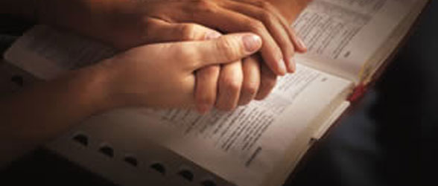
Spiritual Bonding
Two souls coming together
in the pursuit of God

Slide 14
Exhilarating closeness

Slide 15
Physical chemistry

Slide 16
Protection from counterfeit intimacy

Slide 17
How to Build a Spiritual Bond
Become Prayer Partners

Slide 18
Have a Structure of Prayer
Sorry
Thanks
Observation
Request

Slide 19
Keeping each other accountable

