Slide 1
Irrational Love Series Campaign
Love Pays Attention

Slide 2
Rag Dolls

Slide 3
Genesis 1:31
“Then God saw everything that He had made, and indeed it was very good.”

Slide 4
Psalm 8:5
For You have made him a little lower than the angels, And You have crowned him with glory and honor.

Slide 5
The Love we are used to
Eros -the kind of love I give to what satisfies my desires or fulfills my appetites

Slide 6
Love creates value in what is loved

Slide 7
Romans 5:6
“For when we were still without strength, in due time Christ died for the ungodly. ⁷ For scarcely for a righteous man will one die; yet perhaps for a good man someone would even dare to die. ⁸ But God demonstrates His own love toward us, in that while we were still sinners, Christ died for us.”

Slide 8
Isaiah 64:6
But we are all like an unclean thing, And all our righteousnesses are like filthy rags;

Slide 9
Different type of Love
Agape love – Charity
was used to express love in the form of a pure gift

Slide 10
The Sinner woman Luke 7

Slide 11
Love means being “for” the one who is loved

Slide 12
If I am “for” someone I am willing to risk saying painful things, if pain is the only way to bring growth
“for the Lord disciplines those whom he loves.”

Slide 13
Ephesians 5:27
“ that He might present her to Himself a glorious church, not having spot or wrinkle or any such thing, but that she should be holy and without blemish.

Slide 14
Love longs for the person to enter into the splendor that God intends – no spots, no wrinkles, no blemishes

Slide 15
Love delights in and enjoys the one Who is loved

Slide 16
One of the greatest miracles God performs is his attentiveness to us

Slide 17
Numbers 6:24-26
The Lord bless you and keep you;
25 The Lord make His face shine upon you,
And be gracious to you;
26 The Lord [a]lift up His countenance upon you,
And give you peace.” ’

Slide 18
John 9:1
“as he walked along, he [Jesus] saw a man blind from birth.”

Slide 19
Living in God’s love requires eyes that notice.

Slide 20
John 9:2
² And His disciples asked Him, saying, “Rabbi, who sinned, this man or his parents, that he was born blind?”

Slide 21
When we judge people, we feel less of an obligation to suffer with and for them

Slide 22
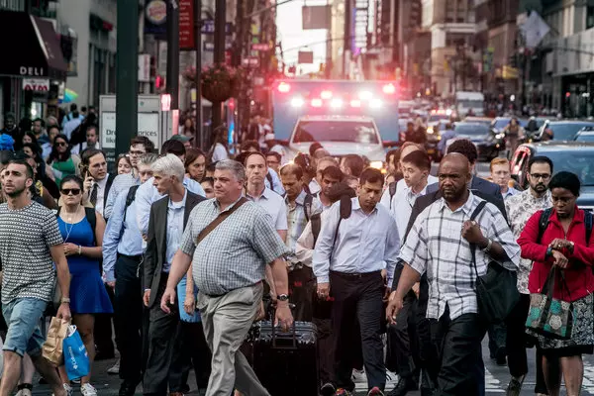
The main place you do the work of God is as you go along.

Slide 23
John 9:8-9
“The neighbors and those who had seen him before as a beggar began to ask, ‘Is this not the man who used to sit and beg?’ Some were saying, ‘It is he.’ Others were saying, ‘No, but it is someone like him.’ He kept saying,‘ I am the man.’”

Slide 24
Spiritual Attention Deficit Disorder

Slide 25
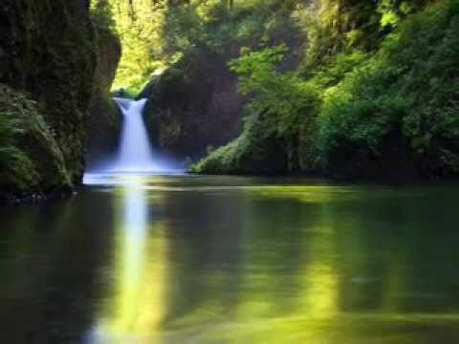
Stillness is always the prerequisite for receptivity.

Slide 26
Psalm 131:1-2
“Lord, my heart is not haughty, Nor my eyes lofty. Neither do I concern myself with great matters, Nor with things too profound for me.
² Surely I have calmed and quieted my soul, Like a weaned child with his mother; Like a weaned child is my soul within me.”

Slide 27
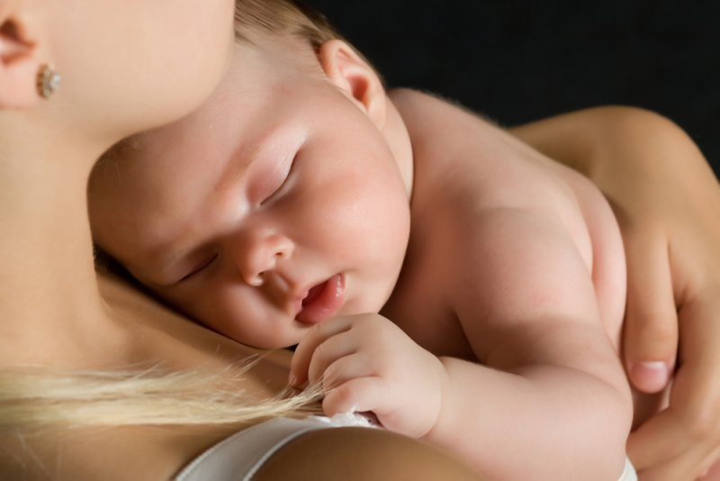
Weaning means learning to live in stillness with unfulfilled desires.

Slide 28
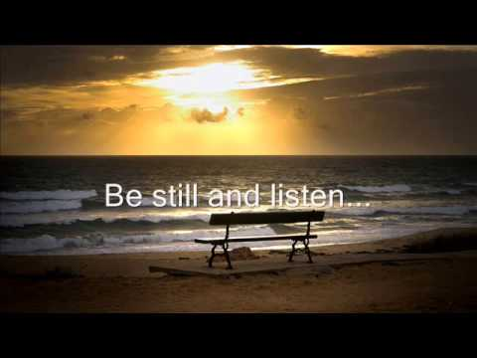
A still soul is the soul that is listening to God

