Slide 1
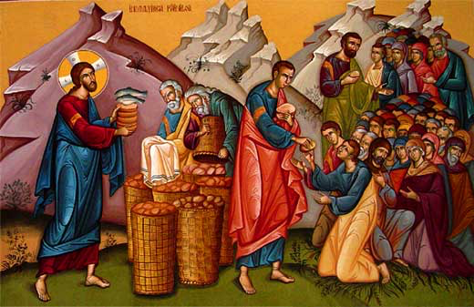
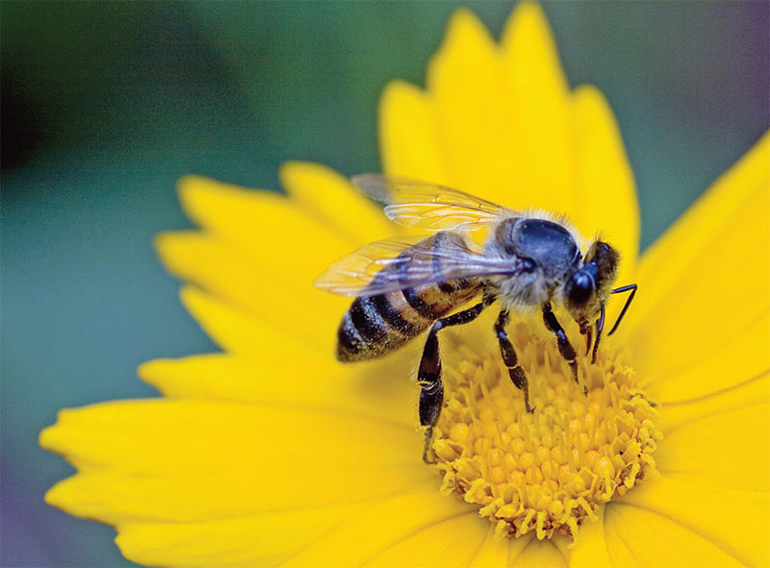
Like A Bee
3rd Sunday of Abib 2016

Slide 2
Like A Bee
But when the multitudes knew it, they followed Him; and He received them and spoke to them about the kingdom of God, and healed those who had need of healing. Luke 9:11

Slide 3
1- You have to find out , where is He?
40 One of the two who heard John speak, and followed Him, was Andrew, Simon Peter’s brother. 41 He first found his own brother Simon, and said to him, “We have found the Messiah” (which is translated, the Christ). 42 And he brought him to Jesus. Jn 1: 40-42

Slide 4
Like A Bee
But when the multitudes knew it, they followed Him; and He received them and spoke to them about the kingdom of God, and healed those who had need of healing. Luke 9:11

Slide 5
2- You have to follow Him
“Not everyone who says to me, ‘Lord, Lord,’ will enter the kingdom of heaven, but the one who does the will of my Father who is in heaven. On that day many will say to me, ‘Lord, Lord, did we not prophesy in your name, and cast out demons in your name, and do many mighty works in your name?’ And then will I declare to them, ‘I never knew you; depart from me, you workers of lawlessness.’ Matt 7:21-23

Slide 6
The Hunger !
When the day began to wear away, the twelve came and said to Him, “Send the multitude away, that they may go into the surrounding towns and country, and lodge and get provisions; for we are in a deserted place here.” Lk 9:12

Slide 7
3- There is a cost !!!
And He was saying to them all, "If anyone wishes to come after Me, he must deny himself, and take up his cross daily and follow Me. Lk 9: 23

Slide 8
St. Jerome
His Cross is the column of humanity. When I say the ‘Cross’ I don’t think of the wooden tree, but of the pain and suffering. This cross is found in Britain, in India, and in all the universes. And you, if you are not willing to carry the Cross-as the case is with Christ, then you can never be His disciple.

Slide 9
4- We will not lack anthing
And He said to them, “When I sent you without money bag, knapsack, and sandals, did you lack anything?” So they said, “Nothing.” Lk 22: 35

Slide 10
The Fraction of St Cyril
Purify our bodies, cleanse us from our iniquities, make us worthy for the descent of Your pure Spirit upon our souls, enlighten our minds so we can see Your praise, purify our thoughts and blend us with Your glory.

