Slide 1
Emptied to be full Kenosis – Part 3
Light & Life
December 16, 2018

Slide 2
who, being in the form of God, did not consider it robbery to be equal with God, but made Himself of no reputation, taking the form of a bondservant, and coming in the likeness of men. (Phil. 2:6,7)

Slide 3
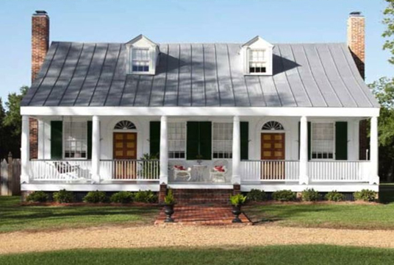
Before
After

Slide 4
⁵ Let this mind be in you which was also in Christ Jesus, ⁶ who, being in the form of God, did not consider it robbery to be equal with God, ⁷ but made Himself of no reputation, taking the form of a bondservant, and coming in the likeness of men.

Slide 5
I need to SLOW DOWN!

Slide 6
Created for Rest not Toil
“The Sabbath was made for man, and not man for the Sabbath.” (Mark 2:27)
“Therefore, since a promise remains of entering His rest, let us fear lest any of you seem to have come short of it.” (Hebrews 4:1)

Slide 7
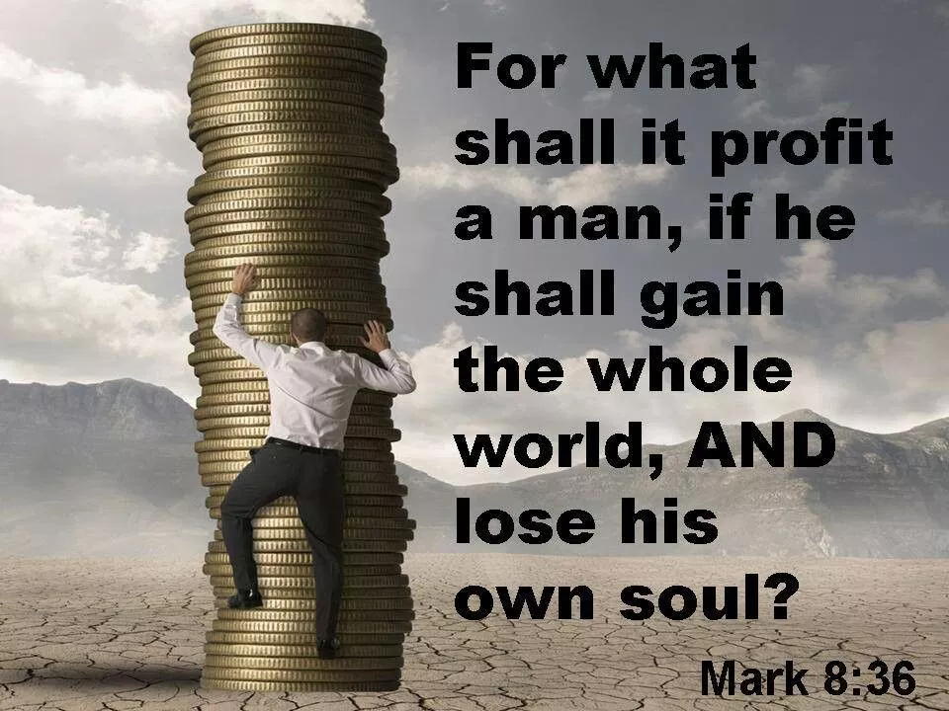

Slide 8
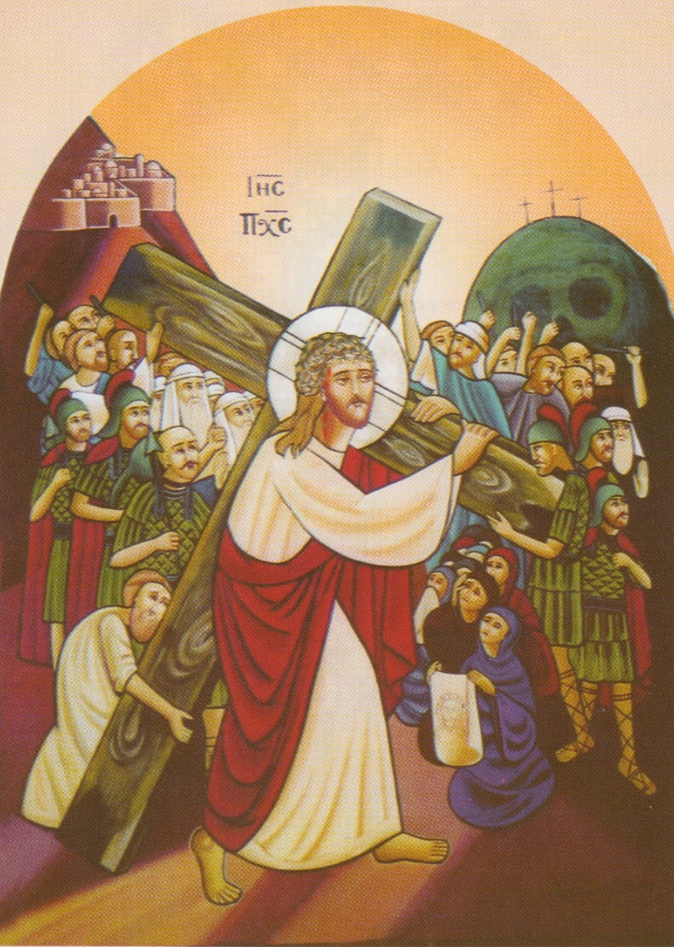
23 Then He said to them all, “If anyone desires to come after Me, let him deny himself, and take up his cross daily, and follow Me. 24 For whoever desires to save his life will lose it, but whoever loses his life for My sake will save it. 25 For what profit is it to a man if he gains the whole world, and is himself destroyed or lost? (Luke 9:23-25)

Slide 9
Enter into Silence!

Slide 10
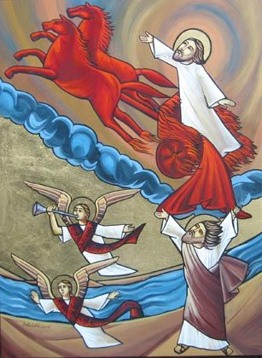
11 Then He said, “Go out, and stand on the mountain before the Lord.” And behold, the Lord passed by, and a great and strong wind tore into the mountains and broke the rocks in pieces before the Lord, but the Lord was not in the wind; and after the wind an earthquake, but the Lord was not in the earthquake; 12 and after the earthquake a fire, but the Lord was not in the fire; and after the fire a still small voice. (1 Kings 19:11,12)

Slide 11
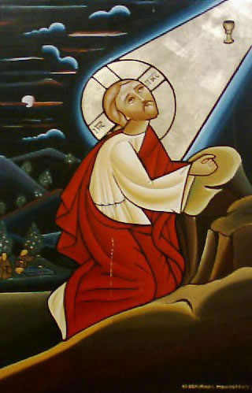
Now in the morning, having risen a long while before daylight, He went out and departed to a solitary place; and there He prayed. (Mark 1:35)
Now it came to pass in those days that He went out to the mountain to pray, and continued all night in prayer to God. (Luke 6:12)

Slide 12
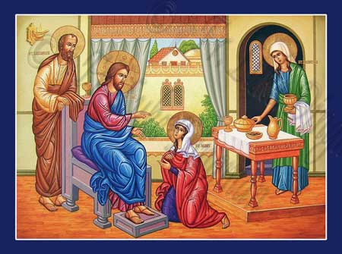
And Jesus answered and said to her, “Martha, Martha, you are worried and troubled about many things. 42 But one thing is needed, and Mary has chosen that good part, which will not be taken away from her.” (Luke 10:41,42)

Slide 13
1) I must schedule daily quiet time with God

Slide 14
2) I need general times of quiet in my life

Slide 15
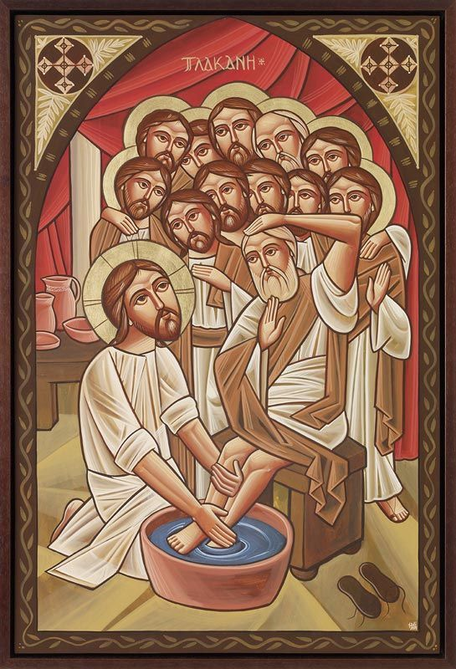
I need to serve!
For even the Son of Man did not come to be served, but to serve, and to give His life a ransom for many.” (Mark 10:45)
For we are God’s fellow workers (1 Cor. 3:9)

Slide 16
I now rejoice in my sufferings for you, and fill up in my flesh what is lacking in the afflictions of Christ, for the sake of His body, which is the church, (Col. 1:24)

Slide 17
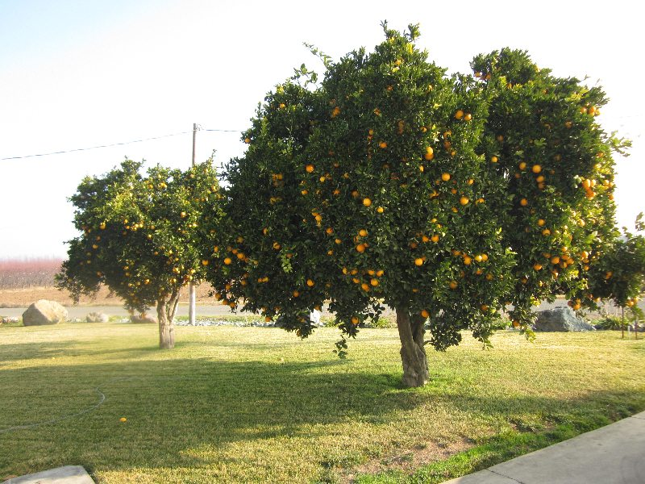
But the ones that fell on the good ground are those who, having heard the word with a noble and good heart, keep it and bear fruit with patience. (Luke 8:15)

Slide 18
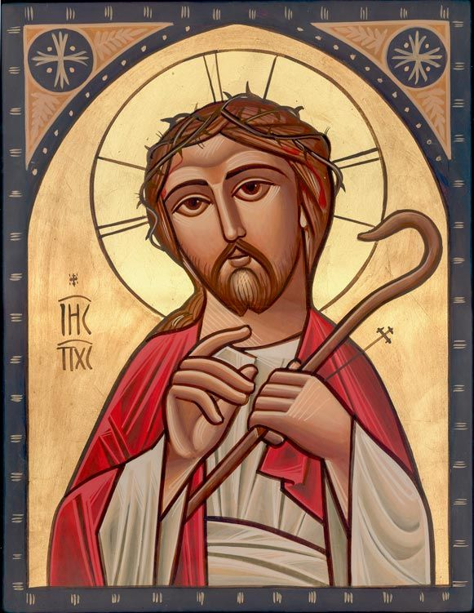
A disciple is not above his teacher, but everyone who is perfectly trained will be like his teacher. (Luke 6:40)

