Slide 1
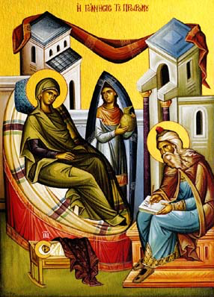
Kenosis (4) Being filled with the Holy Spirit
4th Sunday of Kiahk 2015

Slide 2
Origen De Principiis. Book IV Chapter I.32
As now by participation in the Son of God one is adopted as a son, and by participating in that wisdom which is in God is rendered wise, so also by participation in the Holy Spirit is a man rendered holy and spiritual.

Slide 3
Week (1)
15 For he will be great in the sight of the Lord, and shall drink neither wine nor strong drink. He will also be filled with the Holy Spirit, even from his mother’s womb. Luke 1:15

Slide 4
Week (2)
35 And the angel answered and said to her, “The Holy Spirit will come upon you, and the power of the Highest will overshadow you; therefore, also, that Holy One who is to be born will be called the Son of God. Lk 1:35

Slide 5
Week (3)
And it happened, when Elizabeth heard the greeting of Mary, that the babe leaped in her womb; and Elizabeth was filled with the Holy Spirit. Lk 1:41

Slide 6
Week (4)
67 Now his father Zacharias was filled with the Holy Spirit, and prophesied, saying: LK 1:67

Slide 7
St Ambrose of Milan
“The man who was dumb for a long time has begun to prophesy! He has become filled with God’s grace which made the suspicious people to praise Him! I wish every person not to lose his confidence and not to despair when he thinks over his previous sins, and that he remembers God’s blessings”.

Slide 8
The Catholic Epistle
27 But the anointing which you have received from Him abides in you, and you do not need that anyone teach you; but as the same anointing teaches you concerning all things, and is true, and is not a lie, and just as it has taught you, you will abide in Him. 1 Jn 2:27

Slide 9
St John the Wonder worker
Of course, for union with Christ, the mere conjoining of our body with the Body of Christ does not suffice. The consumption of the Body of Christ becomes beneficial when in spirit we strive towards Him and unite ourselves with Him. Receiving the Body of Christ, while turning away from Him in spirit, is like the contact with Christ which they had who struck Him and mocked and crucified Him. Their contact with Him served not for their salvation and healing, but for their condemnation.

