Slide 1
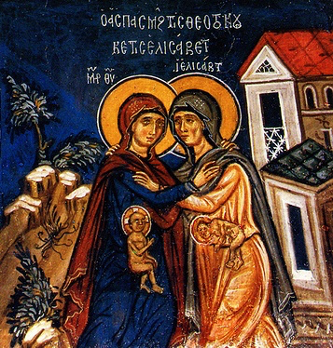
Kenosis (3) Community!
3rd Sunday of Kiahk 2015

Slide 2
The Virgin’s Kenosis
39 Now Mary arose in those days and went into the hill country with haste, to a city of Judah, 40 and entered the house of Zacharias and greeted Elizabeth. Lk 1:39,40

Slide 3
The Virgin’s Kenosis
46 And Mary said: “My soul magnifies the Lord 47 And my spirit has rejoiced in God my Savior. 48 For He has regarded the lowly state of His maidservant; Lk 1:46-48

Slide 4
Elisabeth’ Kenosis
41 And it happened, when Elizabeth heard the greeting of Mary, that the babe leaped in her womb; and Elizabeth was filled with the Holy Spirit. ..43 But why is this granted to me, that the mother of my Lord should come to me? Lk 1:41,43

Slide 5
St. Gregory the Theologian
I ask of you to accept this conception, and to dance before Him, if not in the womb as John did, then let it be when the ark is set, just as David did.

Slide 6
The fruits of Kenosis
42 Then she spoke out with a loud voice and said, “Blessed are you among women, and blessed is the fruit of your womb! …44 For indeed, as soon as the voice of your greeting sounded in my ears, the babe leaped in my womb for joy. 45 Blessed is she who believed, for there will be a fulfillment of those things which were told her from the Lord.” Lk 1:42,44,45

Slide 7
St Ambrose
Elizabeth was the first to hear St. Mary’s voice, but John was the first to be affected by the blessing. Elizabeth knew of St. Mary’s coming, and John felt the presence of Christ. The woman felt the woman’s presence, whereas the babe felt the babe’s presence.

Slide 8
But also for us
23 Now it was not written for his sake alone that it was imputed to him, 24 but also for us. It shall be imputed to us who believe in Him who raised up Jesus our Lord from the dead, Rom 4:23,24

Slide 9
True in HIM and in YOU
8 Again, a new commandment I write to you, which thing is true in Him and in you, because the darkness is passing away, and the true light is already shining. 1 Jn 2:8

Slide 10
A Heart direction
39 whom our fathers would not obey, but rejected. And in their hearts they turned back to Egypt, Acts 7:39

Slide 11
Liturgy of St Basil
O God, Who takes away the sin of the world, hasten, to accept the repentance of Your servants for a light of understanding and for forgiveness of sins.

