Slide 1
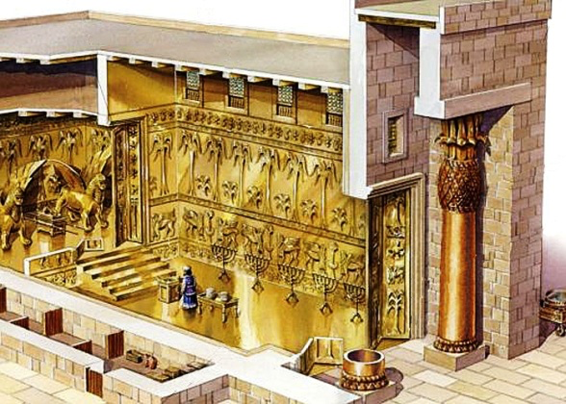
In His temple everyone says, “Glory!” Ps 29:9
1st Sunday of Tout 1733

Slide 2
(Severian, Bishop of Gebalah) Pauline Comm. From the Greek Church.
Being transformed from the knowledge of the law to the grace of the Spirit, We should remember that we are moving from the glory of the Spirit working in us, to the glory of our inheritance as children.

Slide 3
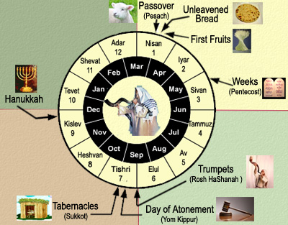
The Jewish feasts

Slide 4
Atonement and Jubilee
Now Solomon assembled the elders of Israel and all the heads of the tribes, the chief fathers of the children of Israel, to King Solomon in Jerusalem, that they might bring up the ark of the covenant of the Lord from the City of David, which is Zion. Therefore all the men of Israel assembled with King Solomon at the feast in the month of Ethanim, which is the seventh month. 1 Kings 8:1,2

Slide 5
Rest, Restoration and Liberty
8 ‘And you shall count seven sabbaths of years for yourself, seven times seven years; and the time of the seven sabbaths of years shall be to you forty-nine years. 9 Then you shall cause the trumpet of the Jubilee to sound on the tenth day of the seventh month; on the Day of Atonement you shall make the trumpet to sound throughout all your land. 10 And you shall consecrate the fiftieth year, and proclaim liberty throughout all the land to all its inhabitants. It shall be a Jubilee for you; and each of you shall return to his possession, and each of you shall return to his family. 11 That fiftieth year shall be a Jubilee to you; in it you shall neither sow nor reap what grows of its own accord, nor gather the grapes of your untended vine. Lev 25:8-11

Slide 6
Forgiveness
So he shall make atonement for the Holy Place, because of the uncleanness of the children of Israel, and because of their transgressions, for all their sins; and so he shall do for the tabernacle of meeting which remains among them in the midst of their uncleanness. Lev 16:16

Slide 7
Could not be counted !!!
Also King Solomon, and all the congregation of Israel who were assembled with him, were with him before the ark, sacrificing sheep and oxen that could not be counted or numbered for multitude. 1 king 8:5

Slide 8
To its place !!!
Then the priests brought in the ark of the covenant of the Lord to its place, into the inner sanctuary of the temple, to the Most Holy Place, under the wings of the cherubim. I king 8:6

Slide 9
Only the two tablets !!
Nothing was in the ark except the two tablets of stone which Moses put there at Horeb, when the Lord made a covenant with the children of Israel, when they came out of the land of Egypt. I King 8:9

Slide 10
(St. Jerome)
It is befitting of the bride of Christ to be like the ark, overlaid by gold on the inside and the outside (Exodus 25: 11); It is befitting of her to be a keeper of the law of the Lord. Like the ark , it is befitting of you to have no outer thoughts; fir the Lord would have pleasure to sit in your mind, as He did once when He sat on the throne of mercy, and on the cherubim (Exodus 25: 22).

Slide 11
The glory of the Lord filled the house
10 And it came to pass, when the priests came out of the holy place, that the cloud filled the house of the Lord, 11 so that the priests could not continue ministering because of the cloud; for the glory of the Lord filled the house of the Lord. I king 8:10,11

Slide 12
St John the Baptist
His message was a trumpet to the coming Jubilee
He was peaching repentance for the forgiveness of sins
The king has his place in His heart
He was a priest ministering in the holy places
God’s glory was overwhelming him

Slide 13
The Least is greater then him?
For I say to you, among those born of women there is not a greater prophet than John the Baptist; but he who is least in the kingdom of God is greater than he.” Luke 7:28

Slide 14
St Gregory of Nyssa the great catechetical oration 32
He so far within the grasp of death as to touch a state of deadness and then in His Own Body to bestow in our nature the principal of resurrection, raising as He did by His power along with Himself the whole man.

