Slide 1
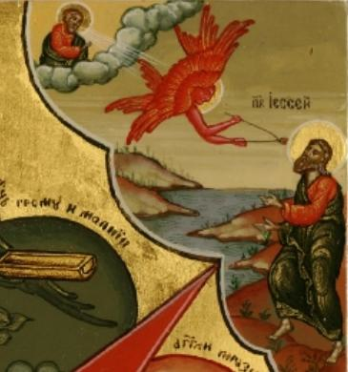
In the beginning there was a vision
Lent’s Eve 2014

Slide 2
A puzzle!!!
At this, some of his disciples said to one another, “What does he mean by saying, ‘In a little while you will see me no more,
and then after a little while you will see me,’
and ‘Because I am going to the Father’?”Jn 16:17

Slide 3
1. The beginning
In the year that King Uzziah died, I saw the Lord, high and exalted, seated on a throne; and the train of his robe filled the temple. Isa 6:1

Slide 4
16 But after Uzziah became powerful, his pride led to his downfall. He was unfaithful to the Lord his God, and entered the temple of the Lord to burn incense on the altar of incense. 17 Azariah the priest with eighty other courageous priests of the Lord followed him in. 18 They confronted King Uzziah and said, “It is not right for you, Uzziah, to burn incense to the Lord. That is for the priests, the descendants of Aaron, who have been consecrated to burn incense. Leave the sanctuary, for you have been unfaithful; and you will not be honored by the Lord God.”2 Chr 26:16 18

Slide 5
19 Uzziah, who had a censer in his hand ready to burn incense, became angry. While he was raging at the priests in their presence before the incense altar in the Lord’s temple, leprosy broke out on his forehead. 20 When Azariah the chief priest and all the other priests looked at him, they saw that he had leprosy on his forehead, so they hurried him out. Indeed, he himself was eager to leave, because the Lord had afflicted him.
21 King Uzziah had leprosy until the day he died. He lived in a separate house[d]—leprous, and banned from the temple of the Lord. Jotham his son had charge of the palace and governed the people of the land. 2Chr 26:19-21

Slide 6
4. Acknowledging the need
5 “Woe to me!” I cried. “I am ruined! For I am a man of unclean lips, and I live among a people of unclean lips, and my eyes have seen the King, the Lord Almighty.” Isa 6:5

Slide 7
5. The Change
6 Then one of the seraphim flew to me with a live coal in his hand, which he had taken with tongs from the altar. 7 With it he touched my mouth and said, “See, this has touched your lips; your guilt is taken away and your sin atoned for.” Isa 6:6,7

Slide 8
6. The mission
8 Then I heard the voice of the Lord saying, “Whom shall I send? And who will go for us?”
And I said, “Here am I. Send me!”

Slide 9
St Gregory of Nyssa The Great Catechetical oration 37
For as the admixture of a poisonous liquid with a wholesome one the whole drought is deprived of its deadly effect, so too the immortal body, by being within that which receives it, changed the whole into its own nature.

