Slide 1
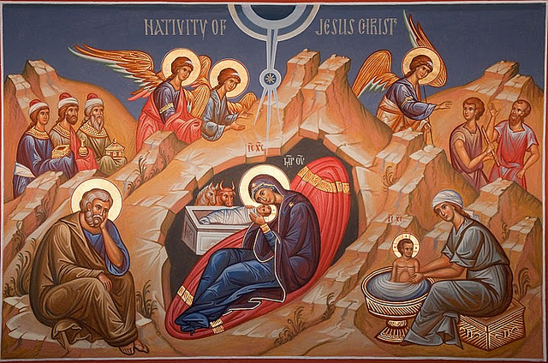
I became a Son
1st Sunday of Toubah

Slide 2
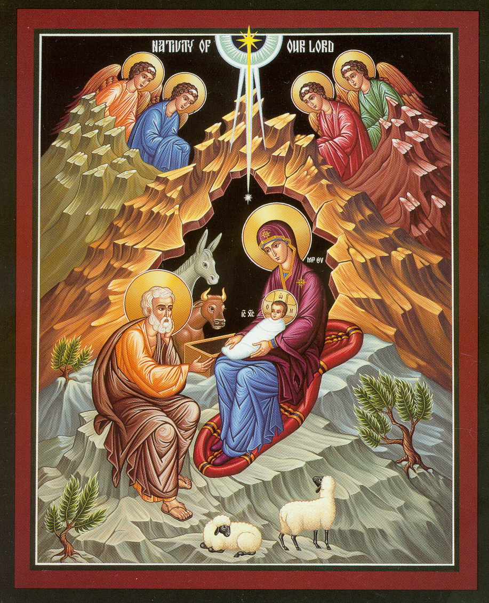
The Incarnation’s Icon
The ox knows its owner And the donkey its master’s crib; But Israel does not know, My people do not consider.” Isa 1:3

Slide 3
St Irenaeus
Being ignorant of Him who from the Virgin is Emmanuel, they are deprived of His gift, which is eternal life; and not receiving the incorruptible Word, they remain in mortal flesh, and are debtors to death, not obtaining the antidote of life. . . . For it was for this end that the Word of God was made man, and He who was the Son of God became the Son of man, that man, having been taken into the Word, and receiving the adoption, might become the son of God. For by no other means could we have attained to incorruptibility and immortality, unless we had been united to incorruptibility and immortality. But how could we be joined to incorruptibility and immortality, unless, first, incorruptibility and immortality had become that which we also are, so that the corruptible might be swallowed up by incorruptibility, and the mortal by immortality, that we might receive the adoption of sons?
Against Heresies III, 19, 1; ANF I, p. 448-449.

Slide 4
Ignorant = deprived
Being ignorant of Him who from the Virgin is Emmanuel, they are deprived of His gift, which is eternal life;.

Slide 5
Not obtaining the antidote of Life
and not receiving the incorruptible Word, they remain in mortal flesh, and are debtors to death, not obtaining the antidote of life. . .

Slide 6
An ignorant
Then Herod, when he saw that he was deceived by the wise men, was exceedingly angry; and he sent forth and put to death all the male children who were in Bethlehem and in all its districts, from two years old and under, according to the time which he had determined from the wise men. Matt 2:16

Slide 7
Become the son of God
For it was for this end that the Word of God was made man, and He who was the Son of God became the Son of man, that man, having been taken into the Word, and receiving the adoption, might become the son of God.

Slide 8
Unless we had been united
For by no other means could we have attained to incorruptibility and immortality, unless we had been united to incorruptibility and immortality.

Slide 9
United in Him
Now when they had departed, behold, an angel of the Lord appeared to Joseph in a dream, saying, “Arise, take the young Child and His mother, flee to Egypt, and stay there until I bring you word; for Herod will seek the young Child to destroy Him.” Matt 2:13

Slide 10
He had become what we also are
But how could we be joined to incorruptibility and immortality, unless, first, incorruptibility and immortality had become that which we also are, so that the corruptible might be swallowed up by incorruptibility, and the mortal by immortality, that we might receive the adoption of sons?

Slide 11
St Irenaeus
Being ignorant of Him who from the Virgin is Emmanuel, they are deprived of His gift, which is eternal life; and not receiving the incorruptible Word, they remain in mortal flesh, and are debtors to death, not obtaining the antidote of life. . . . For it was for this end that the Word of God was made man, and He who was the Son of God became the Son of man, that man, having been taken into the Word, and receiving the adoption, might become the son of God. For by no other means could we have attained to incorruptibility and immortality, unless we had been united to incorruptibility and immortality. But how could we be joined to incorruptibility and immortality, unless, first, incorruptibility and immortality had become that which we also are, so that the corruptible might be swallowed up by incorruptibility, and the mortal by immortality, that we might receive the adoption of sons? Against Heresies III, 19, 1; ANF I, p. 448-449.

