Slide 1
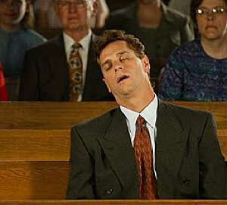
Are you bored in the Church?!!

Slide 2
According to the Barna Research Group, in the 1990s, 30% of the American population never (or almost never) went to church. As of January, 2015, that percentage had risen to 43%.

Slide 3
Survey in 2013 ( for people born between 1982 and 1992)
39% said they could find God elsewhere,
35% said that church wasn’t relevant to them,
31% simply said that church was boring,
20% said that it feels like God is missing from church.

Slide 4
Beware lest anyone cheat you through philosophy and empty deceit, according to the tradition of men, according to the basic principles of the world, and not according to Christ.Col 2:8

Slide 5
Oxford Dictionary
Bored: Feeling weary and impatient because one is unoccupied or lacks interest in one's current activity.

Slide 6
To be Bored : is a personal emotion

Slide 7
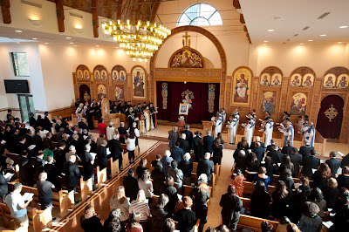
It is not a characteristic of the thing that you are bored of!

Slide 8
What is boring now may be interesting later or vice versa

Slide 9
Is there a Way Out?
Nepsis : watchfulness , where do you put your mind?
The term comes from the New Testament 1st epistle Peter (5:8, νήψατε, γρηγορήσατε. ὁ ἀντίδικος ὑμῶν διάβολος ὡς λέων ὠρυόμενος περιπατεῖ ζητῶν τινα καταπιεῖν — NIV: Be alert and of sober mind. Your enemy the devil prowls around like a roaring lion looking for someone to devour). There nepsis appears in a verb form, in the imperative mood, as an urgent command to vigilance and awakeness: "be alert and awake".

Slide 10
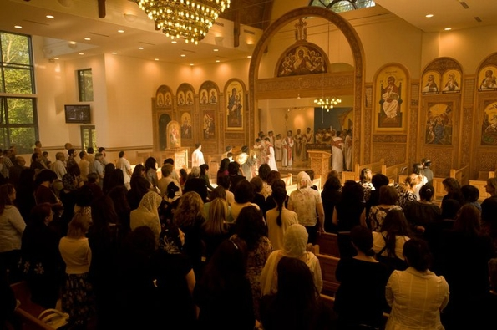
1.Worship is not about you
Look towards the East

Slide 11
An Awesome God
And one cried to another and said: “Holy, holy, holy is the Lord of hosts; The whole earth is full of His glory!” ⁴ And the posts of the door were shaken by the voice of him who cried out, and the house was filled with smoke. Isa 6:3,4

Slide 12
An Awesome presence
¹⁸ Now all the people witnessed the thunderings, the lightning flashes, the sound of the trumpet, and the mountain smoking; and when the people saw it, they trembled and stood afar off. ¹⁹ Then they said to Moses, “You speak with us, and we will hear; but let not God speak with us, lest we die.” Ex 20:18,19

Slide 13
2.You are out of place but in the right place
whom our fathers would not obey, but rejected. And in their hearts they turned back to Egypt. Acts 7:39
…and the Spirit lifted me up between earth and heaven, and brought me in visions of God to Jerusalem, to the door of the north gate of the inner court, …. Eze 8:3

Slide 14
3. Out of time but in time!
was in the Spirit on the Lord’s Day, and I heard behind me a loud voice, as of a trumpet, ¹¹ saying, “I am the Alpha and the Omega, the First and the Last,” and, “What you see, write in a book and send it to the seven churches which are in Asia: ….Write the things which you have seen, and the things which are, and the things which will take place after this..” Rev 1:10,11,19

Slide 15
4. It is about being and becoming not about activities
Graciously grant them to grow in the faith and forgiveness of sins, preparing them to be temple of your Holy Spirit though your only begotten Son Jesus Christ our Lord.
The Liturgy of Baptism

Slide 16
New becoming
Cleanse our inner person as the purity of Your Only Begotten Son, He Who we wish to partake of.
The Liturgy of St Cyril

Slide 17
5. It is about the Author of Life not life coaching
“For while bodily training is of some value, godliness is of value in every way, as it holds promise for the present life and also for the life to come.” 1 tim 4:8

Slide 18
Applications:
How are you going to attend the liturgy?
Will reciting a psalm be a vain repetition?
How are you going to start the fast today?
Will you see Reading the Word of God as a routine boring work?
Will you see your prostrations as an activity?
What kind of sermons are you looking for?

