Slide 1
Fasting & Discipline
Hungering for God – Part 3
December 23, 2012

Slide 2
Matthew 6:17-18
“But you, when you fast, anoint your head and wash your face, so that you do not appear to men to be fasting, but to your Father who is in the secret place; and your Father who sees in secret will reward you openly.”

Slide 3
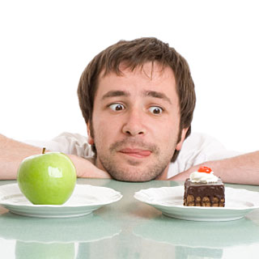
Fasting & Discipline

Slide 4
Romans 7:15
“For what I am doing, I do not understand. For what I will to do, that I do not practice; but what I hate, that I do.”

Slide 5
1 Corinthians 9:24-27
“Do you not know that those who run in a race all run, but one receives the prize? Run in such a way that you may obtain it. And everyone who competes for the prize is temperate in all things. Now they do it to obtain a perishable crown, but we for an imperishable crown. Therefore I run thus: not with uncertainty. Thus I fight: not as one who beats the air.

Slide 6
1 Corinthians 9:24-27
But I discipline my body and bring it into subjection, lest, when I have preached to others, I myself should become disqualified.”

Slide 7
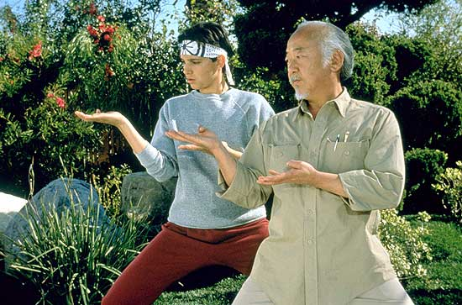
Progress always
requires discipline

Slide 8
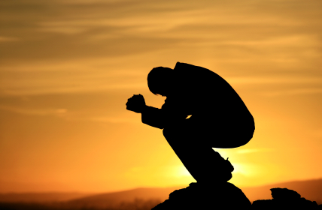
Fasting is a response to the realization of sin & weakness

Slide 9
Stationary Fasts

Slide 10
Stationary Fasts Wednesday & Friday
“But let not your fasts be with the hypocrites, for they fast on the second and fifth day of the week. Rather, fast on the fourth day and the Preparation (Friday).” Didache 8:1

Slide 11
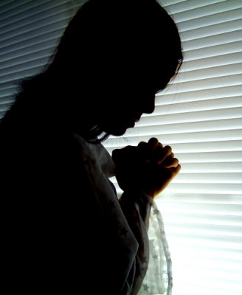
1. Make your fast an act of worship

Slide 12
Zechariah 7:5
“When you fasted and mourned in the fifth and seventh months during those seventy years, did you really fast for Me—for Me?”

Slide 13
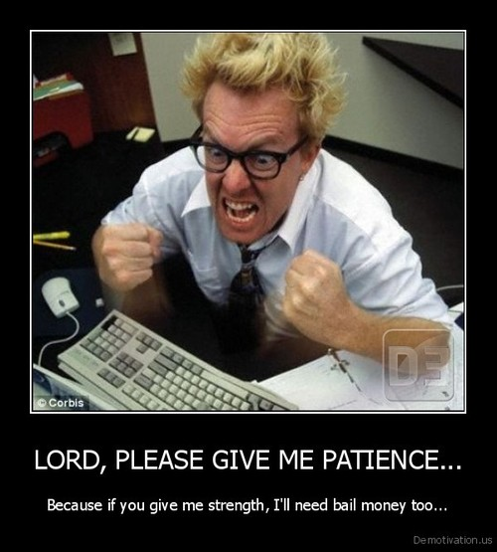
2. Focus on sin, not just food

Slide 14
Isaiah 58:1-5
“Cry aloud, spare not; lift up your voice like a trumpet; tell My people their transgression, and the house of Jacob their sins. Yet they seek Me daily, and delight to know My ways, as a nation that did righteousness, and did not forsake the ordinance of their God. They ask of Me the ordinances of justice; they take delight in approaching God.

Slide 15
Isaiah 58:1-5
‘Why have we fasted,’ they say, ‘and You have not seen? Why have we afflicted our souls, and You take no notice?’ “In fact, in the day of your fast you find pleasure, and exploit all your laborers. Indeed you fast for strife and debate, and to strike with the fist of wickedness. You will not fast as you do this day, to make your voice heard on high.

Slide 16
Isaiah 58:1-5
Is it a fast that I have chosen, a day for a man to afflict his soul? Is it to bow down his head like a bulrush, and to spread out sackcloth and ashes? Would you call this a fast, and an acceptable day to the Lord?”

Slide 17
Why are you fasting? What is your focus? Self or God? Rules or love?

Slide 18
“Fasting gives birth to prophets, she strengthens the powerful. Fasting makes lawmakers wise. She is a safeguard of a soul, a stabilizing companion to the body, a weapon for the brave, a discipline for champions. Fasting knocks over temptations, anoints for godliness. She is a companion for sobriety, the crafter of a sound mind.” ~ St. Basil the Great

