Slide 1
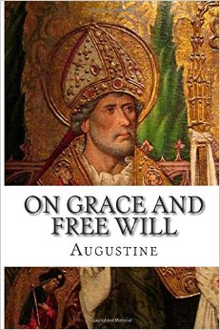
The Holy Tradition and Free Will (4)
Discipleship group
SMSV

Slide 2
The Confusion of John Calvin, Institutes, book 2, chapter 2, section 4
‘Moreover although the Greek Fathers, above others, and especially Chrysostom, have exceeded due bounds in extolling the powers of the human will, yet all ancient theologians, with the exception of Augustine, are so confused, vacillating, and contradictory on this subject, that no certainty can be obtained from their writings.’

Slide 3
Biblical Background

Slide 4
Grace
7 that in the ages to come He might show the exceeding riches of His grace in His kindness toward us in Christ Jesus. 8 For by grace you have been saved through faith, and that not of yourselves; it is the gift of God, 9 not of works, lest anyone should boast. Eph 2:7-9

Slide 5
Free Will
10 For we are His workmanship, created in Christ Jesus for good works, which God prepared beforehand that we should walk in them. Eph 2:10

Slide 6
Insulting the spirit of Grace
Of how much worse punishment, do you suppose, will he be thought worthy who has trampled the Son of God underfoot, counted the blood of the covenant by which he was sanctified a common thing, and insulted the Spirit of grace? Heb 10:29

Slide 7
Grace
3 as His divine power has given to us all things that pertain to life and godliness, through the knowledge of Him who called us by glory and virtue, 4 by which have been given to us exceedingly great and precious promises, that through these you may be partakers of the divine nature, having escaped the corruption that is in the world through lust. 2 Pet 1:3,4

Slide 8
Free Will
5 But also for this very reason, giving all diligence, add to your faith virtue, to virtue knowledge, 6 to knowledge self-control, to self-control perseverance, to perseverance godliness, 7 to godliness brotherly kindness, and to brotherly kindness love. 2 Pet 1:5-7

Slide 9
Not Labored in vain
12 Therefore, my beloved, as you have always obeyed, not as in my presence only, but now much more in my absence, work out your own salvation with fear and trembling; 13 for it is God who works in you both to will and to do for His good pleasure. 14 Do all things without complaining and disputing, 15 that you may become blameless and harmless, children of God without fault in the midst of a crooked and perverse generation, among whom you shine as lights in the world, 16 holding fast the word of life, so that I may rejoice in the day of Christ that I have not run in vain or labored in vain. Phil 2:12-16

Slide 10
Grace
5 not by works of righteousness which we have done, but according to His mercy He saved us, through the washing of regeneration and renewing of the Holy Spirit, 6 whom He poured out on us abundantly through Jesus Christ our Savior, 7 that having been justified by His grace we should become heirs according to the hope of eternal life. Ti 3:5-7

Slide 11
Free Will
8 This is a faithful saying, and these things I want you to affirm constantly, that those who have believed in God should be careful to maintain good works. These things are good and profitable to men. 9 But avoid foolish disputes, genealogies, contentions, and strivings about the law; for they are unprofitable and useless. 10 Reject a divisive man after the first and second admonition, 11 knowing that such a person is warped and sinning, being self-condemned. Ti 3:8-11

Slide 12
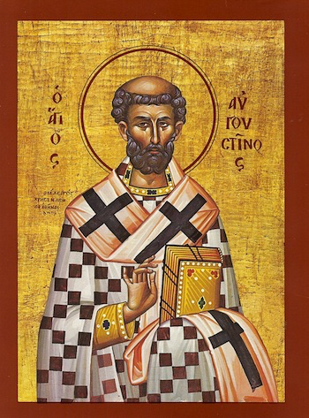
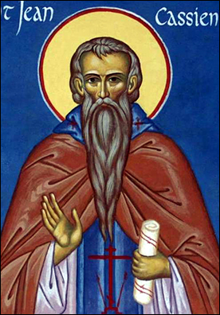
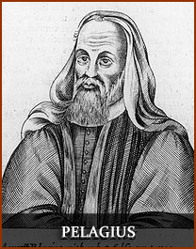
Brief History of 5th and 6th Centuries’ debates

Slide 13
Clement of Rome (died circa 99 AD)
‘For no other reason does God punish the sinner either in the present or future world, except because He knows that the sinner was able to conquer but neglected to gain the victory.’ (Clement of Rome, Recognitions 111. 23, V. 8, IX. 30.)

Slide 14
Ignatius of Antioch (30 – 107 AD, traditionally held to be a disciple of the Apostles John and Peter)
‘ ...and there is set before us life upon our observance [of God's precepts], but death as the result of disobedience, and every one, according to the choice he makes, shall go to his own place, let us flee from death, and make choice of life.’ (The Epistle of Ignatius to the Magnesians, ch.5, long version)

Slide 15
St. Irenaeus, Against Heresies, book 4, chapter 4, 3
This expression [of our Lord], ‘How often would I have gathered thy children together, and thou wouldest not,’ set forth the ancient law of human liberty, because God made man a free [agent] from the beginning, possessing his own power, even as he does his own soul, to obey the behests (ad utendum sententia) of God voluntarily, and not by compulsion of God. For there is no coercion with God, but a good will [towards us] is present with Him continually. And therefore does He give good counsel to all. And in man, as well as in angels, He has placed the power of choice (for angels are rational beings), so that those who had yielded obedience might justly possess what is good, given indeed by God, but preserved by themselves.

Slide 16
(Clement of Alexandria, 195 AD, 2.353)
To obey or not to obey is in our own power, provided we do not have the excuse of ignorance.

Slide 17
^{Melito of Sardis}
There is, therefore, nothing to hinder you from changing your evil manner of life, because you are a free man. (Melito, 170 AD, 8.754)

Slide 18
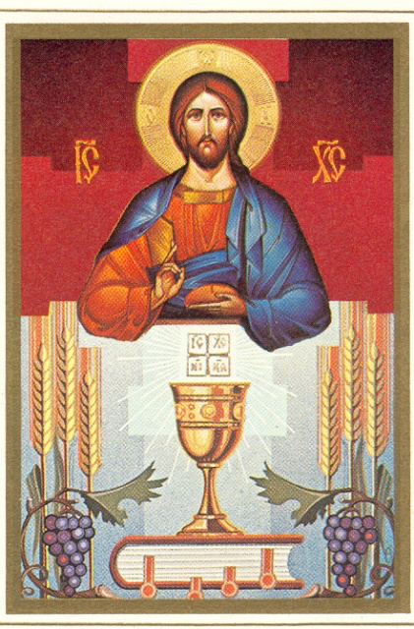
Eucharistic Application

Slide 19
In Himself for us
saying, “Father, if it is Your will, take this cup away from Me; nevertheless not My will, but Yours, be done.” Lk 22:42

Slide 20
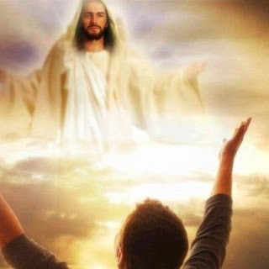
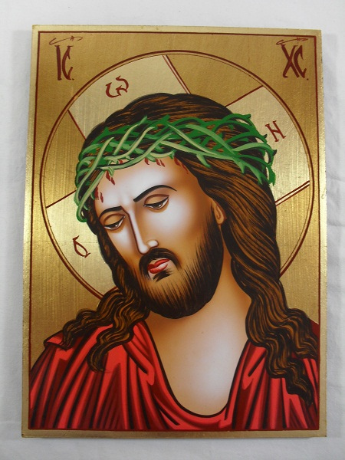
St Augustine
"I (Christ) am the food of full-grown men. Grow and you shall feed on me. But you shall not change me into your own substance, as you do with the food of your body, instead you shall be changed into me“.
Confessions, VII 10 (PL 32, 742) ed & trs. R.S. Pine-Coffin, Penguin 1971, p. 147.

