Slide 1
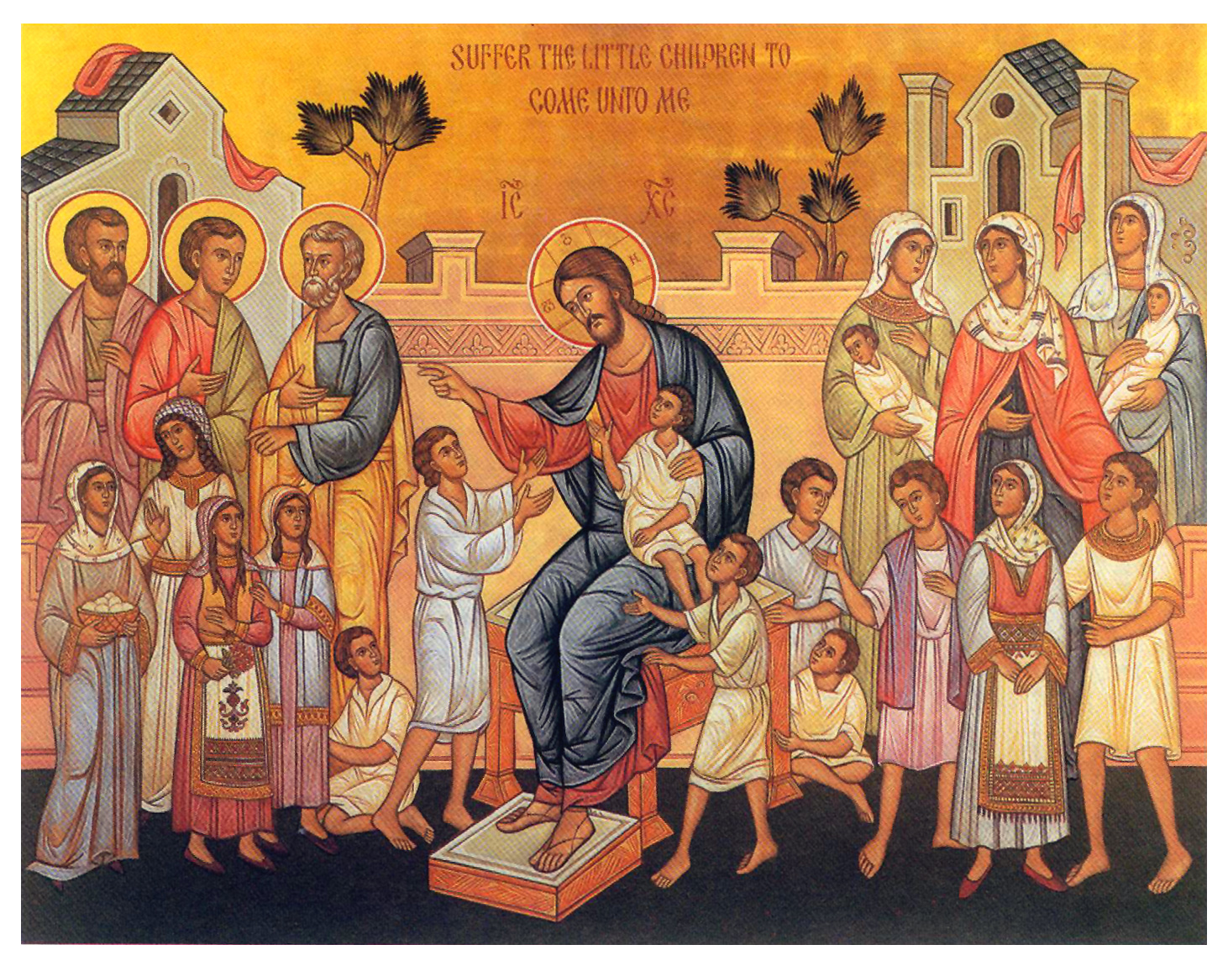
Holy Generation
2nd Sunday of Toubah

Slide 2
St Athanasius
"[Jesus] accepted a decaying body so that decaying bodies might put on immortality."

Slide 3
Evil Generation
And while the crowds were thickly gathered together, He began to say, “This is an evil generation. It seeks a sign, and no sign will be given to it except the sign of Jonah the prophet. Lk 11:29

Slide 4
Are we seeking His Wisdom?
The queen of the South will rise up in the judgment with the men of this generation and condemn them, for she came from the ends of the earth to hear the wisdom of Solomon; and indeed a greater than Solomon is here. Lk 11:31

Slide 5
He is the Author of Wisdom
For the Lord gives wisdom; from his mouth come knowledge and understanding. Prov. 2:6

Slide 6
Wisdom from Heaven
But the wisdom that comes from heaven is first of all pure; then peace-loving, considerate, submissive, full of mercy and good fruit, impartial and sincere. Jas 3:17

Slide 7
Are we seeking Repentance?
The men of Nineveh will rise up in the judgment with this generation and condemn it, for they repented at the preaching of Jonah; and indeed a greater than Jonah is here. Lk 11:32

Slide 8
He commands Repentance
Truly, these times of ignorance God overlooked, but now commands all men everywhere to repent, because He has appointed a day on which He will judge the world in righteousness by the Man whom He has ordained. He has given assurance of this to all by raising Him from the dead.” Acts 17:30,31

Slide 9
Are we seeking a Risen Life?
For as Jonah became a sign to the Ninevites, so also the Son of Man will be to this generation. Lk 11:30
For as Jonah was three days and three nights in the belly of the great fish, so will the Son of Man be three days and three nights in the heart of the earth. Matt 12:40

Slide 10
Spirit of Resurrection
But if the Spirit of Him who raised Jesus from the dead dwells in you, He who raised Christ from the dead will also give life to your mortal bodies through His Spirit who dwells in you. Rom 8:11

Slide 11
St Cyril of Alexandria commentary on the gospel of John (Lib. 10: PG 74, 434)
It can easily be shown from examples both in the Old Testament and the New that the Spirit changes those in whom he comes to dwell; he so transforms them that they begin to live a completely new kind of life.

Slide 12
Applications
Am I seeking His Wisdom?
Am I seeking real life of Repentance?
Am I living a Risen Life?

Slide 13
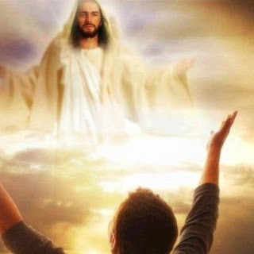
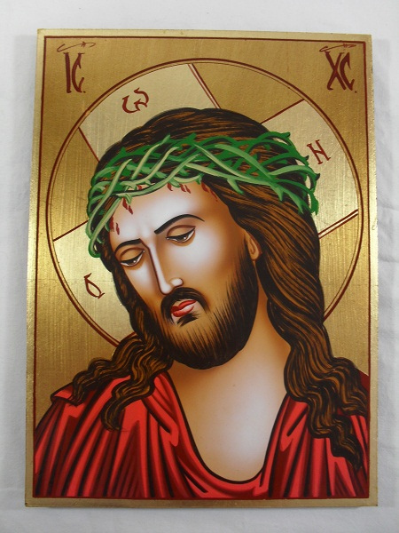
St Augustine
"I (Christ) am the food of full-grown men. Grow and you shall feed on me. But you shall not change me into your own substance, as you do with the food of your body, instead you shall be changed into me“.
Confessions, VII 10 (PL 32, 742) ed & trs. R.S. Pine-Coffin, Penguin 1971, p. 147.

