Slide 1
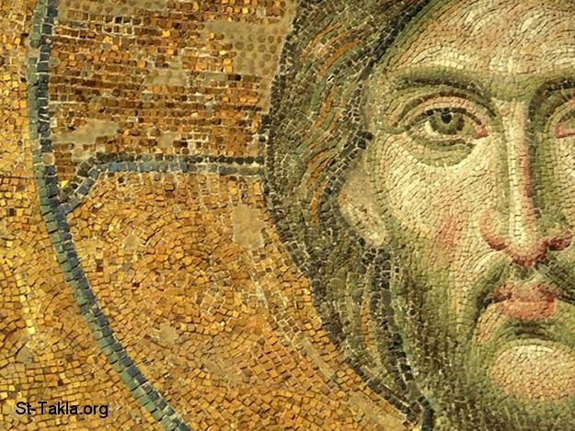
His commandments are not burdensome
4th Sunday of Baonah

Slide 2
His commandments are not burdensome
For this is the love of God, that we keep His commandments. And His commandments are not burdensome. I Jn 5:3

Slide 3
Change of Covenant
31 “Behold, the days are coming, says the Lord, when I will make a new covenant with the house of Israel and with the house of Judah— 32 not according to the covenant that I made with their fathers in the day that I took them by the hand to lead them out of the land of Egypt, My covenant which they broke, though I was a husband to them,[a] says the Lord. Jer 31:31,32

Slide 4
Prophecy
33 But this is the covenant that I will make with the house of Israel after those days, says the Lord: I will put My law in their minds, and write it on their hearts; and I will be their God, and they shall be My people. Jer 31:22

Slide 5
Fullfilment
15 But the Holy Spirit also witnesses to us; for after He had said before,
16 “This is the covenant that I will make with them after those days, says the Lord: I will put My laws into their hearts, and in their minds I will write them. Heb 10:15,16

Slide 6
St Paul’s Confirmation
For as many as are led by the Spirit of God, these are sons of God. Rom 8:14

Slide 7
Less than the sinner of the world
32 “But if you love those who love you, what credit is that to you? For even sinners love those who love them. 33 And if you do good to those who do good to you, what credit is that to you? For even sinners do the same. Luke 6:32,33

Slide 8
Sons of the Most High
But love your enemies, do good, and lend, hoping for nothing in return; and your reward will be great, and you will be sons of the Most High. Luke 6:35

Slide 9
Depression in UK
According to Department of Health figures, around 20 per cent of women and 14 per cent of men in England suffer from depression at any one time but the Mental Health Foundation had estimated the true figure to be higher with symptoms affecting one in four UK adults.
Tracy McVeigh, education correspondent
The Observer, Sunday 7 January 2001

Slide 10
El Eylon = Most High = Sovereign
Now I, Nebuchadnezzar, praise and extol and honor the King of heaven, all of whose works are truth, and His ways justice. And those who walk in pride He is able to put down. Dan 4:37

Slide 11
(St. Athanasius the Apostolic)
The Lord has granted us great gifts: He did not just untie our bonds to sin, but also gave
us authority to trample on the serpents and scorpions and all the power of the enemy.

