Slide 1
His Life is Mine

Slide 2
Inasmuch then as the children have partaken of flesh and blood, He Himself likewise shared in the same, that through death He might destroy him who had the power of death, that is, the devil, ¹⁵ and release those who through fear of death were all their lifetime subject to bondage. ¹⁶ For indeed He does not give aid to angels, but He does give aid to the seed of Abraham. ¹⁷ Therefore, in all things He had to be made like His brethren, that He might be a merciful and faithful High Priest in things pertaining to God, to make propitiation for the sins of the people. ¹⁸ For in that He Himself has suffered, being tempted, He is able to aid those who are tempted.” Hebrews 2:14-18

Slide 3
For what I am doing, I do not understand. For what I will to do, that I do not practice; but what I hate, that I do.” Romans 7:15

Slide 4
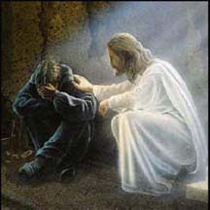
His ability to take the human hurts and turn them to our good and His glory

Slide 5
Hebrews 4:14-16
“Seeing then that we have a great High Priest who has passed through the heavens, Jesus the Son of God, let us hold fast our confession. ¹⁵ For we do not have a High Priest who cannot sympathize with our weaknesses, but was in all points tempted as we are, yet without sin. ¹⁶ Let us therefore come boldly to the throne of grace, that we may obtain mercy and find grace to help in time of need.”

Slide 6
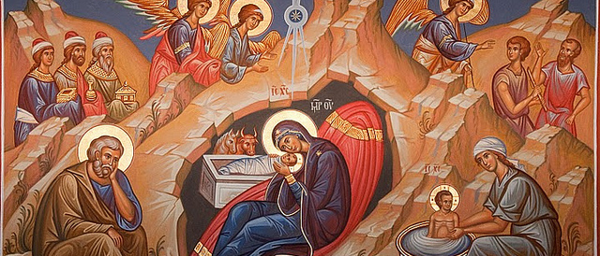
Christ identified with us humans when He became the Son of Man. He knows not only our infirmities but also our feelings.

Slide 7
Likewise the Spirit also helps in our weaknesses. For we do not know what we should pray for as we ought, but the Spirit Himself makes intercession for us^{[a]} with groanings which cannot be uttered. (Rom. 8: 26)

Slide 8
The Father’s unconditional and accepting love, the Son’s complete identification as our High Priest and Wounded Healer with our sins and our infirmities, and the Spirit’s daily loving, lifting help.
God works in and through the things, causing circumstances to work out for our good.

Slide 9
Healing is the miracle of God’s recycling grace, where He takes it all and makes good come out of it. Where He actually recycles our hang-ups into wholeness and usefulness

Slide 10
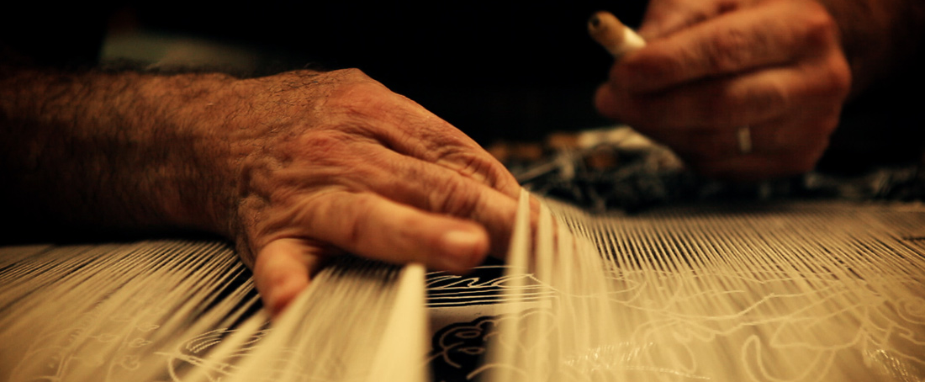
He is the Master Weaver who can take every damage, every hurt, every crippling infirmity and weave them all into His design

Slide 11
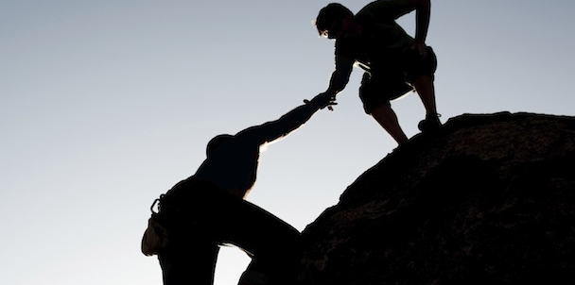
That you would now look with the eyes of Christ, to sympathize with the others weaknesses

Slide 12
Hebrews 5:7-9 who, in the days of His flesh, when He had offered up prayers and supplications, with vehement cries and tears to Him who was able to save Him from death, and was heard because of His godly fear, ⁸ though He was a Son, yet He learned obedience by the things which He suffered. ⁹ And having been perfected, He became the author of eternal salvation to all who obey Him.

Slide 13
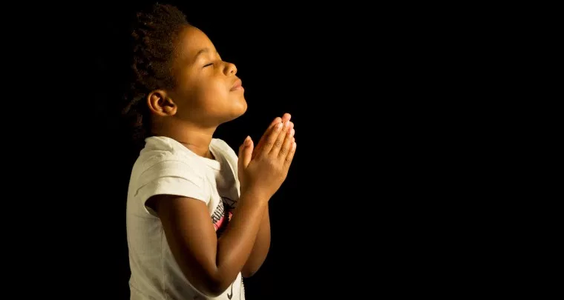
Make intercession for those you who can sympathize with

