Slide 1
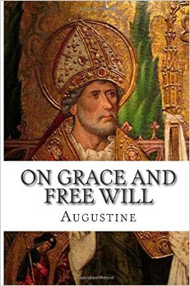
Grace and Free Will (1)
28.11.2015

Slide 2
Biblical Background

Slide 3
Grace
7 that in the ages to come He might show the exceeding riches of His grace in His kindness toward us in Christ Jesus. 8 For by grace you have been saved through faith, and that not of yourselves; it is the gift of God, 9 not of works, lest anyone should boast. Eph 2:7-9

Slide 4
Free Will
10 For we are His workmanship, created in Christ Jesus for good works, which God prepared beforehand that we should walk in them. Eph 2:10

Slide 5
Insulting the spirit of Grace
Of how much worse punishment, do you suppose, will he be thought worthy who has trampled the Son of God underfoot, counted the blood of the covenant by which he was sanctified a common thing, and insulted the Spirit of grace? Heb 10:29

Slide 6
Grace
3 as His divine power has given to us all things that pertain to life and godliness, through the knowledge of Him who called us by glory and virtue, 4 by which have been given to us exceedingly great and precious promises, that through these you may be partakers of the divine nature, having escaped the corruption that is in the world through lust. 2 Pet 1:3,4

Slide 7
Free Will
5 But also for this very reason, giving all diligence, add to your faith virtue, to virtue knowledge, 6 to knowledge self-control, to self-control perseverance, to perseverance godliness, 7 to godliness brotherly kindness, and to brotherly kindness love. 2 Pet 1:5-7

Slide 8
Not Labored in vain
12 Therefore, my beloved, as you have always obeyed, not as in my presence only, but now much more in my absence, work out your own salvation with fear and trembling; 13 for it is God who works in you both to will and to do for His good pleasure. 14 Do all things without complaining and disputing, 15 that you may become blameless and harmless, children of God without fault in the midst of a crooked and perverse generation, among whom you shine as lights in the world, 16 holding fast the word of life, so that I may rejoice in the day of Christ that I have not run in vain or labored in vain. Phil 2:12-16

Slide 9
Grace
5 not by works of righteousness which we have done, but according to His mercy He saved us, through the washing of regeneration and renewing of the Holy Spirit, 6 whom He poured out on us abundantly through Jesus Christ our Savior, 7 that having been justified by His grace we should become heirs according to the hope of eternal life. Ti 3:5-7

Slide 10
Free Will
8 This is a faithful saying, and these things I want you to affirm constantly, that those who have believed in God should be careful to maintain good works. These things are good and profitable to men. 9 But avoid foolish disputes, genealogies, contentions, and strivings about the law; for they are unprofitable and useless. 10 Reject a divisive man after the first and second admonition, 11 knowing that such a person is warped and sinning, being self-condemned. Ti 3:8-11

Slide 11
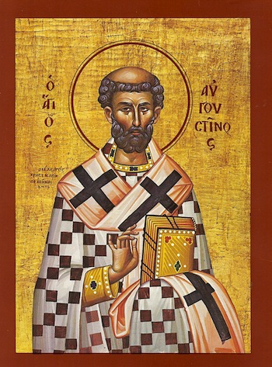
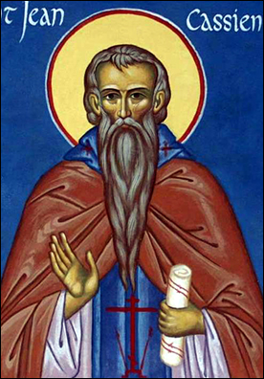
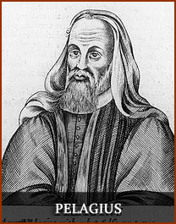
Brief History of 5th and 6th Centuries’ debates

Slide 12
1. Synergism
from the Greek syn- (together) + ergia (work) (I Cor. 3:9).
All the Orthodox Church Fathers supported this belief
“The Lord God created man without his participation,
but He cannot save him without his
agreement and desire, since God gave him a free will”.
“Give what you command, and command what You will.” St. Augustine
Main Teachings
Synergists believe that in spiritual things humans are not wholly dead to being good, even if perhaps almost so; that human beings have a limited but nonetheless natural -- not Spirit-given -- capacity to work with God to make themselves holy. The Grace of God always takes the initiative.
The Grace of God comes to all, enabling a person to choose and to perform what is necessary for salvation and to overcome his innate sinfulness

Slide 13
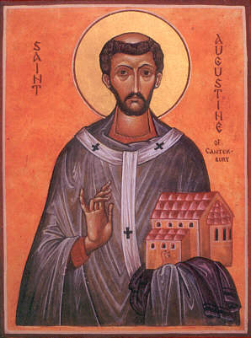
2. Augustinianism
Led by St. Augustine and
rejected by Church Fathers
354- 430
Main Teachings
Man is dead in sin. (total Depravity)
Salvations is totally by the grace of god which is given only to the elect (predestined).
Not condemned officially in any council,
but the teaching was condemned in many Church Father’s writings

Slide 14
3. Pelagianism
led by Pelagiuss and supported by Coelestius and rejected by St. Augustine and all the Church Fathers
(360-418)
Main Teachings:
Man is essentially good and capable of doing what is necessary for salvation.
Adam’s sin affected him only, not the whole human race.
Condemnation of Coelestius ( 411)
Council of Carthage (418)
Council of Ephesus ( 431)

Slide 15
4. Semi Pelagianism
Led by St. John Cassian (c. 360 -345) and St. Vencent of Lerins and rejected by St. Zosimus and all the Church Fathers
Main Teachings
The Grace of God and the Will of Man work together in salvation,
in which Man must take the initiative.
Condemned in council of Orange (529)

Slide 16
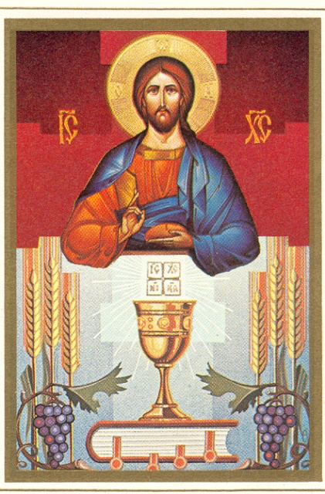
Eucharistic Application

Slide 17
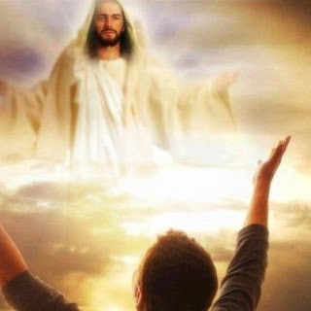
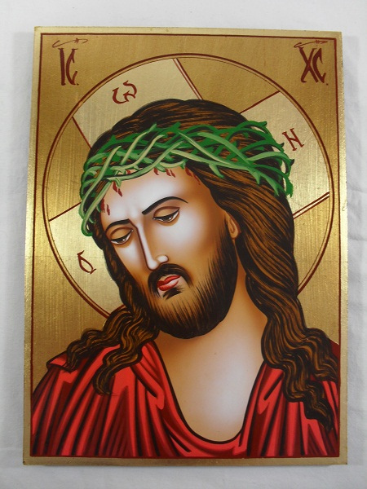
St Augustine
"I (Christ) am the food of full-grown men. Grow and you shall feed on me. But you shall not change me into your own substance, as you do with the food of your body, instead you shall be changed into me“.
Confessions, VII 10 (PL 32, 742) ed & trs. R.S. Pine-Coffin, Penguin 1971, p. 147.

