Slide 1
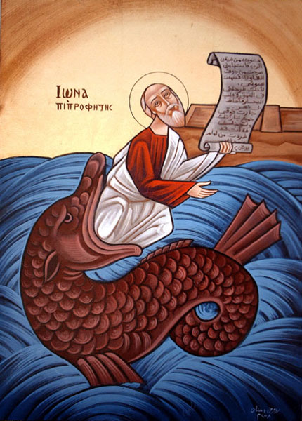
Getting Jonah off your boat

Slide 2
I. Don’t let him board in the first place
But Jonah arose to flee to Tarshish from the presence of the Lord. He went down to Joppa, and found a ship going to Tarshish; so he paid the fare, and went down into it, to go with them to Tarshish from the presence of the Lord. Jon1:3

Slide 3
II. Realize why the storms are in your life
Then the men were exceedingly afraid, and said to him, “Why have you done this?” For the men knew that he fled from the presence of the Lord, because he had told them v 10

Slide 4
III. Don’t get rid of the wrong things
5 Then the mariners were afraid; and every man cried out to his god, and threw the cargo that was in the ship into the sea, to lighten the load.[a] But Jonah had gone down into the lowest parts of the ship, had lain down, and was fast asleep. Jon 1:5

Slide 5
IV. Don’t work to keep Jonah in your life
13 Nevertheless the men rowed hard to return to land, but they could not, for the sea continued to grow more tempestuous against them.

Slide 6
V. When you get rid of your Jonah, your life will immediately get back on course
15 So they picked up Jonah and threw him into the sea, and the sea ceased from its raging. 16 Then the men feared the Lord exceedingly, and offered a sacrifice to the Lord and took vows. Jon 1:15,16

Slide 7
Pauline Epistle
But now I have written to you not to keep company with anyone named a brother, who is sexually immoral, or covetous, or an idolater, or a reviler, or a drunkard, or an extortioner—not even to eat with such a person. 1 Cor 5:12

Slide 8
Chapter Fourteen (Didachi)
And when coming together on the Lord's own day, break bread and give thanks after confessing your transgressions. In that manner, your sacrifice will be pure. And do not let anyone coming with a quarrel against a brother join you until they get reconciled, in order that your sacrifice is not impure. For this has been spoken of by the Lord, "in every place and time offer me a pure sacrifice, for I am a great King," says the Lord, "and My name is wonderful among the nations."

Slide 9
Catholic Epistle
14 Therefore, beloved, looking forward to these things, be diligent to be found by Him in peace, without spot and blameless; 15 and consider that the longsuffering of our Lord is salvation. 2 Pet 3:14,15

Slide 10
Acts
6 So he, trembling and astonished, said, “Lord, what do You want me to do?”
Then the Lord said to him, “Arise and go into the city, and you will be told what you must do.” Acts 9:6

Slide 11
The Psalm
4 For the Lord is great and greatly to be praised; He is to be feared above all gods.
5 For all the gods of the peoples are idols. But the Lord made the heavens.
6 Honor and majesty are before Him; Strength and beauty are in His sanctuary. Ps 96:4-6

Slide 12
The gospel
27 Do not labor for the food which perishes, but for the food which endures to everlasting life, which the Son of Man will give you, because God the Father has set His seal on Him.” Jn 6:27

Slide 13
St Hilary St. Hilary's treatise on the Trinity by (Lib 8, 13-16; PL 10, 246-249) with the scriptural reading taken from Revelation 14:14 - 15:4.
This is why we are all one, because the Father is in Christ, and Christ is in us. He is in us through his flesh and we are in him. With him we form a unity which is in God.

