Slide 1
The Heart is Deceitful Above All
First Sunday of Mesra
August 8, 2010
Luke 20:9-19

Slide 2
Parable of Wicked Vinedressers

Slide 3
Parable of Wicked Vinedressers
“But when the vinedressers saw him, they reasoned among themselves, saying, `This is the heir. Come, let us kill him, that the inheritance may be ours.'” Luke 20:14
Huh?

Slide 4
Sin Affects Perception of Reality

Slide 5
Sin Affects Perception of Reality
“Therefore what will the owner of the vineyard do to them? He will come and destroy those vinedressers and give the vineyard to others. And when they heard it they said, ‘Certainly not!’ …And the chief priests and the scribes that very hour sought to lay hands on Him” Luke 20:16-19

Slide 6
Sin Affects Perception of Reality
“The heart is deceitful above all things, and desperately wicked; who can know it?” Jeremiah 17:9

Slide 7
Solution: RECOGNIZE JESUS
“Jesus said to him, “I am the way, the truth, and the life.” John 14:6
“And you shall know the truth, and the truth shall make you free.” John 8:32

Slide 8
Solution: RECOGNIZE JESUS
“And when they came out of the boat, immediately the people recognized Him, ran through that whole surrounding region, and began to carry about on beds those who were sick to wherever they heard He was.” Mark 6:54-55

Slide 9
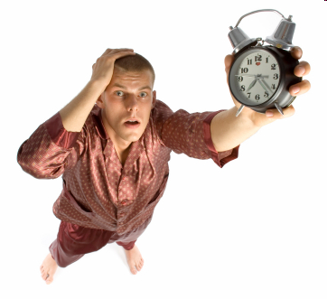

Slide 10
“’The stone which the builders rejected Has become the chief cornerstone'? Whoever falls on that stone will be broken; but on whomever it falls, it will grind him to powder.” Luke 20:17-18

Slide 11
It is impossible to break God’s Law. We can only break ourselves against it.

