Slide 1
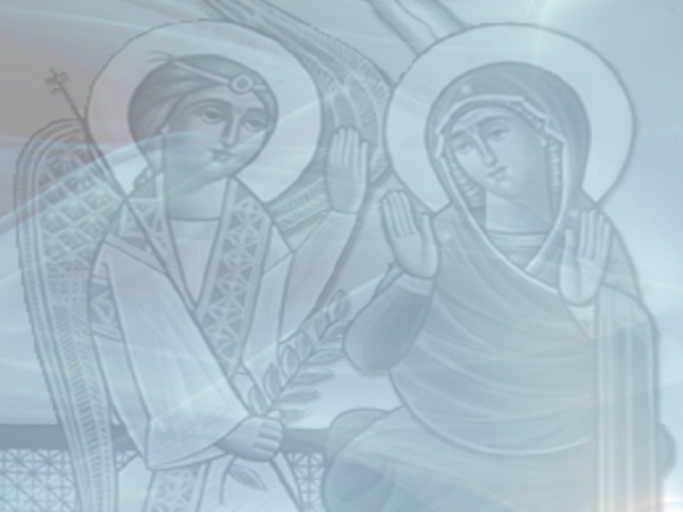
Jesus is Coming
Second Sunday of Kiahk
December 19, 2010
Luke 1:26-38

Slide 2
Sunday of Good News

Slide 3
Sunday of Good News
God Incarnate in my life
“Behold, I make all things new.”
Revelation 21:5

Slide 4
His Name is…
JESUS = Savior, God saves

Slide 5
His Name is…
JESUS = Savior, God saves
“He has sent Me to heal the brokenhearted, to proclaim liberty to the captives, and recovery of sight to the blind, to set at liberty those who are oppressed; to proclaim the acceptable year of the LORD.” Luke 4:18-19

Slide 6
His Name is…
JESUS = Savior, God saves
“I have surely seen the oppression of my people who are in Egypt; I have heard their groaning and have come down to deliver them.” Acts 7:34

Slide 7
Our job is to…BELIEVE!

Slide 8
Our job is to…BELIEVE!
“For with God nothing will be impossible.” Luke 1:37

Slide 9
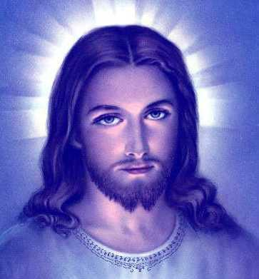
It’s your turn to believe

