Slide 1
What happens when you add 5 plus 2?
Second Sunday of Amshir
February 20, 2011
John 6:5-14

Slide 2
John 6:5
“Then Jesus lifted up His eyes, and seeing a great multitude coming toward Him, He said to Philip, Where shall we buy bread, that these may eat?”

Slide 3
John 6:7
Philip answered Him, “Two hundred denarii worth of bread is not sufficient for them, that every one of them may have a little.”

Slide 4
John 6:8-9
One of His disciples, Andrew, Simon Peter's brother, said to Him, “There is a lad here who has five barley loaves and two small fish, but what are they among so many?”

Slide 5
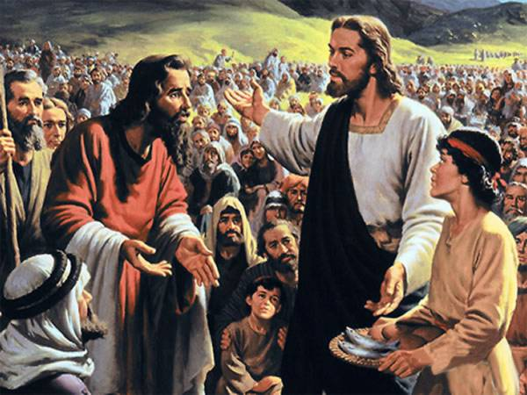
When you offer your limited resources to an unlimited God, miracles are going to happen.

Slide 6
A Lesson in Mathematics

Slide 7
A Lesson in Mathematics
1 + 1 = 2

Slide 8
A Lesson in Mathematics
1 + 1 = 2
0 + infinity = infinity

Slide 9
A Lesson in Mathematics
1 + 1 = 2
0 + infinity = infinity
5 + 2 = 5,000

Slide 10
Psalm 96:7-9
Give to the LORD, O families of the peoples,
Give to the LORD glory and strength.
Give to the LORD the glory due His name;
Bring an offering, and come into His courts.
Oh, worship the LORD in the beauty of holiness!
Tremble before Him, all the earth.

Slide 11
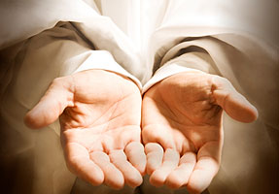
What will you offer?

