Slide 1
Weak or Strong?
Sixth Sunday of Lent
April 10, 2011
John 9:1-41

Slide 2
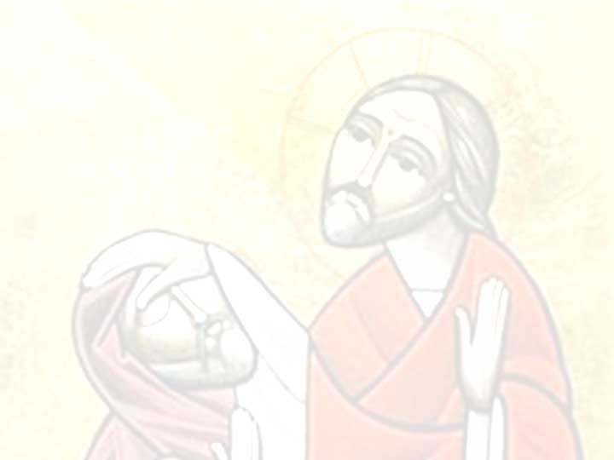
John 9:2
“Rabbi, who sinned, this man or his parents, that he was born blind?”

Slide 3
John 9:3
“Neither this man nor his parents sinned, but that the works of God should be revealed in him.”

Slide 4
Genesis 2:7
“And the LORD God formed man of the dust of the ground, and breathed into his nostrils the breath of life; and man became a living being.”

Slide 5
The Test of Weakness

Slide 6
The Test of Weakness
Attitude of Obedience vs Criticism

Slide 7
The Test of Weakness
Attitude of Obedience vs Criticism
“For if anyone thinks himself to be something, when he is nothing, he deceives himself.” Galatians 6:3

Slide 8
The Test of Weakness
Attitude of Obedience vs Criticism
Attitude of Caring vs Judging

Slide 9
The Test of Weakness
Attitude of Obedience vs Criticism
Attitude of Caring vs Judging
“For we do not have a High Priest who cannot sympathize with our weaknesses, but was in all points tempted as we are, yet without sin. Let us therefore come boldly to the throne of grace, that we may obtain mercy and find grace to help in time of need.” Hebrews 4:15-16

Slide 10
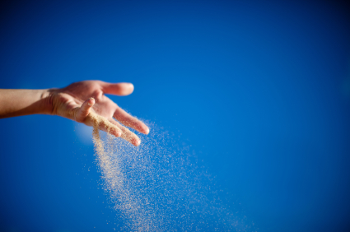
“Naked I came from my mother’s womb, and naked shall I return there. The LORD gave, and the LORD has taken away; blessed be the name of the LORD.” Job 1:21

