Slide 1
Simply Amazing!
Third Sunday of Babah
October 31, 2010
Matthew 12:22-28

Slide 2
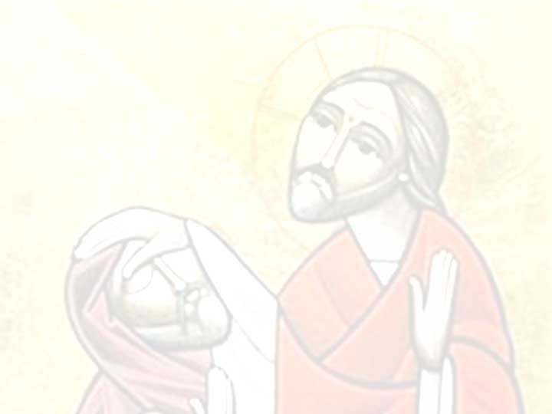
Matthew 12:23-24
“And all the multitudes were amazed and said, “Could this be the Son of David?”
“Now when the Pharisees heard it they said, “This fellow does not cast out demons except by Beelzebub, the ruler of the demons.”

Slide 3
Simply Amazing
“Immediately he arose, took up the bed, and went out in the presence of them all, so that all were amazed and glorified God, saying, “We never saw anything like this!” Mark 2:12
“Then He went up into the boat to them, and the wind ceased. And they were greatly amazed in themselves beyond measure, and marveled.” Mark 6:51
“Immediately, when they saw Him, all the people were greatly amazed, and running to Him, greeted Him.” Mark 9:15

Slide 4
Simply Amazing
“And they were astonished at His teaching, for He taught them as one having authority, and not as the scribes.” Mark 1:22
“And they were astonished beyond measure, saying, “He has done all things well. He makes both the deaf to hear and the mute to speak.” Mark 7:37

Slide 5
Simply Amazing
“And they were astonished at His teaching, for He taught them as one having authority, and not as the scribes.” Mark 1:22
“And they were astonished beyond measure, saying, “He has done all things well. He makes both the deaf to hear and the mute to speak.” Mark 7:37
Does Jesus still amaze you?

Slide 6
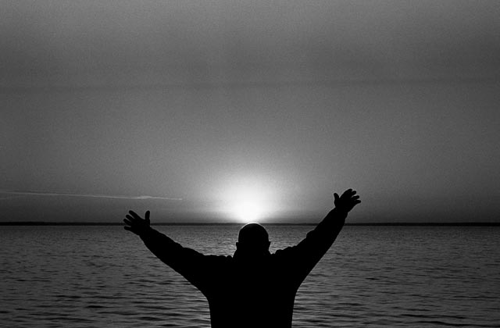
Simply Amazing

Slide 7
Simply Amazing
“But Jesus answered them, “My Father has been working until now, and I have been working.” John 5:17

Slide 8
Simply Amazing
“Then all the multitude kept silent and listened to Barnabas and Paul declaring how many miracles and wonders God had worked through them among the Gentiles.” Acts 15:12

Slide 9
Can You See His Hand?

