Slide 1
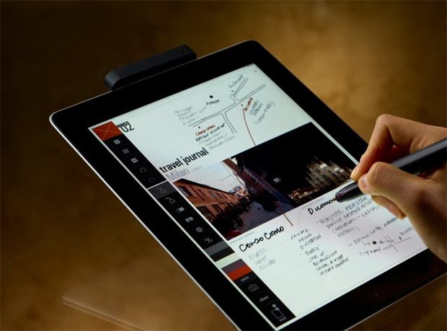
Get today’s handout on your iPad
Find wireless network: STSA Church
Password: stsa1342
Go to TheWellAtSTSA.com

Slide 2




The Process of Purity
August 12, 2012
Part 3

Slide 3



GOD’S STANDARD
“But among you there must not be even a hint of sexual immorality, or of any kind of impurity, or of greed, because these are improper for God’s holy people.” Ephesians 5:3

Slide 4
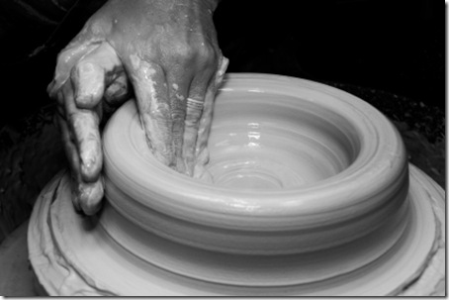
The Process of Purity

Slide 5
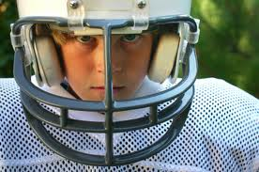
We need a “WHATEVER IT TAKES” attitude towards lust

Slide 6
Hebrews 12:4
“You have not yet resisted to bloodshed, striving against sin.”

Slide 7
Matthew 5:29-30
“If your right eye causes you to sin, pluck it out and cast it from you; for it is more profitable for you that one of your members perish, than for your whole body to be cast into hell. And if your right hand causes you to sin, cut it off and cast it from you; for it is more profitable for you that one of your members perish, than for your whole body to be cast into hell.”

Slide 8
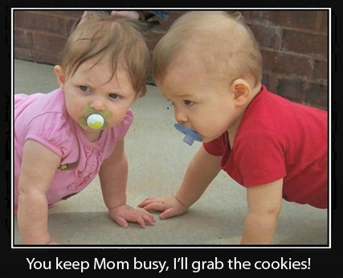
Our attack plan

Slide 9

1. Recognize your uniqueness

Slide 10
1 Corinthians 10:12
“Therefore let him who thinks he stands take heed lest he fall.”

Slide 11
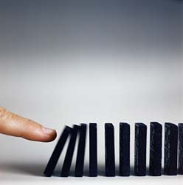
2. Identify your lust triggers

Slide 12
Romans 13:14
“But put on the Lord Jesus Christ, and make no provision for the flesh, to fulfill its lusts.”

Slide 13

3. Write down your plan

Slide 14
Philippians 2:12-13
“…work out your own salvation with fear and trembling; for it is God who works in you both to will and to do for His good pleasure.”

Slide 15
What is the goal of the plan?

Slide 16
What is the goal of the plan?
The goal is not to stop lust,
but rather to grow in purity.

Slide 17


Slide 18
Mark 12:41-44
Now Jesus sat opposite the treasury and saw how the people put money into the treasury. And many who were rich put in much. Then one poor widow came and threw in two mites, which make a quadrans.

Slide 19
Mark 12:41-44
So He called His disciples to Himself and said to them, “Assuredly, I say to you that this poor widow has put in more than all those who have given to the treasury; for they all put in out of their abundance, but she out of her poverty put in all that she had, her whole livelihood.”

Slide 20
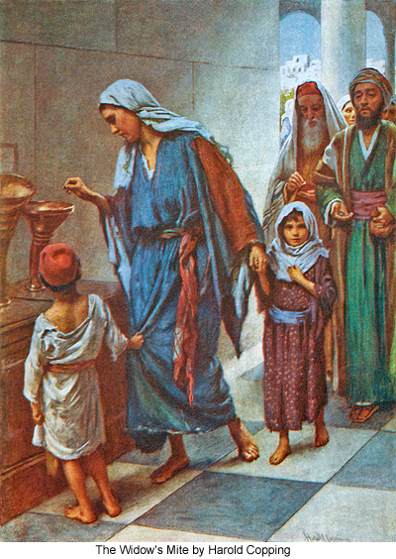
God looks at effort, not results

