Slide 1
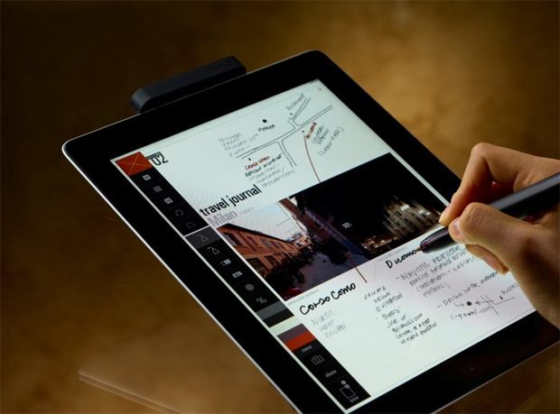

Get today’s handout on your iPad
Find wireless network: STSA Church
Password: stsa1342
Go to TheWellAtSTSA.com

Slide 2




ARMED WITH GRACE
August 5, 2012
Part 2

Slide 3



GOD’S STANDARD
“But among you there must not be even a hint of sexual immorality, or of any kind of impurity, or of greed, because these are improper for God’s holy people.” Ephesians 5:3

Slide 4
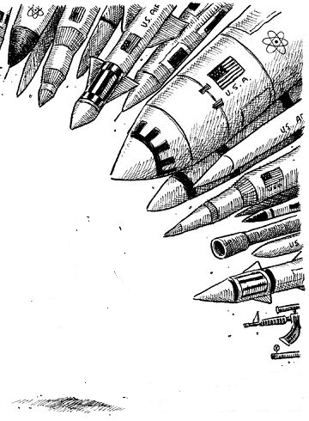
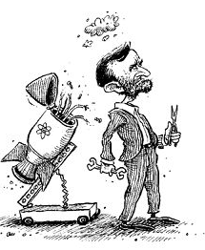
The Weapons of this War

Slide 5
Lust is any desire that you can’t control

Slide 6
Lust is any desire that you can’t control
Not sin: any desire
Sin: that you can’t control

Slide 7
Genesis 1:27-28
“So God created man in His own image; in the image of God He created him; male and female He created them. Then God blessed them, and God said to them, “Be fruitful and multiply; fill the earth and subdue it.”

Slide 8
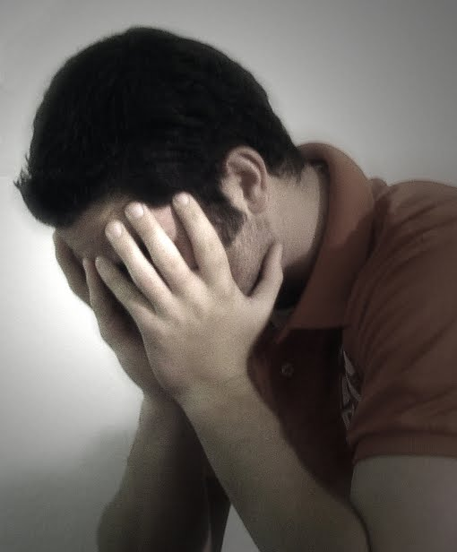
Tip: Talk to God when the desire comes

Slide 9
Hebrews 2:14-18
“Inasmuch then as the children have partaken of flesh and blood, He Himself likewise shared in the same, that through death He might destroy him who had the power of death, that is, the devil, and release those who through fear of death were all their lifetime subject to bondage…

Slide 10
Hebrews 2:14-18
Therefore, in all things He had to be made like His brethren, that He might be a merciful and faithful High Priest in things pertaining to God, to make propitiation for the sins of the people. For in that He Himself has suffered, being tempted, He is able to aid those who are tempted.”

Slide 11
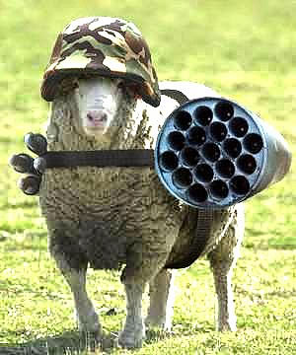
Our Secret Weapon…

Slide 12
Acts 7:23
“Now when he was forty years old, it came into his heart to visit his brethren, the children of Israel.”

Slide 13
Acts 7:24
“And seeing one of them suffer wrong, he defended and avenged him who was oppressed, and struck down the Egyptian.”

Slide 14
Acts 7:29
“Then, at this saying, Moses fled and became a dweller in the land of Midian, where he had two sons.”

Slide 15
Acts 7:32-35
“I am the God of your fathers—the God of Abraham, the God of Isaac, and the God of Jacob.’ … I have surely seen the oppression of My people who are in Egypt; I have heard their groaning and have come down to deliver them. And now come, I will send you to Egypt.”

Slide 16
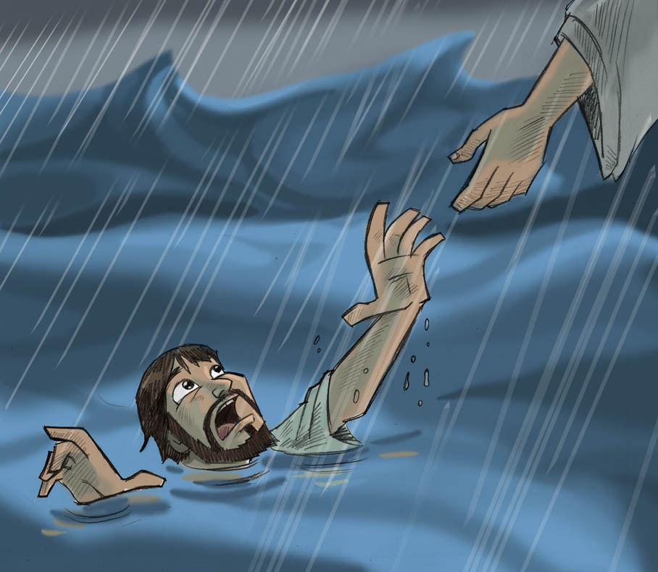

Slide 17
1 Peter 1:13-16
“Therefore gird up the loins of your mind, be sober, and rest your hope fully upon the grace that is to be brought to you at the revelation of Jesus Christ; as obedient children, not conforming yourselves to the former lusts, as in your ignorance; but as He who called you is holy, you also be holy in all your conduct, because it is written, "Be holy, for I am holy."”

Slide 18
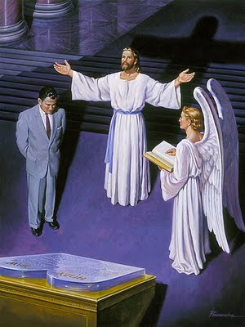
KEY POINT:
Our standing is not the same as our sanctification

Slide 19
Romans 3:23-24
“for all have sinned and fall short of the glory of God, being justified freely by His grace through the redemption that is in Christ Jesus”

Slide 20
Romans 3:28
“Therefore we conclude that a man is justified by faith apart from the deeds of the law.”

Slide 21
Cyril of Alexandria
“For truly the compassion from the Father is Christ, as he takes away the sins, dismisses the charges and justifies by faith, and recovers the lost and makes [them] stronger than death. For what is good and He does not give? … For by him and in him we have known the Father, and we have become rich in the justification by faith.”

Slide 22
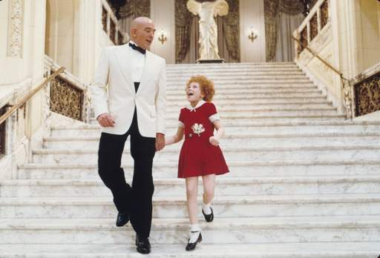
We don’t grow in holiness to be accepted, but rather because we are already accepted.

Slide 23
Romans 6:14
“For sin shall not have dominion over you, for you are not under law but under grace.”

Slide 24
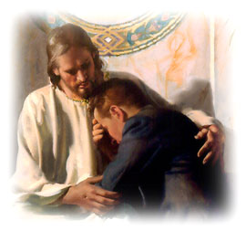
Victory begins in your mind

Slide 25
Romans 5:6-11
For when we were still without strength, in due time Christ died for the ungodly. For scarcely for a righteous man will one die; yet perhaps for a good man someone would even dare to die. But God demonstrates His own love toward us, in that while we were still sinners, Christ died for us.

Slide 26
Romans 5:6-11
Much more then, having now been justified by His blood, we shall be saved from wrath through Him. For if when we were enemies we were reconciled to God through the death of His Son, much more, having been reconciled, we shall be saved by His life.

Slide 27
Romans 5:6-11
And not only that, but we also rejoice in God through our Lord Jesus Christ, through whom we have now received the reconciliation.”

Slide 28
EAST TO WEST
I start the day, the war begins,
Endless reminding of my sin
Time and time again Your truth is
Drowned out by the storm I'm in
Today I feel like I'm just one mistake away,
From You leaving me this way

Slide 29
“We do not have a High Priest who cannot sympathize with our weaknesses, but was in all points tempted as we are, yet without sin. Let us therefore come boldly to the throne of grace, that we may obtain mercy and find grace to help in time of need.”
Hebrews 4:15-16

