Slide 1
Love like a Mother
Fifth Sunday of Holy 50
John 14:1-11
May 9, 2010

Slide 2
John 14:1-4
“Let not your heart be troubled; you believe in God, believe also in Me. In My Father’s house are many mansions; if it were not so, I would have told you. I go to prepare a place for you. And if I go and prepare a place for you, I will come again and receive you to Myself; that where I am, there you may be also. And where I go you know, and the way you know.”

Slide 3
John 14:5-6
Thomas said to Him, “Lord, we do not know where You are going, and how can we know the way?” Jesus said to him, “I AM THE WAY, the truth, and the life. No one comes to the Father except through Me.

Slide 4
Don’t lose the forest for the trees

Slide 5
Result of Focusing on My Way

Slide 6
Result of Focusing on My Way
No point in trying

Slide 7
Result of Focusing on My Way
No point in trying
Must try harder and harder

Slide 8
The Right Way to Approach God
“Therefore, brethren, having boldness to enter the Holiest by the blood of Jesus” Hebrews 10:19
“…let us draw near with a true heart in full assurance of faith” Hebrews 10:22
“Therefore do not cast away your confidence, which has great reward.” Hebrews 10:35

Slide 9
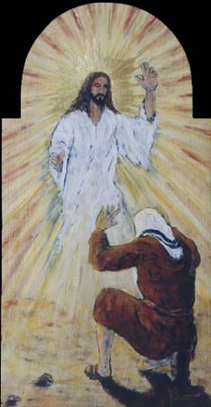
“Then Saul, still breathing threats and murder against the disciples of the Lord, went to the high priest…” Acts 9:1

Slide 10
“Oh, give thanks to the LORD, for He is good! For His mercy endures forever.” Psalm 136:1

