Slide 1
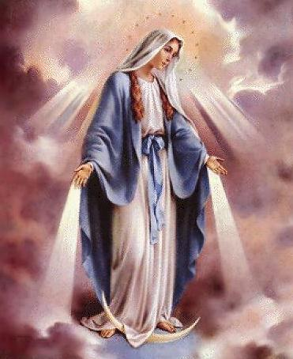
The Truth about Virgin Mary
Back to Basics – Part 3
August 22, 2010

Slide 2
“We evangelical Christians do not give Mary her proper due” Billy Graham

Slide 3
“We evangelical Christians do not give Mary her proper due” Billy Graham
What is her proper due?

Slide 4
What the Bible Has to Say

Slide 5
What the Bible Has to Say
She is the GREATEST WOMAN who ever lived
“And having come in, the angel said to her, “Rejoice, highly favored one, the Lord is with you; blessed are you among women!” Luke 1:28
“Then she spoke out with a loud voice and said, “Blessed are you among women, and blessed is the fruit of your womb!” Luke 1:42

Slide 6
What the Bible Has to Say
She is the GREATEST WOMAN who ever lived
“My soul magnifies the Lord, And my spirit has rejoiced in God my Savior.” Luke 1:47

Slide 7
What the Bible Has to Say
She is the GREATEST WOMAN who ever lived
“To them God willed to make known what are the riches of the glory of this mystery among the Gentiles: which is Christ in you, the hope of glory.” Colossians 1:27

Slide 8
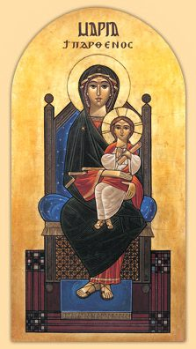

Slide 9
What the Bible Has to Say
She is the GREATEST WOMAN who ever lived
“the first of the redeemed”
“Then Mary said, “Behold the maidservant of the Lord! Let it be to me according to your word.” Luke 1:38

Slide 10
What the Bible Has to Say
She is the MOTHER OF GOD
Theo-tokos = “bearer of God”

Slide 11
What the Bible Has to Say
She is the MOTHER OF GOD
Theo-tokos = “bearer of God”
“But why is this granted to me, that the mother of my Lord should come to me? For indeed, as soon as the voice of your greeting sounded in my ears, the babe leaped in my womb for joy. Blessed is she who believed, for there will be a fulfillment of those things which were told her from the Lord.” Luke 1:43-45

Slide 12
What the Bible Has to Say
She is the MOTHER OF GOD
Theo-tokos = “bearer of God”
“For with God nothing will be impossible” Luke 1:37

Slide 13
What the Bible Has to Say
She is the MOTHER OF GOD
Theo-tokos = “bearer of God”
“Behold, the virgin shall conceive and bear a Son, and shall call His name Immanuel.” Isaiah 7:14
“was incarnate of the Holy Spirit and of the Virgin Mary”

Slide 14
What the Bible Has to Say
We are to HONOR her and call her BLESSED.

Slide 15
What the Bible Has to Say
We are to HONOR her and call her BLESSED.
venerate = “to regard or treat with reverence”

Slide 16
What the Bible Has to Say
We are to HONOR her and call her BLESSED.
Why venerate her?

Slide 17
What the Bible Has to Say
We are to HONOR her and call her BLESSED.
Why venerate her?
BECAUSE THE BIBLE COMMANDS IT
“For behold, henceforth all generations will call me blessed.” Luke 1:48

Slide 18
Some Clarifications

Slide 19
Some Clarifications
a) We don’t worship, we VENERATE
“If anyone serves Me, him My Father will honor.” John 12:26

Slide 20
Some Clarifications
a) We don’t worship, we VENERATE
“If anyone serves Me, him My Father will honor.” John 12:26
b) We don’t pray to her, we ask for her INTERCESSION.

Slide 21
Some Clarifications
“Therefore I exhort first of all that supplications, prayers, intercessions, and giving of thanks be made for all men,” 1 Timothy 2:1
“Confess your trespasses to one another, and pray for one another, that you may be healed. The effective, fervent prayer of a righteous man avails much.” James 5:16

Slide 22
Doctrines about Virgin Mary

Slide 23
Doctrines about Virgin Mary
She is the EVER-VIRGIN

Slide 24
Doctrines about Virgin Mary
She is the EVER-VIRGIN
“Behold, the virgin shall conceive and bear a Son, and shall call His name Immanuel.” Isaiah 7:14

Slide 25
Doctrines about Virgin Mary
She is the EVER-VIRGIN
“Then He brought me back to the outer gate of the sanctuary which faces toward the east, but it was shut. And the LORD said to me, “This gate shall be shut; it shall not be opened, and no man shall enter by it, because the LORD God of Israel has entered by it; therefore it shall be shut.” Ezekiel 44:1-2

Slide 26
Doctrines about Virgin Mary
She is the EVER-VIRGIN
“Christ . . . was the only Son of Mary, and the Virgin Mary bore no children besides Him.”

Slide 27
Doctrines about Virgin Mary
She is the EVER-VIRGIN
“Christ . . . was the only Son of Mary, and the Virgin Mary bore no children besides Him.”
Martin Luther

Slide 28
Doctrines about Virgin Mary
She is the EVER-VIRGIN
Didn’t Jesus have brothers?
“And a multitude was sitting around Him; and they said to Him, “Look, Your mother and Your brothers are outside seeking You.” Mark 3:32

Slide 29
Doctrines about Virgin Mary
She is the EVER-VIRGIN
Didn’t Jesus have brothers?
NO, BROTHERS = COUSINS OR RELATIVES
“So he brought back all the goods, and also brought back his brother Lot and his goods, as well as the women and the people.” Genesis 14:16

Slide 30
Doctrines about Virgin Mary
She is the EVER-VIRGIN
Didn’t Jesus have brothers?
NO, BROTHERS = COUSINS OR RELATIVES
“I am inclined to agree with those who declare that 'brothers' really mean 'cousins' here, for Holy Writ and the Jews always call cousins brothers…” Martin Luther

Slide 31
Doctrines about Virgin Mary
She is the EVER-VIRGIN
But didn’t Mary & Joseph have sexual relations?
“Joseph…did not know her till she had brought forth her firstborn Son.” Matthew 1:25

Slide 32
Doctrines about Virgin Mary
She is the EVER-VIRGIN
But didn’t Mary & Joseph have sexual relations?
“Joseph…did not know her till she had brought forth her firstborn Son.” Matthew 1:25
“and lo, I am with you always, even to the end of the age” Matthew 28:20

Slide 33
Doctrines about Virgin Mary
She is the EVER-VIRGIN
But didn’t Mary & Joseph have sexual relations?
“Joseph…did not know her till she had brought forth her firstborn Son.” Matthew 1:25
“And He buried him in a valley in the land of Moab, opposite Beth Peor; but no one knows his grave to this day.” Deuteronomy 34:6

Slide 34
“When Matthew 1:25 says that Joseph did not know Mary carnally until she had brought forth her son, it does not follow that he knew her subsequently; on the contrary, it means that he never did know her . . . This babble . . . is without justification. . . he [one who accepts this false teaching] has neither noticed nor paid any attention to either Scripture or the common idiom.” Martin Luther

Slide 35
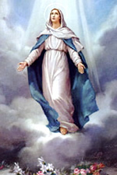
Doctrines about Virgin Mary
Her body was ASSUMED into heaven.

Slide 36
Doctrines about Virgin Mary
Her body was ASSUMED into heaven.
“So all the days of Enoch were three hundred and sixty-five years. And Enoch walked with God; and he was not, for God took him.” Genesis 5:23-24

Slide 37
Doctrines about Virgin Mary
Her body was ASSUMED into heaven.
“Then it happened, as they continued on and talked, that suddenly a chariot of fire appeared with horses of fire, and separated the two of them; and Elijah went up by a whirlwind into heaven.” 2 Kings 2:11

Slide 38
But how could anyone believe that Virgin Mary was conceived immaculately?

Slide 39
But how could anyone believe that Virgin Mary was conceived immaculately?
Don’t ask me!
“My soul magnifies the Lord, And my spirit has rejoiced in God my Savior.” Luke 1:47

Slide 40
Her Role in My Salvation

Slide 41
Her Role in My Salvation
“And on some have compassion, making a distinction; but others save with fear, pulling them out of the fire” Jude 22, 23
“let him know that he who turns a sinner from the error of his way will save a soul from death and cover a multitude of sins.” Jas 5:20

Slide 42
Her Role in My Salvation
“And on some have compassion, making a distinction; but others save with fear, pulling them out of the fire” Jude 22, 23
“let him know that he who turns a sinner from the error of his way will save a soul from death and cover a multitude of sins.” Jas 5:20
She is our HELPER and our GUIDE.

Slide 43
Her Role in My Salvation
“You are the Mother of the Light who is honored, from the rising of the sun to its setting, and is offered glorification, O Mother of God, the second heaven. For you are the lighted blossom and unchangeable mother, in humility the Ever-Virgin. The Father chose you, the Holy Spirit overshadowed you, and the Son has come down and was incarnate from you.” First Hour Prayer

