Slide 1
Fellow Workers with God – Part 2
Ministry and Virtue

Slide 2
For we are God’s fellow workers; you are God’s field, you are God’s building. (1 Cor. 3:9)

Slide 3
What’s the goal?
till we all come to the unity of the faith and of the knowledge of the Son of God, to a perfect man, to the measure of the stature of the fullness of Christ; (Ephesians 4:13)

Slide 4
What is the purpose of ministry?
11 And He Himself gave some to be apostles, some prophets, some evangelists, and some pastors and teachers, 12 for the equipping of the saints for the work of ministry, for the edifying of the body of Christ, 13 till we all come to the unity of the faith and of the knowledge of the Son of God, to a perfect man, to the measure of the stature of the fullness of Christ; (Ephesians 4:11-13)

Slide 5
The Good Samaritan

Slide 6
“God can save the sinner you are, but not the saint you pretend to be.” (Met. Anthony Bloom)

Slide 8
What is the purpose of ministry?
Edify the body
Grow in virtue

Slide 9
Now in those days, when the number of the disciples was multiplying, there arose a complaint against the Hebrews by the Hellenists, because their widows were neglected in the daily distribution. 2 Then the twelve summoned the multitude of the disciples and said, “It is not desirable that we should leave the word of God and serve tables. 3 Therefore, brethren, seek out from among you seven men of good reputation, full of the Holy Spirit and wisdom, whom we may appoint over this business; 4 but we will give ourselves continually to prayer and to the ministry of the word.” (Acts 6:1-4)

Slide 10
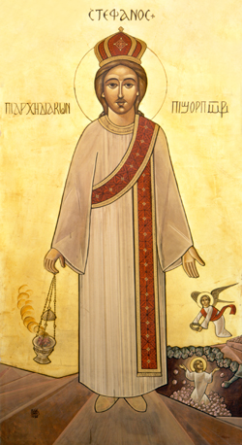
Then the word of God spread, and the number of the disciples multiplied greatly in Jerusalem, and a great many of the priests were obedient to the faith. (Acts 6:7)

Slide 11
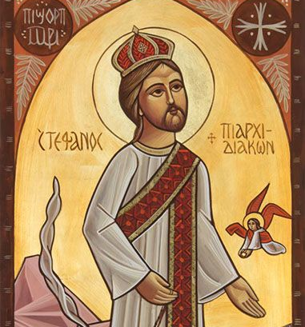
And Stephen, full of faith and power, did great wonders and signs among the people. (Acts 6:8)
“And all who sat in the council, looking steadfastly at him, saw his face as the face of an angel.” (Acts 6:15)

Slide 12
20 But now indeed there are many members, yet one body. 21 And the eye cannot say to the hand, “I have no need of you”; nor again the head to the feet, “I have no need of you.” 22 No, much rather, those members of the body which seem to be weaker are necessary. 23 And those members of the body which we think to be less honorable, on these we bestow greater honor; and our unpresentable parts have greater modesty, 24 but our presentable parts have no need. But God composed the body, having given greater honor to that part which lacks it, 25 that there should be no schism in the body, but that the members should have the same care for one another. 26 And if one member suffers, all the members suffer with it; or if one member is honored, all the members rejoice with it. (1 Cor. 12:20-26)

Slide 13
And I, brethren, could not speak to you as to spiritual people but as to carnal, as to babes in Christ. 2 I fed you with milk and not with solid food; for until now you were not able to receive it, and even now you are still not able; 3 for you are still carnal. For where there are envy, strife, and divisions among you, are you not carnal and behaving like mere men? 4 For when one says, “I am of Paul,” and another, “I am of Apollos,” are you not carnal? 5 Who then is Paul, and who is Apollos, but ministers through whom you believed, as the Lord gave to each one? 6 I planted, Apollos watered, but God gave the increase. 7 So then neither he who plants is anything, nor he who waters, but God who gives the increase. 8 Now he who plants and he who waters are one, and each one will receive his own reward according to his own labor. 9 For we are God’s fellow workers; you are God’s field, you are God’s building. (1 Cor. 3:1-9)

Slide 14
Danger Signs in Ministry
ME-centered

Slide 15
Danger Signs in Ministry
ME-centered
Independent

Slide 16
Danger Signs in Ministry
ME-centered
Independent
Critical of ministry and others

Slide 17
5 Let this mind be in you which was also in Christ Jesus, 6 who, being in the form of God, did not consider it robbery to be equal with God, 7 but made Himself of no reputation, taking the form of a bondservant, and coming in the likeness of men. 8 And being found in appearance as a man, He humbled Himself and became obedient to the point of death, even the death of the cross. (Phil. 2:5-8)

Slide 18
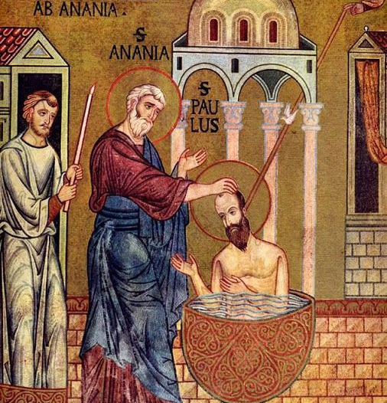
I have been crucified with Christ; it is no longer I who live, but Christ lives in me; (Gal. 2:20)

Slide 19
I have been crucified with Christ; it is no longer I who live, but Christ lives in me; (Gal. 2:20)
15 But the Lord said to him, “Go, for he is a chosen vessel of Mine to bear My name before Gentiles, kings, and the children of Israel. 16 For I will show him how many things he must suffer for My name’s sake.” (Acts 9:15,16)

Slide 20
Before
After

Slide 21
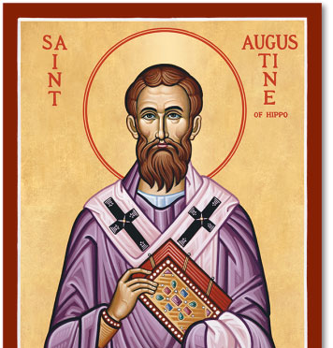
“My soul is like a house, small for you to enter, but I pray you to enlarge it. It is in ruins, but I ask you to remake it. It contains much that you will not be pleased to see: this I know and do not hide. But who is to rid it of these things? There is no one but you.” (St. Augustine of Hippo, Confessions)

Slide 22
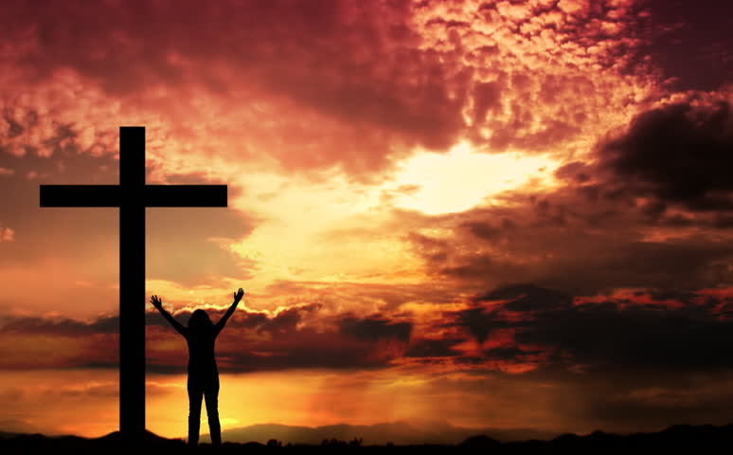
strengthening the souls of the disciples, exhorting them to continue in the faith, and saying, “We must through many tribulations enter the kingdom of God.” (Acts 14:22)

Slide 24
What is the purpose of ministry?
Edify the body
Grow in virtue

Slide 25
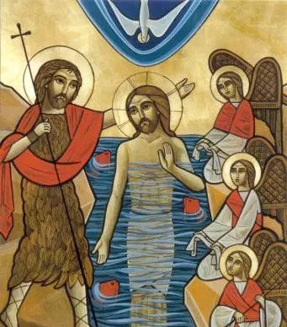
“He must increase, but I must decrease.” (John 3:30)

