Slide 1
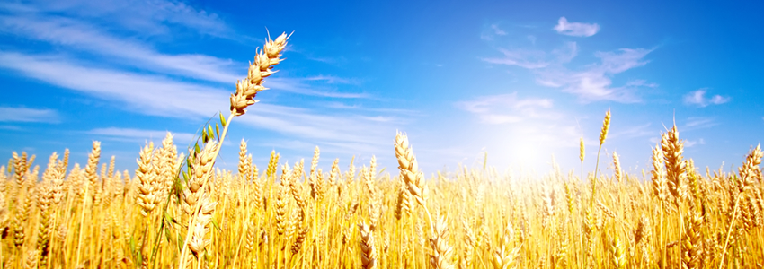
Fellow Workers with God – Part 1
The Purpose of Ministry

Slide 2
For we are God’s fellow workers; you are God’s field, you are God’s building. (1 Cor. 3:9)

Slide 3
What’s the goal?
till we all come to the unity of the faith and of the knowledge of the Son of God, to a perfect man, to the measure of the stature of the fullness of Christ; (Ephesians 4:13)

Slide 4
11 And He Himself gave some to be apostles, some prophets, some evangelists, and some pastors and teachers, 12 for the equipping of the saints for the work of ministry, for the edifying of the body of Christ, 13 till we all come to the unity of the faith and of the knowledge of the Son of God, to a perfect man, to the measure of the stature of the fullness of Christ;

Slide 5
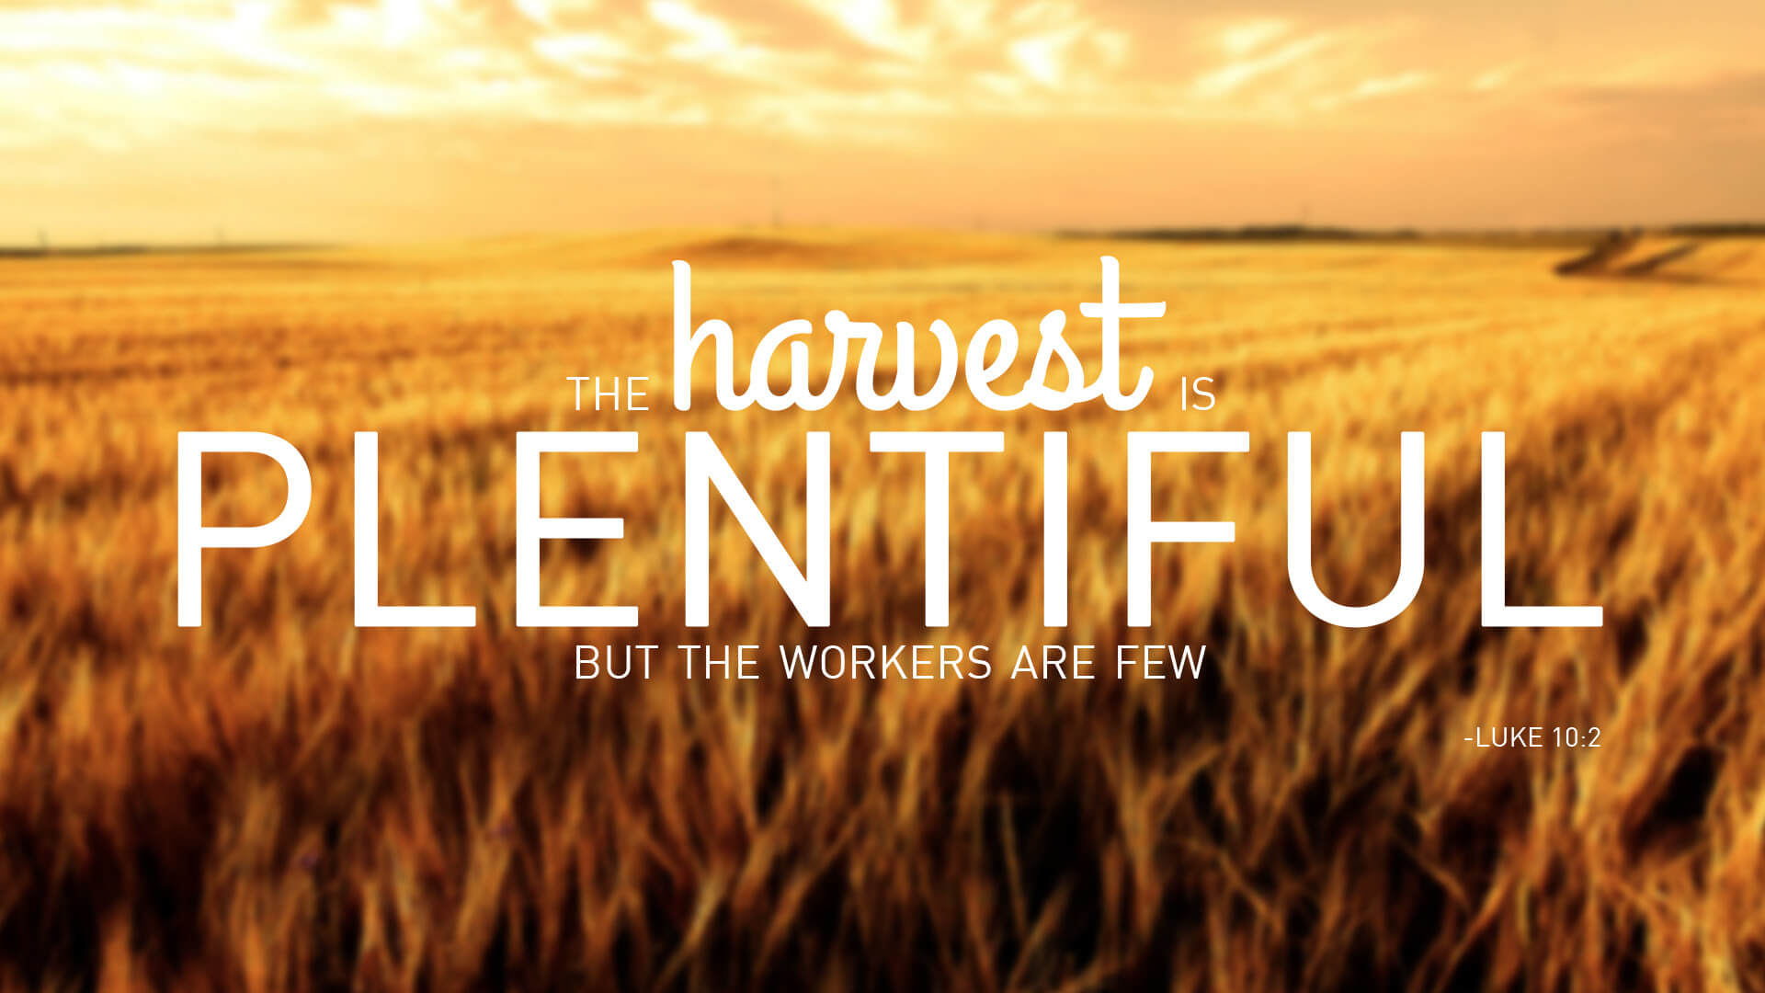

Slide 6
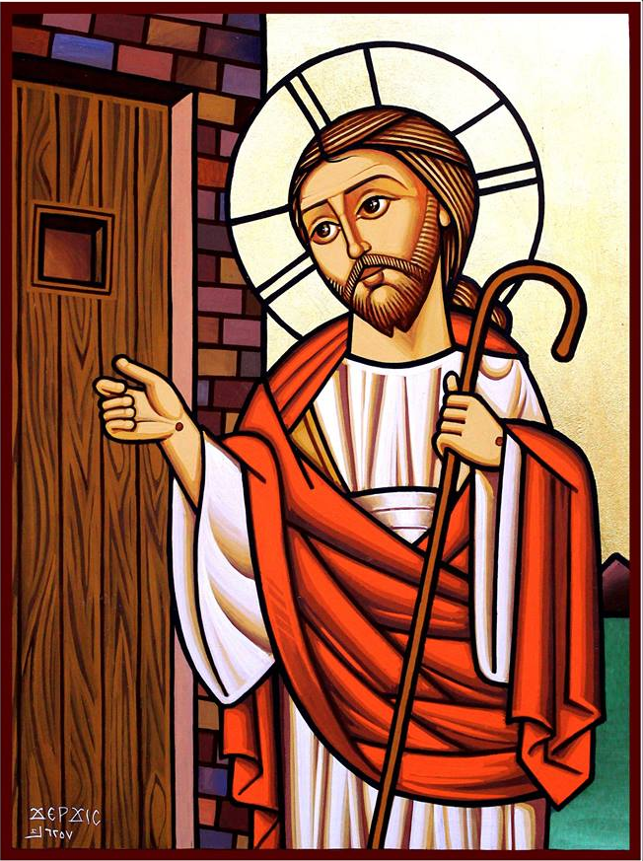
God’s Fellow Workers
Synergy = cooperation of God and man
Behold, I stand at the door and knock. If anyone hears My voice and opens the door, I will come in to him and dine with him, and he with Me. (Rev. 3:20)

Slide 7
14 that we should no longer be children, tossed to and fro and carried about with every wind of doctrine, by the trickery of men, in the cunning craftiness of deceitful plotting, 15 but, speaking the truth in love, may grow up in all things into Him who is the head—Christ— 16 from whom the whole body, joined and knit together by what every joint supplies, according to the effective working by which every part does its share, causes growth of the body for the edifying of itself in love. (Eph. 4:11-16)

Slide 8
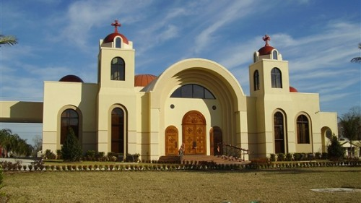
²² And He put all things under His feet, and gave Him to be head over all things to the church, ²³ which is His body, the fullness of Him who fills all in all. (Ephesians 1:22)

Slide 9
“Anyone who leaves the Church of Christ behind cannot benefit from the rewards of Christ. Such people are strangers, outcasts, and enemies. You cannot have God as Father unless you have the Church as mother. If any had been able to escape outside Noah’s Ark, there might have been a way of escape for those who are outside the Church.” There is only one Church, and outside its bounds salvation is impossible.
(St. Cyprian, ‘On the Unity of the Catholic Church’)

Slide 10
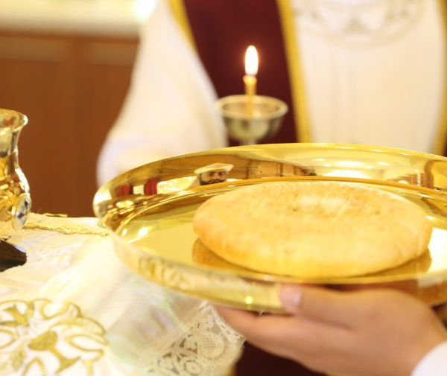
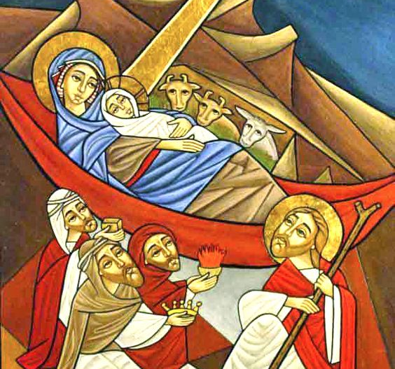
The Nature of the Church
The spiritual reality of the Church is rooted in the mystery of the Incarnation.

Slide 11
Christ and His Church
Acts 9 (Conversion of Saul)
Then Saul, still breathing threats and murder against the disciples of the Lord, went to the high priest 2 and asked letters from him to the synagogues of Damascus, so that if he found any who were of the Way, whether men or women, he might bring them bound to Jerusalem….“Saul, Saul, why are you persecuting Me?” Acts 9:1-4

Slide 12
Christ and His Church
Christ sent Ananias to baptize Saul of Tarsus
The Lord works through His church.

Slide 13
A High Calling
I, therefore, the prisoner of the Lord, beseech you to walk worthy of the calling with which you were called, 2 with all lowliness and gentleness, with longsuffering, bearing with one another in love, 3 endeavoring to keep the unity of the Spirit in the bond of peace. 4 There is one body and one Spirit, just as you were called in one hope of your calling; (Eph. 4:1-4)

Slide 14
The Good Samaritan
30 Then Jesus answered and said: “A certain man went down from Jerusalem to Jericho, and fell among thieves, who stripped him of his clothing, wounded him, and departed, leaving him half dead. 31 Now by chance a certain priest came down that road. And when he saw him, he passed by on the other side. 32 Likewise a Levite, when he arrived at the place, came and looked, and passed by on the other side. 33 But a certain Samaritan, as he journeyed, came where he was. And when he saw him, he had compassion.

Slide 15
The Good Samaritan
34 So he went to him and bandaged his wounds, pouring on oil and wine; and he set him on his own animal, brought him to an inn, and took care of him. 35 On the next day, when he departed, he took out two denarii, gave them to the innkeeper, and said to him, ‘Take care of him; and whatever more you spend, when I come again, I will repay you.’ 36 So which of these three do you think was neighbor to him who fell among the thieves?” 37 And he said, “He who showed mercy on him.” Then Jesus said to him, “Go and do likewise.” (Luke 10:25-37)

Slide 16
Who is the Good Samaritan?

Slide 17
For we are God’s fellow workers; you are God’s field, you are God’s building. (1 Cor. 3:9)

Slide 18
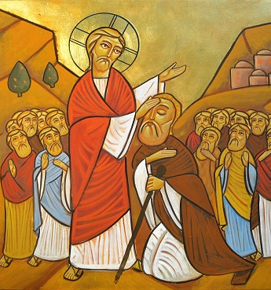
The Church is a Hospital!

Slide 19
St. John Chrysostom on “The Church”
The Church is a hospital, and not a courtroom, for souls. She does not condemn on behalf of sins, but grants remission of sins. Nothing is so joyous in our life as the thanksgiving that we experience in the Church. In the Church, the joyful sustain their joy. In the Church, those worried acquire merriment, and those saddened, joy. In the Church, the troubled find relief, and the heavy-laden, rest. "Come," says the Lord, "near Me, all of you who labor and are heavy-laden, and I will give you rest." (Matthew 11:28)

Slide 20
St. John Chrysostom on “The Church”
What could be more desirable than to meet this voice? What is sweeter than this invitation? The Lord is calling you to the Church for a rich banquet. He transfers you from struggles to rest, and from tortures to relief. He relieves you from the burden of your sins. He heals worries with thanksgiving, and sadness with joy. No one is truly free or joyful besides he who lives for Christ. Such a person overcomes all evil and does not fear anything!
-St. John Chrysostom

Slide 21
¹⁹ Now, therefore, you are no longer strangers and foreigners, but fellow citizens with the saints and members of the household of God, ²⁰ having been built on the foundation of the apostles and prophets, Jesus Christ Himself being the chief cornerstone, ²¹ in whom the whole building, being fitted together, grows into a holy temple in the Lord, ²² in whom you also are being built together for a dwelling place of God in the Spirit. (Eph. 2:19-22)

