Slide 1
Don’t Get Left Out
Third Sunday of Lent
February 28, 2010

Slide 2
What was the problem?

Slide 3
What was the problem?
BITTERNESS

Slide 4
The Solution? BE OPEN

Slide 5
The Solution? BE OPEN
“O Corinthians! We have spoken openly to you, our heart is wide open. You are not restricted by us, but you are restricted by your own affections. Now in return for the same… you also be open.” 2 Corinthians 6:11-13

Slide 6
The Solution? BE OPEN
“…so that, on the contrary, you ought rather to forgive and comfort him, lest perhaps such a one be swallowed up with too much sorrow. Therefore I urge you to reaffirm your love to him. For to this end I also wrote, that I might put you to the test, whether you are obedient in all things.” 2 Corinthians 2:7-9

Slide 7
The Solution? BE OPEN
“Do you not yet understand that whatever enters the mouth goes into the stomach and is eliminated? But those things which proceed out of the mouth come from the heart, and they defile a man. For out of the heart proceed evil thoughts, murders, adulteries, fornications, thefts, false witness, blasphemies. These are the things which defile a man” Matthew 15:17-20

Slide 8
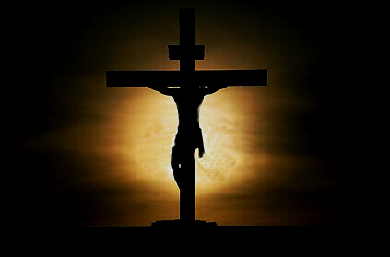
What are you focusing on?

