Slide 1
The Life of Elijah the Prophet
Battle of th DEITIES
Light & Life Fall Series

Slide 2
1 Kings 18:1
Now it came about after many days, that the word of the LORD came to Elijah in the third year , saying , “ Go, show yourself to Ahab , and I will send rain on the face of the earth . ”

Slide 3
1 Kings 18:17-19
17 Then it happened, when Ahab saw Elijah, that Ahab said to him, “Is that you, O troubler of Israel?”
18 And he answered, “I have not troubled Israel, but you and your father’s house have, in that you have forsaken the commandments of the Lord and have followed the Baals. 19 Now therefore, send and gather all Israel to me on Mount Carmel, the four hundred and fifty prophets of Baal, and the four hundred prophets of [c]Asherah, who [d]eat at Jezebel’s table.”

Slide 4
Elijah was not intimated

Slide 5
Darkness all over the land

Slide 6
1 Kings 18:21-23
²¹ And Elijah came to all the people, and said, “How long will you falter between two opinions? If the Lord is God, follow Him; but if Baal, follow him.” But the people answered him not a word. ²² Then Elijah said to the people, “I alone am left a prophet of the Lord; but Baal’s prophets are four hundred and fifty men. ²³ Therefore let them give us two bulls; and let them choose one bull for themselves, cut it in pieces, and lay it on the wood, but put no fire under it; and I will prepare the other bull, and lay it on the wood, but put no fire under it.

Slide 7
1 Kings 18 : 24
Then you call on the name of your gods, and I will call on the name of the Lord; and the God who answers by fire, He is God.”
And all the people answered and said , “ That is a good idea . ”

Slide 8
1 Kings 18:27-29
And it came about at noon, that Elijah mocked them and said, “ Call out with a loud voice, for he is a god; either he is occupied or gone aside, or is on a journey, or perhaps he is asleep and needs to be awakened . ” “So they cried aloud, and cut themselves, as was their custom, with knives and lances, until the blood gushed out on them. ²⁹ And when midday was past, they prophesied until the time of the offering of the evening sacrifice. But there was no voice; no one answered, no one paid attention.”

Slide 9
1 Kings 18:30-35
Then Elijah said to all the people, “Come near to me.” So all the people came near to him. And he repaired the altar of the Lord that was broken down. ³¹ And Elijah took twelve stones, according to the number of the tribes of the sons of Jacob, to whom the word of the Lord had come, saying, “Israel shall be your name.” ³² Then with the stones he built an altar in the name of the Lord; and he made a trench around the altar large enough to hold two seahs of seed.

Slide 10
³³ And he put the wood in order, cut the bull in pieces, and laid it on the wood, and said, “Fill four waterpots with water, and pour it on the burnt sacrifice and on the wood.” ³⁴ Then he said, “Do it a second time,” and they did it a second time; and he said, “Do it a third time,” and they did it a third time. ³⁵ So the water ran all around the altar; and he also filled the trench with water.

Slide 11
1 Kings 18:36-37
And it came to pass, at the time of the offering of the evening sacrifice, that Elijah the prophet came near and said, “Lord God of Abraham, Isaac, and Israel, let it be known this day that You are God in Israel and I am Your servant, and that I have done all these things at Your word. 37 Hear me, O Lord, hear me, that this people may know that You are the Lord God, and that You have turned their hearts back to You again.”

Slide 12
1 Kings 18-38
Then the fire of the LORD fell, and consumed the burnt offering and the wood and the stones and the dust , and licked up the water that was in the trench.

Slide 13
When we are sure that we are in the will of God, we are invincible.

Slide 14
Divided allegiance is as wrong as open idolatry

Slide 15
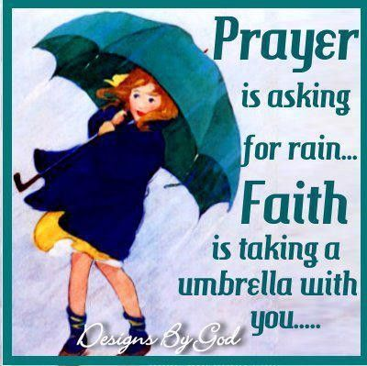
Our most effective tool is the prayer of faith

Slide 16
Never underestimate the power of one
totally dedicated life

Slide 17
God’s promises
CONDITIONAL OR UNCONDITIONAL?

Slide 18
1 John 1 : 9
“If we confess our sins , He is faithful and righteous to forgive us our sins and to cleanse us from all unrighteousness . ”

Slide 19
Philippians 4 : 19
And my God will supply all your needs according to His riches in glory in Christ Jesus .

Slide 20
1 Kings 18 : 42 – 44
So Ahab went up to eat and drink . But Elijah went up to the top of Carmel ; and he crouched down on the earth , and put his face between his knees . And he said to his servant , “ Go up now , look toward the sea . ” So he went up and looked and said , “ There is nothing . ” And he said , “ Go back ” seven times . And it came about at the seventh time , that he said , “ Behold , a cloud as small as a man’s hand is coming up from the sea . ” And he said , “ Go up , say to Ahab , ‘ Prepare your chariot and go down , so that the heavy shower does not stop you . ’ ”

Slide 21
He separated himself
He Humbled himself
He was specific in his prayer
He was persistent
He was expectant

