Slide 1
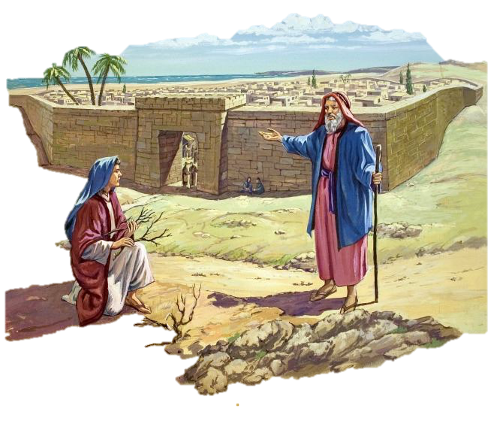
The Refiners Fire at Zarephath
Elijah Series Talk 2

Slide 2
Go to Zarephath: 1 Kings 17:7-9
Some time later the brook dried up because there had been no rain in the land
⁸ Then the word of the Lord came to him:
⁹ “Go at once to Zarephath in the region of Sidon and stay there.

Slide 3
Zarephath
Zarephath comes from a Hebrew verb that means “to melt, to smelt.
In noun form it means “crucible.”

Slide 4
The Refiner’s Fire
For He is like a refiner’s fire and like launderers’ soap.
He will sit as a refiner and a purifier of silver
Malachi 3:2-3
Notes:
A woman read that passage in Malachi and wanted to learn about a silversmith's work to understand this whole "refining with fire" idea better. So she made an appointment with a silversmith to watch him while at work. She didn't mention anything about the reason for her interest, beyond her curiosity about the process of refining silver. As she watched the silversmith work, he held a piece of silver over the fire and let it heat up. He explained that in refining silver, one needed to hold the silver in the middle of the fire, where the flames were the hottest as to burn away all the impurities. The woman thought about God holding us in such a hot spot, then she thought again about the verse, that "He sits as a refiner and purifier of silver." She asked the silversmith if it was true that he had to sit there in front of the fire the entire time the silver was being refined. The man answered, yes, that not only did he have to sit there holding the silver, but he had to keep his eyes on it the entire time it was in the fire. If the silver was left even a moment too long in the flames, it would be destroyed. The woman was silent for a moment. Then she asked the silversmith, "But how do you know when the silver is fully refined?" He smiled at her and answered, "Oh, that's easy - when I see my image in it."

Slide 5
The Truth
God knows where we are and He knows where He is taking us!
Fear not, for I am with you; Be not dismayed, for I am your God. I will strengthen you, Yes, I will help you, I will uphold you with My righteous right hand. Isa 41:10

Slide 6
The Road to Zarephath
Estimated to be
100 Miles!

Slide 7
A Widow?!
9 I have directed a widow there to supply you with food.”

Slide 8
1 Kings 17:10-11: Trial 1
¹⁰ So he went to Zarephath. When he came to the town gate, a widow was there gathering sticks. He called to her and asked, “Would you bring me a little water in a jar so I may have a drink?”
¹¹ As she was going to get it, he called, “And bring me, please, a piece of bread.”
Notes:
Swift Obedience - Elijah responded to God’s plan with swift obedience.
Never underestimate first impres­sions, for they are often a test. Elijah was dying of thirst. The brook had been dried up for an undisclosed period of time.
Then he had trekked a hundred miles across a dry and barren land. By the time he arrived at his destination, he was desperately in need of water. At the gate of the city of Zarephath he saw a widow gathering sticks. Aha, this must be the widow who was going to provide for him. “Please get me a drink of water,” Elijah said. “Oh, and while you’re at it, could you bring me a piece of bread too?”

Slide 9
1 Kings 17:12-13
¹² “As surely as the Lord your God lives,” she replied, “I don’t have any bread—only a handful of flour in a jar and a little olive oil in a jug. I am gathering a few sticks to take home and make a meal for myself and my son, that we may eat it—and die.”
¹³ Elijah said to her, “Don’t be afraid. Go home and do as you have said. But first make a small loaf of bread for me from what you have and bring it to me, and then make something for yourself and your son.

Slide 10
1 Kings 17:14-16
¹⁴ For this is what the Lord, the God of Israel, says: ‘The jar of flour will not be used up and the jug of oil will not run dry until the day the Lord sends rain on the land.
¹⁵ She went away and did as Elijah had told her. So there was food every day for Elijah and for the woman and her family.
¹⁶ For the jar of flour was not used up and the jug of oil did not run dry, in keeping with the word of the Lord spoken by Elijah.
Notes:
Elijah was determined that those initial first-impression blues were not going to get him down. The widow had her eyes on the impossibilities: a handful of flour, a tiny amount of oil, a few sticks. Elijah rolled up his sleeves and focused only on the possibilities.
How could he do that? Because he was an emerging man of God. He had been to Cherith. He had seen the proof of God’s faithfulness. He had survived the dried-up brook. He had obeyed God and, without hesitation, he had walked to Zarephath.
You can’t talk the talk if you have never walked the walk. You can’t encour­age somebody else to believe the improbable if you haven’t believed the impossible. You can’t light another’s candle of hope if your own torch of faith isn’t burning.

Slide 11
1 Kings 17:17-18: Trial 2
17 Some time later the son of the woman who owned the house became ill. He grew worse and worse, and finally stopped breathing.
18 She said to Elijah, “What do you have against me, man of God? Did you come to remind me of my sin and kill my son?”

Slide 12
When Disaster Strikes How do you respond?
Notes:
Do you know what really impresses me here? It’s the silence of Elijah.

Slide 13
1 Kings 17:19-20
¹⁹ And he said to her, “Give me your son.” So he took him out of her arms and carried him to the upper room where he was staying, and laid him on his own bed.
²⁰ Then he cried out to the Lord and said, “O Lord my God, have You also brought tragedy on the widow with whom I lodge, by killing her son?”
Notes:
He took the child where he learned to fight all his battles, in the upper room. In prayer!
What do you do when tragedy strikes? What do you do when a test comes? What’s your first response? Is it to complain? To blame? To try to reason your way out of it? Or have you formed the habit of doing what Elijah did? Do you go to your special place and get alone with God?

Slide 14
Where is Your Secret Place?: Psalm 91
¹He who dwells in the secret place of the Most High Shall abide under the shadow of the Almighty.
² I will say of the Lord, “He is my refuge and my fortress; My God, in Him I will trust.”
³ Surely He shall deliver you from the snare of the fowler And from the perilous pestilence.
⁴ He shall cover you with His feathers, And under His wings you shall take refuge;

Slide 15
1 Kings 17:21-22
²¹ And he stretched himself out on the child three times, and cried out to the Lord and said, “O Lord my God, I pray, let this child’s soul come back to him.”
²² Then the Lord heard the voice of Elijah; and the soul of the child came back to him, and he revived.
Our Struggles are often the catalyst for Bold Prayers!

Slide 16
1 Kings 17:23-24
²³ And Elijah took the child and brought him down from the upper room into the house, and gave him to his mother. And Elijah said, “See, your son lives!”
²⁴ Then the woman said to Elijah, “Now by this I know that you are a man of God, and that the word of the Lord in your mouth is the truth.”

Slide 18
Lessons Learned
Elijah learned the theology of faith in the secret hiding place at Cherith. He was given the opportunity to develop it during his advance training at Zarephath. But it was not until he stared death in the face, that he personified it. And he did it all that by heeding to the word of the Lord

Slide 19
Can you make these four faith statements?
I am here by God’s direction.
I am in His protection
I am under His training.
He will show me His purposes in due time.

