Slide 1
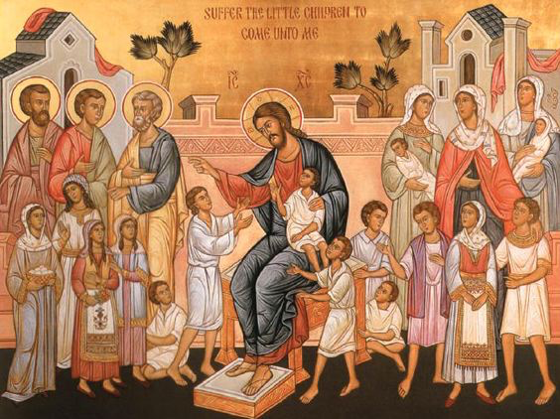
Converted or Drowned?
2nd Sunday of Abib (2016)

Slide 2
The Necessity of conversion
and said, “Assuredly, I say to you, unless you are converted and become as little children, you will by no means enter the kingdom of heaven. Matt 18: 3

Slide 3
St. Ambrose
“Who is this child whose example is to be followed by Jesus’ disciples other than the one about whom Isaiah said, (Is 9:6) “For unto us a child is born, unto us a son is given…” It is he who said, “Carry your cross and follow me” (Matt 16:24). Also it is he (1 Peter 2:23) “Who, when he was reviled, did not revile in return; when he suffered, he did not threaten.”

Slide 4
The Beginning
12 buried with Him in baptism, in which you also were raised with Him through faith in the working of God, who raised Him from the dead. Col 2:12

Slide 5
Renew your covenant
19 Repent therefore and be converted, that your sins may be blotted out, so that times of refreshing may come from the presence of the Lord, Acts 3:19

Slide 6
The confidence
6 being confident of this very thing, that He who has begun a good work in you will complete it until the day of Jesus Christ; Phil 1:6

Slide 7
Are you causing others to sin?
6 “Whoever causes one of these little ones who believe in Me to sin, it would be better for him if a millstone were hung around his neck, and he were drowned in the depth of the sea. Matt 18:6

Slide 8
How terrible is it?
5 Whoever receives one little child like this in My name receives Me. Matt 18:5
4 Then he fell to the ground, and heard a voice saying to him, “Saul, Saul, why are you persecuting Me?”5 And he said, “Who are You, Lord?” Acts 9:4,5

Slide 9
St. John Chrysostom
“By this punishment that man deserves for obstructing others, we learn the reward awaiting those who save others. If the salvation of one soul had not been so great to Christ, he would not have threatened a punishment as such for him who obstructs anyone.”

Slide 10
words of Jesus should motivate us to take children seriously…
For parents: how important to bring your child up in the nurture and admonition of the Lord!
For teachers: How serious and noble is your task of teaching our children!
For all of us: We are examples and role models, whether good or bad...and God will hold us accountable for the effect we have on them!

Slide 11
And for those who are seeking to enter the kingdom
Heed the necessity of being converted!
Let the example of child-like trust and humility be a guide as to how we should serve God and one another!

Slide 12
St. Cyril the great
“By what means can man on earth, wrapped in death come back to incorruption? I answer and say that this dead body has to share in the power of the Giver of life descending from God. As for the power of the Giver which belongs to God the Father, this is the only begotten Son, the Word, whom He sent to us as Saviour and a Redeemer.

