Slide 1
Contagious Christian Series
Formula to Impact Your World

Slide 2
Formula for Impacting
Your World
HP+CP+CC=MI

Slide 3

MI= Maximum Impact

Slide 4
Maximum impact
This is to have the greatest spiritual influence possible on those around us

Slide 5
Acts 1:8
“But you shall receive power when the Holy Spirit has come upon you; and you shall be witnesses to Me^{[a]} in Jerusalem, and in all Judea and Samaria, and to the end of the earth.”

Slide 6
2 Corinthians 5:18
”Now all things are of God, who has reconciled us to Himself through Jesus Christ, and has given us the ministry of reconciliation,”

Slide 7
Matthew 28:19
“Go therefore and make disciples of all the nations, baptizing them in the name of the Father and of the Son and of the Holy Spirit,”

Slide 8

“You are the salt of the earth;”
“You are the light of the world”
Matthew 5:13,14

Slide 9
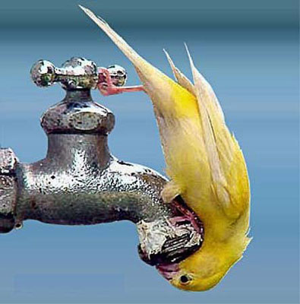
Salt makes us thirsty

Slide 10

Salt adds flavor

Slide 11
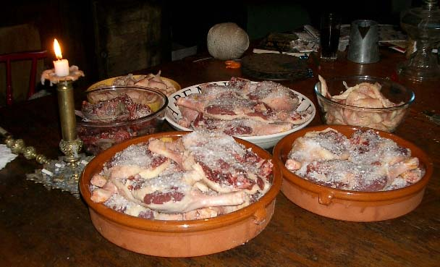
Salt preserves

Slide 12
Creating Thirst in the world around us

Slide 13
Godly sincerity
¹² For our boasting is this: the testimony of our conscience that we conducted ourselves in the world in simplicity and godly sincerity, not with fleshly wisdom but by the grace of God, and more abundantly toward you.
2 Corinthians 1:12

Slide 14
Potency and Proximity
Formula: HP+CP+CC=MI

Slide 15
HP= High Potency
High Potency- in order to have high impact on the world around us we need to have a strong enough concentration of Christ’s influence in our lives that His power and presence will be undeniable to others

Slide 16
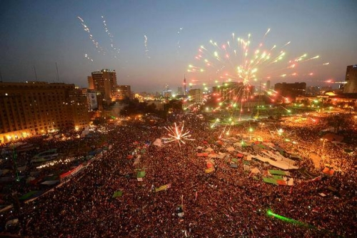
Close Proximity

Slide 17
Matthew 5:13
“You are the salt of the earth; but if the salt loses its flavor, how shall it be seasoned? It is then good for nothing but to be thrown out and trampled underfoot by men.”

Slide 18
CC= Close Communication
declaring and defending the major doctrines of the gospel with a straightforward simplicity
HP+CP (salt) +CC (light)= MI

Slide 19
Matthew 5:14-16
“You are the light of the world. A city that is set on a hill cannot be hidden. ¹⁵ Nor do they light a lamp and put it under a basket, but on a lampstand, and it gives light to all who are in the house. ¹⁶ Let your light so shine before men, that they may see your good works and glorify your Father in heaven.

Slide 20

Your light shouldn’t be covered up

Slide 21
Romans 10:14
How then shall they call on Him in whom they have not believed? And how shall they believe in Him of whom they have not heard? And how shall they hear without a preacher?

Slide 22
Acts 8:31
³¹ And he said, “How can I, unless someone guides me?” And he asked Philip to come up and sit with him.

Slide 23
Questions
What do you think is lacking in the formula of most Christians? Close proximity, potency, or clear communication?
What do you think is important for people to know about the Gospel message that people don’t comprehend about our faith?

