Slide 1
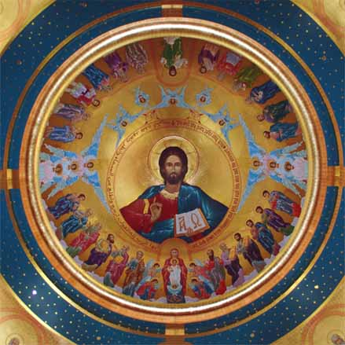
Cloud of Witnesses
Saints Series

Slide 2
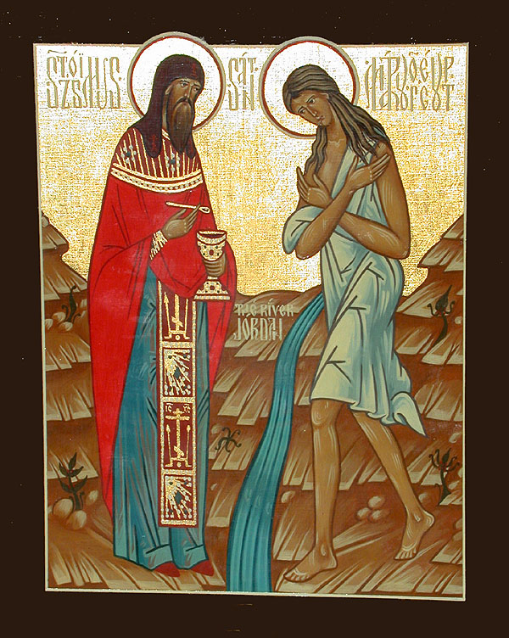
Abba Zosima

Slide 3
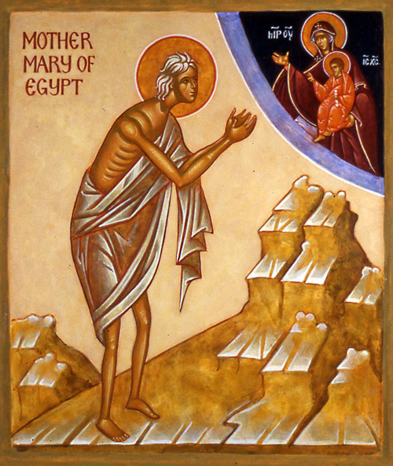
St Mary of Egypt

Slide 4
Abba Zosima at meeting Mary of Egypt
"O mother, filled with the Spirit, by your mode of life it is evident that you live with God and have died to the world. The Grace granted to you is apparent -- for you have called me by name and recognized that I am a priest, though you have never seen me before. Grace is recognized not by one's orders, but by gifts of the Spirit, so give me your blessing for God's sake, for I need your prayers."

Slide 5
Great Humilty
"Why have you come, man of God, to me who am so sinful? Why do you wish to see a woman naked an devoid of every virtue?”

Slide 6
Ezekiel 18:21-23
““But if a wicked man turns from all his sins which he has committed, keeps all My statutes, and does what is lawful and right, he shall surely live; he shall not die. ²² None of the transgressions which he has committed shall be remembered against him; because of the righteousness which he has done, he shall live. ²³ Do I have any pleasure at all that the wicked should die?” says the Lord God, “and not that he should turn from his ways and live?”

Slide 7
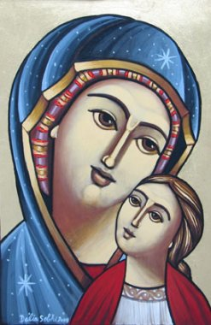
The turning point in her life

Slide 8
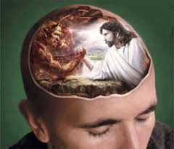
17 years of Struggle
Missed the meat and fish
Missed drinking the wine
Strong desire to sing the satanic songs
A strong thirst for embraces by others
The thoughts of lust again and their memories

Slide 9
But when such desires entered me I struck myself on the breast and reminded myself of the vow which I had made, when going into the desert. In my thoughts I returned to the ikon of the Mother of God which had received me and to her I cried in prayer. I implored her to chase away the thoughts to which my miserable soul was succumbing. And after weeping for long and beating my breast I used to see light at last which seemed to shine on me from everywhere. And after the violent storm, lasting calm descended.
As soon as this craving came to me, I flung myself on the earth and watered it with my tears, as if I saw before me my witness, who had appeared to me in my disobedience, and who seemed to threaten punishment for the crime. And I did not rise from the ground (sometimes I lay thus prostrate for a day and a night) until a calm and sweet light descended and enlightened me and chased away the thoughts that possessed me. But always I turned to the eyes of my mind to my Protectress, asking her to extend help to one who was sinking fast in the waves of the desert. And I always had her as my Helper and the Accepter of my repentance. And thus I lived for seventeen years amid constant dangers. And since then even till now the Mother of God helps me in everything and leads me as it were by the hand."

Slide 10
How did She overcome?
When I only reflect on the evils from which Our Lord has delivered me I have imperishable food for hope o of salvation. I am fed and clothed by the all-powerful Word of God, the Lord of all.
For it is not by bread alone that man lives. And those who have stripped off the rags of sin have no refuge, hiding themselves in the clefts of the rocks (Job 24; Heb. 11:38)."

Slide 11
The burning desires within us can be transformed and redirected to long for the fiery love of God

Slide 12
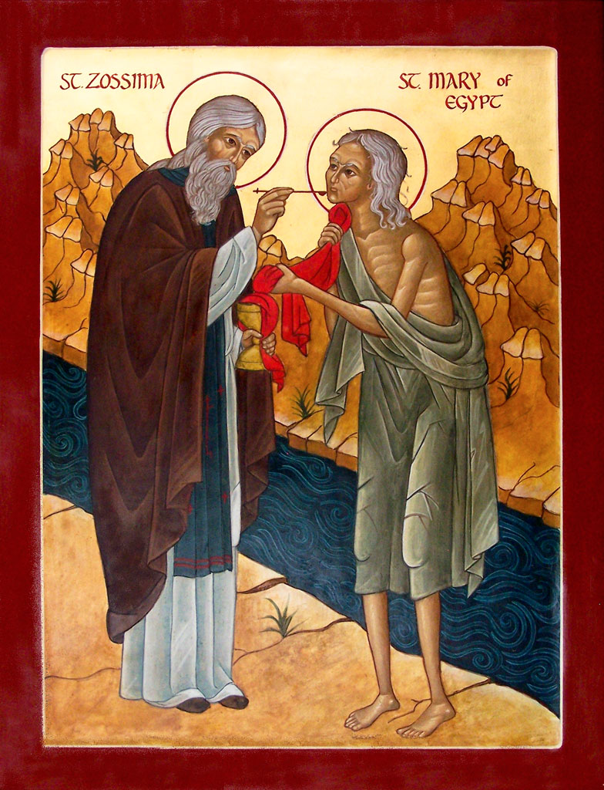
Abba Zosima gives her communion
"Truly God did not lie when He promised that when we purify ourselves we shall be like Him. Glory to Thee, Christ our God, Who has shown me through this thy slave how far away I stand from perfection."

