Slide 1
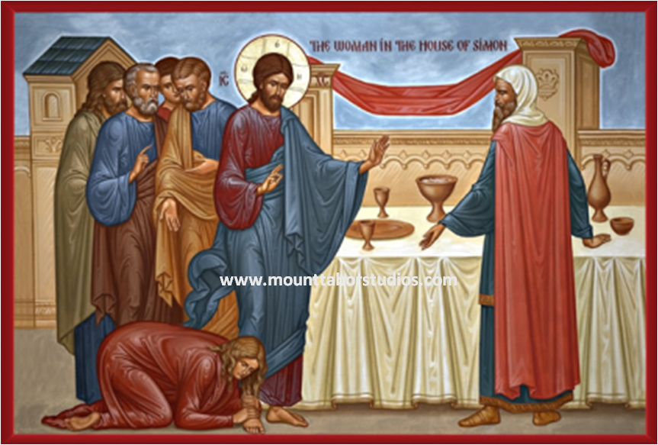
Arrogant religious or Repented humble Sinner?
4th Sunday of Tout 2015

Slide 2
St. Augustine
I would not exist--I would simply not be at all--unless I exist in You, from whom and by whom and in whom all things are

Slide 3
In Flow and our Flow
4 who comforts us in all our tribulation, that we may be able to comfort those who are in any trouble, with the comfort with which we ourselves are comforted by God. 2 Cor 1:4

Slide 4
Of God or of the Devil ?
He who sins is of the devil, for the devil has sinned from the beginning. For this purpose the Son of God was manifested, that He might destroy the works of the devil. 1 Jn 3:8

Slide 5
Woman of God
At Joppa there was a certain disciple named Tabitha, which is translated Dorcas. This woman was full of good works and charitable deeds which she did. Acts 9:36

Slide 6
He is my strength
The LORD is their strength,
And He is the saving refuge of His anointed.
Save Your people,
And bless Your inheritance;
Shepherd them also,
And bear them up forever. Ps 28:8,9

Slide 7
The Pharisee’s invitation
Then one of the Pharisees asked Him to eat with him. And He went to the Pharisee’s house, and sat down to eat. Lk 7:36

Slide 8
A woman unexpected visit
And behold, a woman in the city who was a sinner, when she knew that Jesus sat at the table in the Pharisee’s house, brought an alabaster flask of fragrant oil. Lk 7:37

Slide 9
Humility of a sinner
and stood at His feet behind Him weeping; and she began to wash His feet with her tears, and wiped them with the hair of her head; and she kissed His feet and anointed them with the fragrant oil. Lk 7:38

Slide 10
St. Augustine
Man should withdraw from himself, not for worldly affairs, but to get attached to God.

Slide 11
Arrogance of the Pharisee
Now when the Pharisee who had invited Him saw this, he spoke to himself, saying, “This Man, if He were a prophet, would know who and what manner of woman this is who is touching Him, for she is a sinner.” Lk 7:39

Slide 12
Forgiven woman
48 Then He said to her, “Your sins are forgiven.”
50 Then He said to the woman, “Your faith has saved you. Go in peace.” Lk 7:48,50

Slide 13
St. John Chrysostom
He does not just care for us, but loves us with no limits, a flaring unquenchable holy love, and a truly unbreakable strong love.

