Slide 1
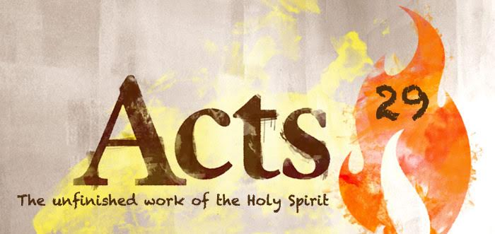

Slide 2
The plan of God was to change ordinary people to live extraordinary lives

Slide 3
Transformation
The Church experienced a Metamorphosis on the day of Pentecost

Slide 4
People in the early church had a sensitivity to the promptings of the Holy Spirit

Slide 5
People witnessed vitality in the church, a different type of life experienced by believers

Slide 6
Acts 2:46-48
⁴⁶ So continuing daily with one accord in the temple, and breaking bread from house to house, they ate their food with gladness and simplicity of heart,⁴⁷ praising God and having favor with all the people. And the Lord added to the church daily those who were being saved.

Slide 7
What were the changes they saw in people?

Slide 8
Dedication

Slide 9
Athenagorus 2nd Century
Among us you will find uneducated persons and artisans and old women, who, if they are unable to prove the benefits of our doctrine, yet by their deeds they exhibit the benefits arising from their persuasion of its truth. They do not practice great speeches, but they exhibit good works. When struck, they do not strike back. When robbed, they do not go to law. They give to those that ask of them. And they love their neighbors as themselves.

Slide 10
Joy could not be denied

Slide 11
Hebrews 10:32
³² But recall the former days in which, after you were illuminated, you endured a great struggle with sufferings: ³³ partly while you were made a spectacle both by reproaches and tribulations, and partly while you became companions of those who were so treated; ³⁴ for you had compassion on me^{[h]} in my chains, and joyfully accepted the plundering of your goods, knowing that you have a better and an enduring possession for yourselves in heaven.^{[i]} ³⁵ Therefore do not cast away your confidence, which has great reward.

Slide 12
21 martyrs of Libya

Slide 13
Holiness

Slide 14
Theophilus of Antioch 2nd Century
Believers are forbidden to go to gladiatorial shows, lest they become hardened to cruelty and condone murder. Be it far from Christians to conceive any such deeds, for with them temperance dwells, self- restraint is practiced, monogamy observed, chastity guarded, righteousness exercised, worship performed and God acknowledged. Truth governs them, grace guards them, peace screens them and the holy word guides. ( Ad Autolochum, 15).

Slide 15
Generosity

Slide 16
Acts 2:42-45
And they continued steadfastly in the apostles’ doctrine and fellowship, in the breaking of bread, and in prayers. ⁴³ Then fear came upon every soul, and many wonders and signs were done through the apostles.
⁴⁴ Now all who believed were together, and had all things in common, ⁴⁵ and sold their possessions and goods, and divided them among all, as anyone had need

Slide 17
2 Corinthians 8: 1-5
Moreover, brethren, we make known to you the grace of God bestowed on the churches of Macedonia: ² that in a great trial of affliction the abundance of their joy and their deep poverty abounded in the riches of their liberality. ³ For I bear witness that according to their ability, yes, and beyond their ability, they were freely willing, ⁴ imploring us with much urgency that we would receive^{[a]}the gift and the fellowship of the ministering to the saints. ⁵ And not only as we had hoped, but they first gave themselves to the Lord, and then to us by the will of God.

Slide 18
Why were they transformed?

Slide 19
Acts 4:13-14
¹³ Now when they saw the boldness of Peter and John, and perceived that they were uneducated and untrained men, they marveled. And they realized that they had been with Jesus. ¹⁴ And seeing the man who had been healed standing with them, they could say nothing against it.

Slide 20
Letter to Hadrian
“The Christians know and trust their God…If any of them have bondwomen orchildren, they persuade them to become Christians for the love they have toward them; and when they become so, they call them “brother” without distinction. They love one another…If they see a stranger, they take him into their dwellings and rejoice over him as a real brother;

Slide 21
for they do not call each other brother after the flesh, but after the Spirit of “”God. If any among them is poor and needy, and they do not have food to spare, they fast two or three days that they may supply him with necessary food. But, the deeds which they do, they do not proclaim to the ears of the multitude, but they take care that no man shall perceive them. Thus they labor to become righteous. Truly, this is a new people and there is something divine in them.”

Slide 22
Weekly challenge
Have a meaningful experience with God in prayer & while reading His Word ask Him to make a change in your behavior, noticeable to your family or coworkers.

