Slide 2
Acts 1:4-5
And being assembled together with them, He commanded them not to depart from Jerusalem, but to wait for the Promise of the Father, “which,” He said, “you have heard from Me; ⁵ for John truly baptized with water, but you shall be baptized with the Holy Spirit not many days from now.

Slide 3
Acts 1:6-8
Therefore, when they had come together, they asked Him, saying, “Lord, will You at this time restore the kingdom to Israel?” ⁷ And He said to them, “It is not for you to know times or seasons which the Father has put in His own authority. ⁸ But you shall receive power when the Holy Spirit has come upon you; and you shall be witnesses to Me in Jerusalem, and in all Judea and Samaria, and to the end of the earth.”

Slide 4
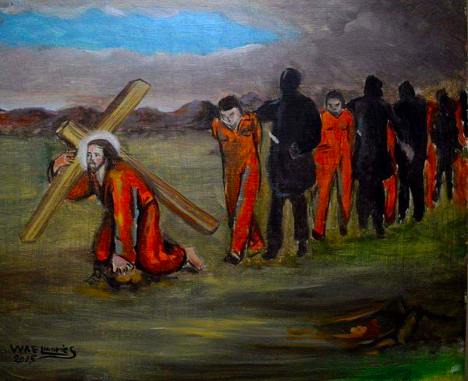
Witnessing means our lives must display the inner reality of what we externally proclaim

Slide 5
Wind of the Holy Spirit

Slide 6
Expectant Belief

Slide 7
Expectant Belief

Slide 8
Expectant prayer
These all continued with one accord in prayer and supplication,nwith the women and Mary the mother of Jesus, and with His brothers.
Acts 1:14

Slide 9
Luke 11:13
“If you then, being evil, know how to give good gifts to your children, how much more will your heavenly Father give the Holy Spirit to those who ask Him!”

Slide 10
Prayer in Unity
“Now the multitude of those who believed were of one heart and one soul; neither did anyone say that any of the things he possessed was his own, but they had all things in common.” Acts 4:32

Slide 12
Acts 4:33
“And with great power the apostles gave witness to the resurrection of the Lord Jesus. And great grace was upon them all.”

