Slide 1
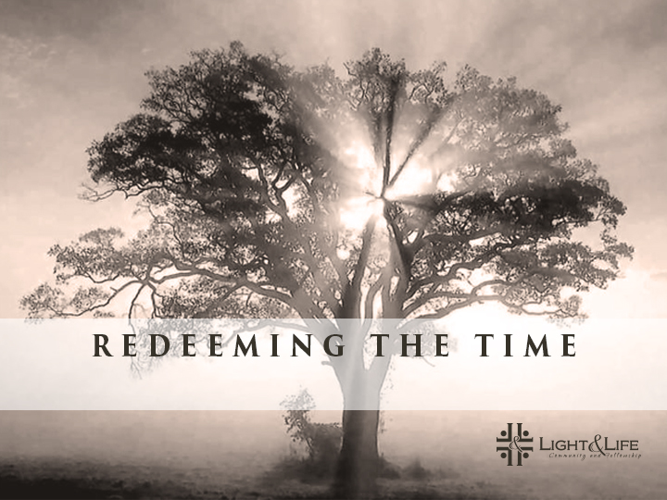
Accepting of Good and Bad

Slide 2
Our World is Good and Bad
Our natural tendency is to try and resolve the problem of good and evil by keeping the good and the bad separated

Slide 3
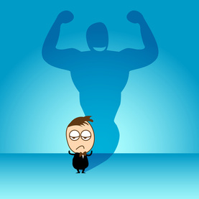
The Ideal self
:The one we can imagine and want to be

Slide 4
Romans 8:22– 25
“Not only so, but we ourselves, who have the first-fruits of the Spirit, groan inwardly as we wait eagerly for our adoption as sons, the redemption of our bodies. For in this hope we were saved. But hope that is seen is no hope at all. Who hopes for what he already has? But if we hope for what we do not yet have, we wait for it patiently”

Slide 5
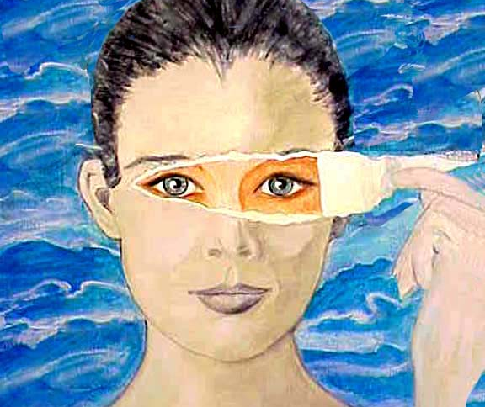
Real Self
is the one that we truly are, not the one we wish to be

Slide 6
Romans 7:14
“For we know that the law is spiritual, but I am carnal, sold under sin.”

Slide 7
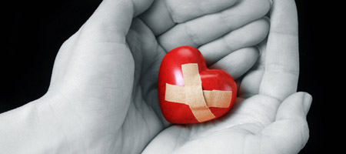
Our real selves are suffering from brokenness and immaturity

Slide 8
Ideal Self and the Real Self
Whenever the real self becomes apparent, the ideal self will judge it, and try to make it hide.
When we are hiding, we are not in relationship with God and others

Slide 9
If we are able to accept the parts of ourselves we do not feel are ideal, then those parts will be
loved and healed.

Slide 10
What heals our brokenness is:
Acceptance is the answer to the dilemma of the ideal versus the real.
“to the praise of the glory of His grace, by which He made us accepted in the Beloved.” Ephesians 1:6

Slide 11
Romans 7:15-19
“I do not understand what I do. For what I want to do I do not do, but what I hate I do. And if I do what I do not want to do, I agree that the law is good. As it is, it is no longer I myself who do it, but it is sin living in me. I know that nothing good lives in me, that is, in my sinful nature. For I have the desire to do what is good, but I cannot carry it out. For what I do is not the good I want to do; no, the evil I do not want to do— this I keep on doing”

Slide 12
Romans 8:1
“Therefore, there is now no condemnation for those who are in Christ Jesus”
It is only when we are no longer condemned for the bad that we can let go of it.

Slide 13
The nature of the relationship between the ideal and the real needs to be one of grace, of unconditional love and acceptance.
If the real is loved and accepted, it can be encouraged to grow toward the ideal.

Slide 14
Ecclesiastes 7:15-18
I have seen everything in my days of vanity:
There is a just man who perishes in his righteousness,
And there is a wicked man who prolongs life in his wickedness.
16 Do not be overly righteous, Nor be overly wise:
Why should you destroy yourself?
17 Do not be overly wicked, Nor be foolish:
Why should you die before your time?
18 It is good that you grasp this, And also not remove your hand from the other;
For he who fears God will escape them all.

Slide 15
Attacking and judging is the most common way we deal with the bad.

Slide 16
2 Corinthians 7:10
“Godly sorrow brings repentance that leads to salvation and leaves no regret, but worldly sorrow brings death”
Sadness over badness that turns to repentance is
godly sorrow

Slide 17
The relationship between the ideal and the real
one of correction toward a goal of love, instead of one of anger and attack toward the real self who fails

Slide 18
When we Fail to Accept Good and Bad
Perfectionism : an extreme or excessive striving for perfection of self, others, and the world
Inability to Tolerate Weakness
Inability to Tolerate Negative Feelings
Guilt

Slide 19
HOW WE GET GOOD AND BAD BACK TOGETHER?
The 3 most important medicines for curing this problem are
Confession
Forgiveness
Integrative negative emotions

Slide 20
Confess
If we confess our sins, He is faithful and just to forgive us our sins and to cleanse us from all unrighteousness. 1 John 1:9
“Confess your trespasses[a] to one another, and pray for one another, that you may be healed.” James 5:16

Slide 21
The Key to Changes that Heal
Realizing our forgiveness through confessing our real self to a priest and those we hurt

Slide 22
Through Confession…..
the ideal self can become a goal and not a demand, and the true self can be loved along the way

Slide 23
Forgive
“bearing with one another, and forgiving one another, if anyone has a complaint against another; even as Christ forgave you, so you also must do.” Colossians 3:13

Slide 24
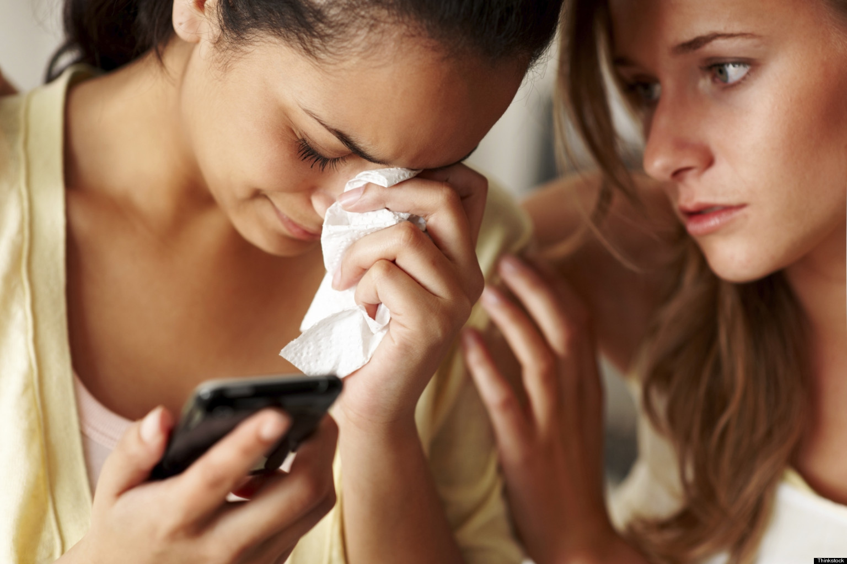
Process Negative Emotions

Slide 25
Rework the Ideal
Much of the content of our ideal self is false; it is not what an ideal person would be. Check out what needs to be eliminated from your picture of what an ideal you would be.

Slide 26
Rework Distortions
Challenge your distorted views of God, yourself, and others

Slide 27
Practice Loving the Less than Ideal in Others
Stay connected to others when they are less than ideal

Slide 28
Expect Badness and Weakness from Everyone
Everyone you know, including yourself, has good and bad, strengths and weaknesses. Therefore, expect to see them in action.

