Slide 1
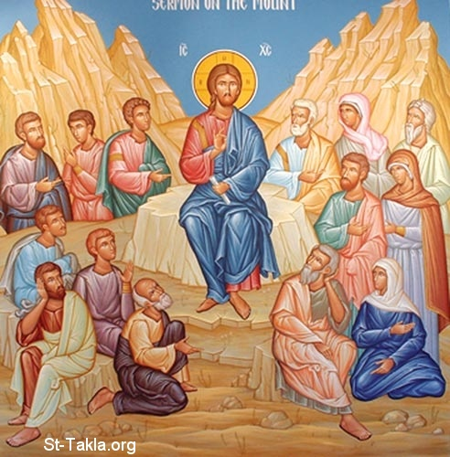
We could not bring forth lice…!!!
3rd Sunday of Baoonah

Slide 2
A Higher calling
that their hearts may be encouraged, being knit together in love, and attaining to all riches of the full assurance of understanding, to the knowledge of the mystery of God, both of the Father and of Christ, in whom are hidden all the treasures of wisdom and knowledge. Col 2:2

Slide 3
The Inaudible Prayer Of The Catholic Prayer
Lord God, Who has revealed unto us, through Your holy apostles, the mystery of the gospel of the glory of Your Christ;

Slide 4
We could not bring forth lice…!!!
3rd Sunday of Baoonah

Slide 5
The Finger of God
¹⁸ Now the magicians so worked with their enchantments to bring forth lice, but they could not. So there were lice on man and beast. ¹⁹ Then the magicians said to Pharaoh, “This is the finger of God.” But Pharaoh’s heart grew hard, and he did not heed them, just as the Lord had said. Ex 8:18,19

Slide 6
The Spirit of God
²⁸ But if I cast out demons by the Spirit of God, surely the kingdom of God has come upon you. .. Matt 12:28

Slide 7
The Finger of God
But if I cast out demons with the finger of God, surely the kingdom of God has come upon you. Luke 11:20

Slide 8
St Cyril of Alexandria On the Gospel of St Luke , Hom. 81
And by the finger of God He means the Holy Ghost. For the Son is called the hand and arm of God the Father; for He does all things by the Son, and the Son in like manner works by the Spirit. For just as the finger is appended to the hand, as something not foreign from it, but belonging to it by nature, so also the Holy Spirit, by reason of His being equal in substance, is joined in oneness to the Son, even though He proceed from God the Father.

Slide 9
1. The Pharisees’ option
²⁴ Now when the Pharisees heard it they said, “This fellow does not cast out demons except by Beelzebub, the ruler of the demons.” Matt 12:24

Slide 10
The Pharisees’ reward
³¹ “Therefore I say to you, every sin and blasphemy will be forgiven men, but the blasphemy against the Spirit will not be forgiven men. Matt 12:31

Slide 11
(St. John Chrysostom)
For he who after sinning has practiced repentance, is a worthy object not of grief but of congratulations, having passed over into the choir of the righteous.

Slide 12
2- The Multitude’s option
²³ And all the multitudes were amazed and said, “Could this be the Son of David?” Matt 12:23

Slide 13
3- The oppressed option
³⁸ how God anointed Jesus of Nazareth with the Holy Spirit and with power, who went about doing good and healing all who were oppressed by the devil, for God was with Him. Acts 10:38

Slide 14
4- Devil's option
And demons also came out of many, crying out and saying, “You are the Christ, the Son of God!” And He, rebuking them, did not allow them to speak, for they knew that He was the Christ. Lk 4:41

Slide 15
5. The disciples’ option
¹⁷ Then the seventy returned with joy, saying, “Lord, even the demons are subject to us in Your name.” Lk 10:17

Slide 16
Warning
Judas was one of them
¹⁸ And He said to them, “I saw Satan fall like lightning from heaven.¹⁹ Behold, I give you the authority to trample on serpents and scorpions, and over all the power of the enemy, and nothing shall by any means hurt you. ²⁰ Nevertheless do not rejoice in this, that the spirits are subject to you, but rather rejoice because your names are written in heaven.” Lk 10:18-21

Slide 17
The five options
Pharisees : blasphemy
The multitude : doubting
The oppressed : healed
The devils: cry out !
The disciples : enjoying the power of the finger of God

Slide 18
St. Augustine
Breath in me, O Holy Spirit, that my thoughts may all be holy. Act in me, O Holy Spirit, that my work, too, may be holy. Draw my heart, O Holy Spirit, that I love but what is holy. Strengthen me, O Holy Spirit, to defend all that is holy. Guard me, then, O Holy Spirit, that I always may be holy.

