Slide 1
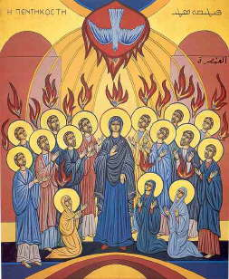
The Holy Spirit in Luke 1
4th Sunday of Kiahk/2020

Slide 2
Sanctification
For he will be great in the sight of the Lord, and shall drink neither wine nor strong drink. He will also be filled with the Holy Spirit, even from his mother’s womb. Lk 1:15

Slide 3
The will of God
3 For this is the will of God, your sanctification: that you should abstain from sexual immorality;
1 Thes 4:3

Slide 4
Incarnation
And the angel answered and said to her, “The Holy Spirit will come upon you, and the power of the Highest will overshadow you; therefore, also, that Holy One who is to be born will be called the Son of God. Lk 1:35

Slide 5
Christ may dwell in You…
6 that He would grant you, according to the riches of His glory, to be strengthened with might through His Spirit in the inner man, 17 that Christ may dwell in your hearts through faith; that you, being rooted and grounded in love, Eph 3:16,17

Slide 6
Blessing and relevation
41 And it happened, when Elizabeth heard the greeting of Mary, that the babe leaped in her womb; and Elizabeth was filled with the Holy Spirit. 42 Then she spoke out with a loud voice and said, “Blessed are you among women, and blessed is the fruit of your womb! 43 But why is this granted to me, that the mother of my Lord should come to me? Lk 1:41-32

Slide 7
Spirit of Revelation
17 that the God of our Lord Jesus Christ, the Father of glory, may give to you the spirit of wisdom and revelation in the knowledge of Him, Eph 1:17

Slide 8
Prophecy
67 Now his father Zacharias was filled with the Holy Spirit, and prophesied, saying:
68 “Blessed is the Lord God of Israel, For He has visited and redeemed His people, Lk 1:67,68

Slide 9
Prophesied
6 And when Paul had laid hands on them, the Holy Spirit came upon them, and they spoke with tongues and prophesied. Acts 19:6

Slide 10
St Cyril the Great on Jn 5:13-21
After Christ had completed his mission on earth, it still remained necessary for us to become sharers in the divine nature of the Word. We had to give up our own life and be so transformed that we would begin to live an entirely new kind of life that would be pleasing to God. This was something we could do only by sharing in the Holy Spirit.

