Slide 1
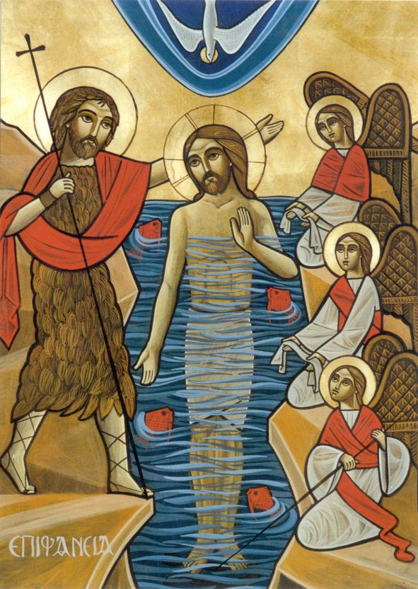
This is my Beloved Son
26th Jan , 2020

Slide 2
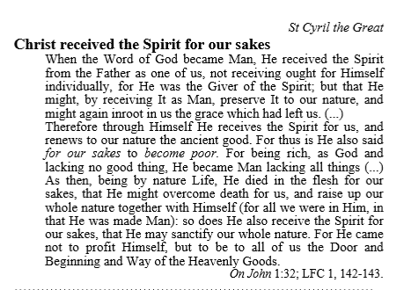

Slide 3
Heirs and Joint Heirs
¹⁵ For you did not receive the spirit of bondage again to fear, but you received the Spirit of adoption by whom we cry out, “Abba, Father.” ¹⁶ The Spirit Himself bears witness with our spirit that we are children of God, ¹⁷ and if children, then heirs—heirs of God and joint heirs with Christ, if indeed we suffer with Him, that we may also be glorified together. Rom 8:15-16

Slide 5
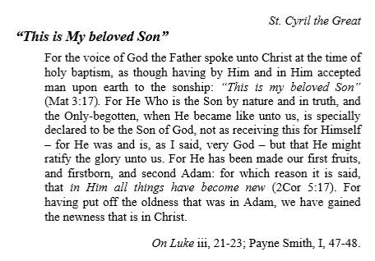

Slide 6
The invocation of the Holy Spirit
And we ask You, O Lord, our God, we, Your sinful and unworthy servants; we worship You by the pleasure of Your goodness; that Your Holy Spirit descend upon us and upon these gifts set forth, and purify them, change them, and manifest them as a sanctification of Your saints.

