Slide 1
Preserve One Another “Salty” Confrontation

Slide 2
Colossians 4:6
“Let your speech always be with grace, seasoned with salt, that you may know how you ought to answer each one.”

Slide 3
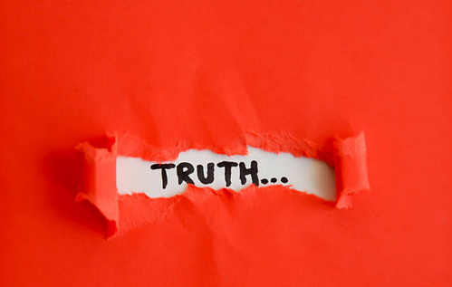
Every one of us needs a few people to tell us the truth about our hearts and souls.

Slide 4
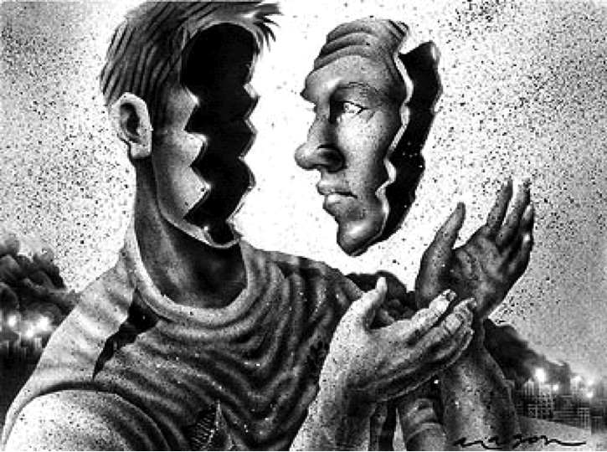
Self-deception is a process where we pull the cover over our own eyes.

Slide 5
“And you shall know the truth, and the truth shall make you free.”
John 8:32

Slide 6
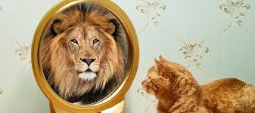
We need Truth-Tellers who will help us grow in our acceptance of reality.

Slide 7
2 Samuel 11:1-8
It happened in the spring of the year, at the time when kings go out to battle, that David sent Joab and his servants with him, and all Israel; and they destroyed the people of Ammon and besieged Rabbah. But David remained at Jerusalem.
Then it happened one evening that David arose from his bed and walked on the roof of the king’s house. And from the roof he saw a woman bathing, and the woman was very beautiful to behold. So David sent and inquired about the woman. And someone said, “Is this not Bathsheba, the daughter of Eliam, the wife of Uriah the Hittite?” Then David sent messengers, and took her; and she came to him, and he lay with her, for she was cleansed from her impurity; and she returned to her house. And the woman conceived; so she sent and told David, and said, “I am with child.”
Then David sent to Joab, saying, “Send me Uriah the Hittite.” And Joab sent Uriah to David. When Uriah had come to him, David asked how Joab was doing, and how the people were doing, and how the war prospered. And David said to Uriah, “Go down to your house and wash your feet.” So Uriah departed from the king’s house, and a gift of food from the king followed him.

Slide 8
Anytime we try to handle temptation in isolation, we are extremely vulnerable to deception.

Slide 9
2 Samuel 12:1-7
Then the Lord sent Nathan to David. And he came to him, and said to him: “There were two men in one city, one rich and the other poor. The rich man had exceedingly many flocks and herds. But the poor man had nothing, except one little ewe lamb which he had bought and nourished; and it grew up together with him and with his children. It ate of his own food and drank from his own cup and lay in his bosom; and it was like a daughter to him. And a traveler came to the rich man, who refused to take from his own flock and from his own herd to prepare one for the wayfaring man who had come to him; but he took the poor man’s lamb and prepared it for the man who had come to him.”
So David’s anger was greatly aroused against the man, and he said to Nathan, “As the Lord lives, the man who has done this ^{[a]}shall surely die! And he shall restore fourfold for the lamb, because he did this thing and because he had no pity.”
Then Nathan said to David, “You are the man! Thus says the Lord God of Israel: ‘I anointed you king over Israel, and I delivered you from the hand of Saul.

Slide 10
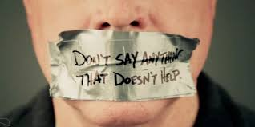
Ephesians 4:29
Let no corrupt word proceed out of your mouth, but what is good for necessary edification, that it may impart grace to the hearers.

Slide 11
What burns deeply in the heart of a true prophet is not just anger but love.

Slide 12
Accountability is a tool and a gift we give to one another to try to realize the growth we could never know all by ourselves.

Slide 13
Proverbs 27:6
“Faithful are the wounds of a friend, But the kisses of an enemy are deceitful.”

Slide 14
Avoidance kills relationships and causes resentment to build up inside you.
We live in what is called pseudo-relationships. It’s the avoidance of conflict.

Slide 15
To go beyond pseudo-relationships we have to be willing to enter into chaos.

Slide 16
People who love authentic relationships always prefer the pain of temporary turmoil to the peace of long-lasting superficiality

