Slide 1
On the Incarnation
by St Athanasius
Notes:
NOTE:
To change the image on this slide, select the picture and delete it. Then click the Pictures icon in the placeholder to insert your own image.

Slide 2
When God created Adam, he was equipped with 2 different graces:
General grace: He brought us into existence from non-existence
the animals were given general grace, the plants, all of creation
“All things were made through Him, and without Him nothing was made that was made.”
John 1:3

Slide 3
2. Special Grace:
He made all things out of nothing through His own Word, our Lord Jesus Christ and of all these His earthly creatures He reserved especial mercy for the race of men. Upon them, therefore, upon men who, as animals, were essentially impermanent, He bestowed a grace which other creatures lacked—namely the impress of His own Image, a share in the reasonable being of the very Word Himself, so that, reflecting Him and themselves becoming reasonable and expressing the Mind of God even as He does, though in limited degree they might continue for ever in the blessed and only true life of the saints in paradise.
Athanasius – On the Incarnation Ch. 3

Slide 4
Special Grace
Man was created in His own image – sharing in the being of Christ the Word
Then God said, “Let Us make man in Our image, according to Our likeness; let them have dominion over the fish of the sea, over the birds of the air, and over the cattle, over ^{[a]}all the earth and over every creeping thing that creeps on the earth.” Genesis 1:26

Slide 5
Special Grace
Man was bestowed with a grace to have the ability to be creative, to reason, to live forever (be immortal)
The Indwelling of the Holy Spirit!
And the Lord God formed man of the dust of the ground, and breathed into his nostrils the breath of life; and man became a living being. Genesis 2:7

Slide 6
The Indwelling of the Holy Spirit
The cause of the incorruption of man and his abidance in all virtue was evidently that the Spirit from God indwelt in him; for He breathed upon his face the breath of life, as it is written.
By St. Cyril of Alexandria Commentary on Gospel of John 7:37-39

Slide 7
With the special Grace man received, there were two things that came with it:
A law and place
God secured this grace that He had given by making it conditional from the first upon two things—namely, a law and a place. He set them in His own paradise, and laid upon them a single prohibition.
If they guarded the grace and retained the loveliness of their original innocence, then the life of paradise should be theirs, without sorrow, pain or care, and after it the assurance of immortality in heaven.
But if they went astray and became vile, throwing away their birthright of beauty, then they would come under the natural law of death and live no longer in paradise, but, dying outside of it, continue in death and in corruption. This is what Holy Scripture tells us, proclaiming the command of God, "Of every tree that is in the garden thou shalt surely eat, but of the tree of the knowledge of good and evil ye shall not eat, but in the day that ye do eat, ye shall surely die."

Slide 8
Every relationship has a LAW

Slide 9
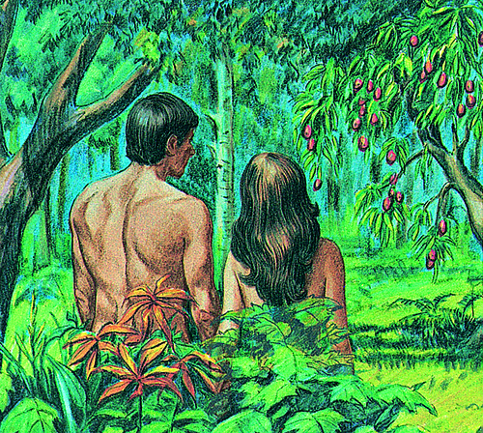
He gave them a place: Paradise
The place and environment where they were to reach their potential

Slide 10
The fall of Adam and Eve
⁶ So when the woman saw that the tree was good for food, that it was ^{[a]}pleasant to the eyes, and a tree desirable to make one wise, she took of its fruit and ate. She also gave to her husband with her, and he ate.

Slide 11
What was the result of the Fall?
Man broke the law
Was kicked out of Paradise
Holy Spirit left man
St Cyril of Alexandria “but he having the ancient deceit turned aside to sin, then by degrees in succession received much advance thereto, alone with the remaining good things he suffers the loss of the Spirit and so at length became not only subject to corruption but also prone to sin.”
Became corruptible – prone to sin, going to “non-existence” – lost the special grace and only became like the animals that will go into non-existence when they die

Slide 12
St. Athanasius- On The Incarnation ch. 4
Instead of remaining in the state in which God had created them, they were in process of becoming corrupted entirely, and death had them completely under its dominion. For the transgression of the commandment was making them turn back again according to their nature; and as they had at the beginning come into being out of non-existence, so were they now on the way to returning, through corruption, to non-existence again. The presence and love of the Word had called them into being; inevitably, therefore when they lost the knowledge of God, they lost existence with it; for it is God alone Who exists, evil is non-being, the negation and antithesis of good.

Slide 13
St Athanasius On the Incarnation Ch. 4
“Through constant contemplation, then his nature is deprived of its power and he remains incorrupt. So is it affirmed in Wisdom: "The keeping of His laws is the assurance of incorruption."8 And being incorrupt, he would be henceforth as God, as Holy Scripture says, "I have said, Ye are gods and sons of the Highest all of you: but ye die as men and fall as one of the princes."

Slide 14
What do we pray in liturgy?
“ O God, the great and the Eternal, Who formed man in incorruption, and death which entered into the world through the envy of the devil, You have destroyed by the life-giving manifestation of Your Only – Begotten Son,……

Slide 15
What was God’s dilemma?
It was solving the dilemma of man
Either God would cancel what He said- which isn’t just and that is not God’s nature
Or He would destroy mankind or let mankind go to non-existence which does not reflect God’s goodness

Slide 16
On the Incarnation ch. 6-7
and, besides that, such indifference to the ruin of His own work before His very eyes would argue not goodness in God but limitation, and that far more than if He had never created men at all.
It was impossible, therefore, that God should leave man to be carried off by corruption, because it would be unfitting and unworthy of Himself.
(7) Yet, true though this is, it is not the whole matter. As we have already noted, it was unthinkable that God, the Father of Truth, should go back upon His word regarding death in order to ensure our continued existence.
He could not falsify Himself; what, then, was God to do?

Slide 17
Why not repentance?
Was He to demand repentance from men for their transgression? You might say that that was worthy of God, and argue further that, as through the Transgression they became subject to corruption, so through repentance they might return to incorruption again. But repentance would not guard the Divine consistency, for, if death did not hold dominion over men, God would still remain untrue. Nor does repentance recall men from what is according to their nature; all that it does is to make them cease from sinning.

Slide 18
Why the Incarnation of the Word?
What—or rather Who was it that was needed for such grace and such recall as we required? Who, save the Word of God Himself, Who also in the beginning had made all things out of nothing? His part it was, and His alone, both to bring again the corruptible to incorruption and to maintain for the Father His consistency of character with all. For He alone, being Word of the Father and above all, was in consequence both able to recreate all, and worthy to suffer on behalf of all and to be an ambassador for all with the Father.

