Slide 1

Hosea during COVID-19

Slide 2
“When the Lord began to speak through Hosea, the Lord said to him, “Go, marry a promiscuous woman and have children with her, for like an adulterous wife this land is guilty of unfaithfulness to the Lord.” Hosea 1:2

Slide 3

Hosea discovered what unfaithfulness means to love
This Photo by Unknown Author is licensed under CC BY-ND

Slide 4
For their mother has played the harlot;
She who conceived them has behaved
shamefully.
For she said, ‘I will go after my lovers,
Who give me my bread and my water,
My wool and my linen,
My oil and my drink.’

Slide 5
“Therefore, behold,
I will hedge up your way with thorns,
And wall her in,
So that she cannot find her paths.
⁷ She will chase her lovers,
But not overtake them;

Slide 6
Yes, she will seek them, but not find them.
Then she will say,
‘I will go and return to my first husband,

Slide 7
For then it was better for me than now.’
For she did not know
That I gave her grain, new wine, and oil,
And multiplied her silver and gold— Hosea 2:5-7

Slide 8
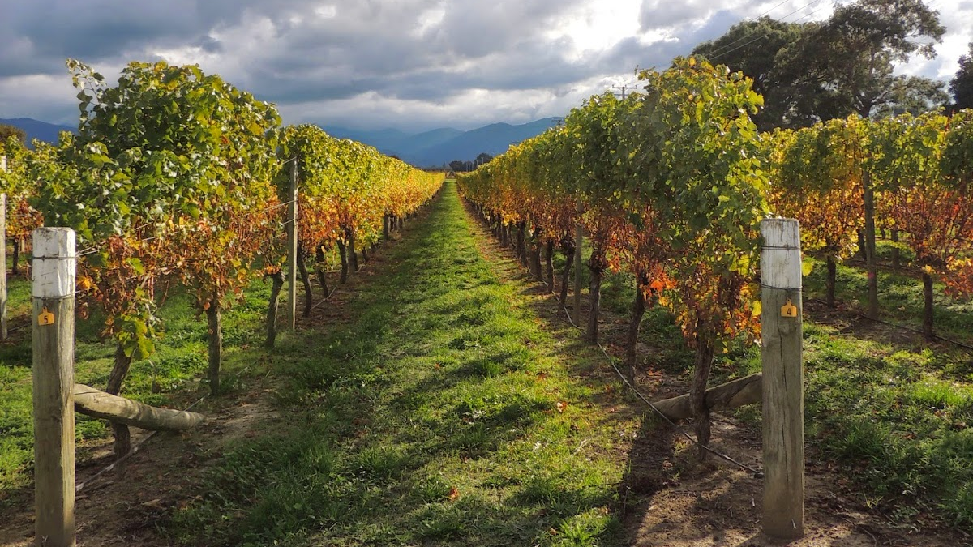
Therefore, behold, I will allure her,
Will bring her into the wilderness,
And speak comfort to her.
¹⁵ I will give her vineyards from there,
And the Valley of Achor as a door of hope;
She shall sing there,
This Photo by Unknown Author is licensed under CC BY-ND

Slide 9
As in the days of her youth,
As in the day when she came up from the land of Egypt.
“And it shall be, in that day,”
Says the Lord,
“That you will call Me ‘My Husband,’
And no longer call Me ‘My Master,’

Slide 10

“I will betroth you to Me forever;
Yes, I will betroth you to Me
In righteousness and justice,
In lovingkindness and mercy;
²⁰ I will betroth you to Me in faithfulness,
And you shall know the Lord.
Hosea 2:19-20
This Photo by Unknown Author is licensed under CC BY-NC

Slide 11
Then the Lord said to me, “Go again, love a woman who is loved by a love and is committing adultery, just like the love of the Lord for the children of Israel, who look to other gods and love the raisin cakes of the pagans.”

Slide 12
So I bought her for myself for fifteen shekels of silver, and one and one-half homers of barley. And I said to her, “You shall stay with me many days; you shall not play the harlot, nor shall you have a man—so, too, will I be toward you.” Hosea 3:1-3

Slide 13
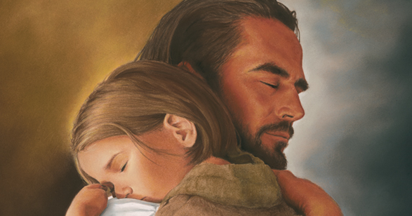
God still loves in spite of sin
This Photo by Unknown Author is licensed under CC BY

Slide 14
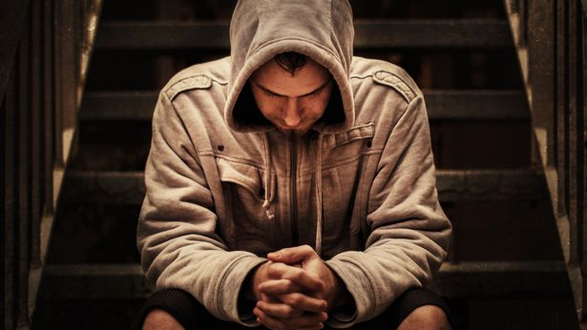
God suffers trouble because the one who ceases to love Him is suffering

Slide 15
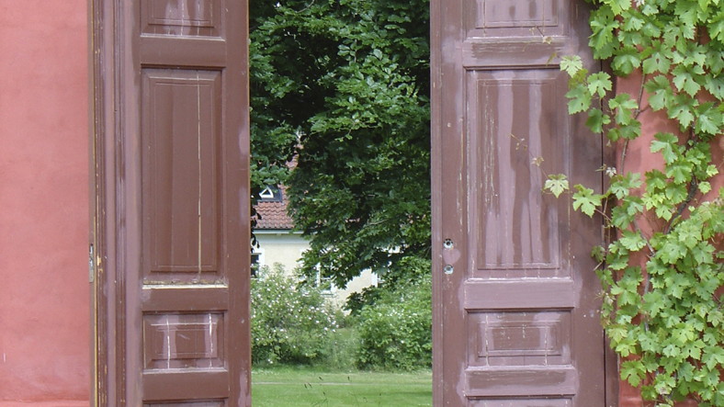
“Now My soul is troubled, and what shall I say? ‘Father, save Me from this hour’? John 12:27
Through the troubling of Christ, He opens the door for us
This Photo by Unknown Author is licensed under CC BY-ND

