Slide 1
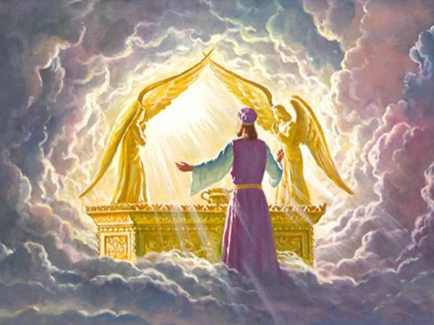
Glory of God
Vs
Glory of Men

Slide 2
An obstacle to believe!!!
How can you believe, who receive honor from one another, and do not seek the honor that comes from the only God? Jn 5:44

Slide 3
For the obtaining of the glory of our Lord Jesus Christ !!
¹³ But we are bound to give thanks to God always for you, brethren beloved by the Lord, because God from the beginning chose you for salvation through sanctification by the Spirit and belief in the truth, ¹⁴ to which He called you by our gospel, for the obtaining of the glory of our Lord Jesus Christ. 2 Thes 2:13,14

Slide 4
Glory of God
13 Then the priest of Zeus, whose temple was in front of their city, brought oxen and garlands to the gates, intending to sacrifice with the multitudes.
14 But when the apostles Barnabas and Paul heard this, they tore their clothes and ran in among the multitude, crying out 15 and saying, “Men, why are you doing these things? We also are men with the same nature as you, and preach to you that you should turn from these useless things to the living God, who made the heaven, the earth, the sea, and all things that are in them. Acts 14:13,14

Slide 5
19 Then Jews from Antioch and Iconium came there; and having persuaded the multitudes, they stoned Paul and dragged him out of the city, supposing him to be dead. Acts 14:19

Slide 6
Glory of Men
21 So on a set day Herod, arrayed in royal apparel, sat on his throne and gave an oration to them. 22 And the people kept shouting, “The voice of a god and not of a man!” 23 Then immediately an angel of the Lord struck him, because he did not give glory to God. And he was eaten by worms and died. Acts 12:21-23

Slide 7
The Key to Glory of God
35 Then Jesus said to them, “A little while longer the light is with you. Walk while you have the light, lest darkness overtake you; he who walks in darkness does not know where he is going. 36 While you have the light, believe in the light, that you may become sons of light.” These things Jesus spoke, and departed, and was hidden from them. Jn 12:35,36

Slide 8
Applications
Ask yourself : Am I seeking his glory at home, Church ,work …ect?
Do I need to repent for my previous self vain glory?
Do I enjoy the walk in the Light?

Slide 9
(St. Cyril of Jerusalem)
By partaking of the body and blood of Christ you become one body and one blood with him. In such a way you become bearers of Christ, his body and blood spread through your limbs. In this way you become, in the words of St. Peter, 'partakers of the divine nature'."

