Slide 1
Faithful (Loyal) Friendships

Slide 2
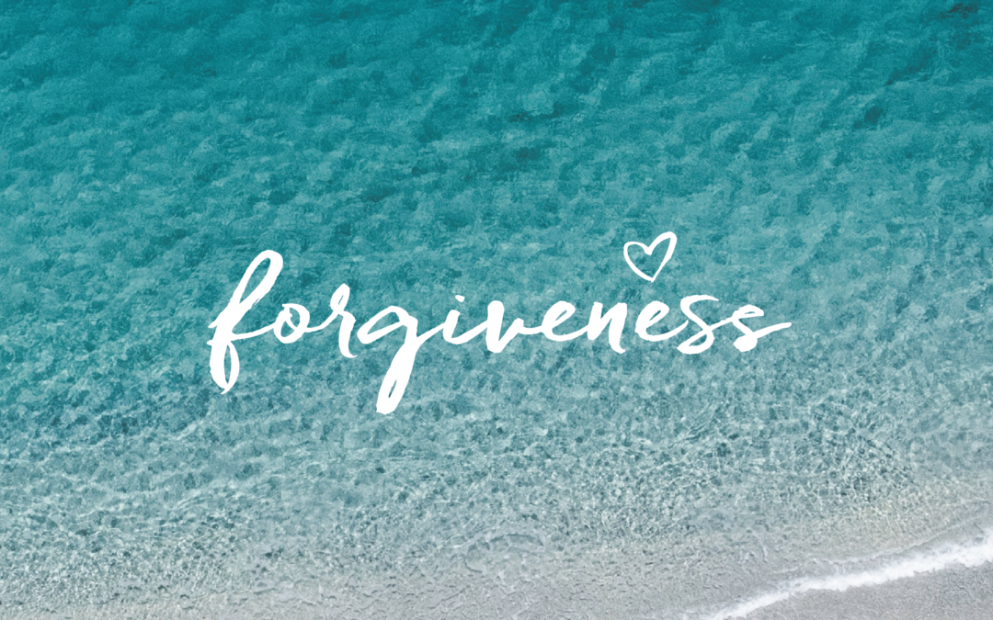
Forgiveness is the only force strong enough to
heal relationships by
hatred and betrayal.

Slide 3
.” ~Matthew 18:21-352:1-12
Then Peter came to Him and said, “Lord, how often shall my brother sin against me, and I forgive him? Up to seven times?”
²² Jesus said to him, “I do not say to you, up to seven times, but up to seventy times seven. ²³ Therefore the kingdom of heaven is like a certain king who wanted to settle accounts with his servants. ²⁴ And when he had begun to settle accounts, one was brought to him who owed him ten thousand talents. ²⁵ But as he was not able to pay, his master commanded that he be sold, with his wife and children and all that he had, and that payment be made.

Slide 4
²⁶ The servant therefore fell down before him, saying, ‘Master, have patience with me, and I will pay you all.’ ²⁷ Then the master of that servant was moved with compassion, released him, and forgave him the debt. ²⁸ “But that servant went out and found one of his fellow servants who owed him a hundred denarii; and he laid hands on him and took him by the throat, saying, ‘Pay me what you owe!’ ²⁹ So his fellow servant fell down ^{[e]}at his feet and begged him, saying, ‘Have patience with me, and I will pay you ^{[f]}all.’

Slide 5
³⁰ And he would not, but went and threw him into prison till he should pay the debt. ³¹ So when his fellow servants saw what had been done, they were very grieved, and came and told their master all that had been done. ³² Then his master, after he had called him, said to him, ‘You wicked servant! I forgave you all that debt because you begged me. ³³ Should you not also have had compassion on your fellow servant, just as I had pity on you?’ ³⁴ And his master was angry, and delivered him to the torturers until he should pay all that was due to him.
³⁵ “So My heavenly Father also will do to you if each of you, from his heart, does not forgive his brother ^{[g]}his trespasses.

Slide 6
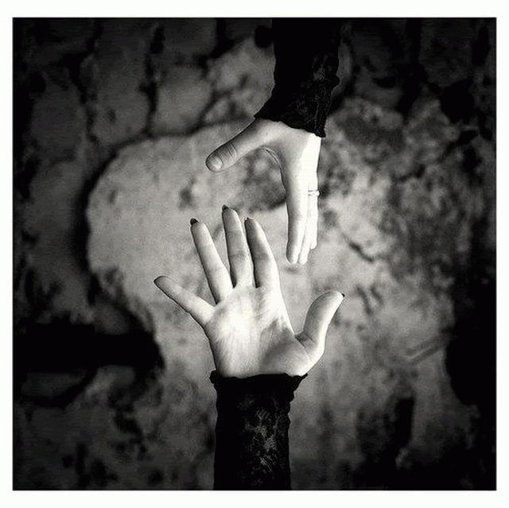
There are two ways to live with hurt:
The way of vengeance
The way of forgiveness.
What’s the better choice?
This Photo by Unknown Author is licensed under CC BY-NC-ND

Slide 7
First, forgiving is not the same thing as excusing!

Slide 8
Forgiving is not forgetting. Forgetting means that our past sins become irrelevant to His dealings with us.

Slide 9
Forgiving is not the same thing as reconciling
Forgiveness takes place within the heart of one human being and can be granted even if the other person does not ask for it or deserve it.
Reconciliation requires the rebuilding of trust, and that means good faith on the part of both parties.

Slide 10
The first stage of forgiveness is the decision not to try to inflict a reciprocal amount of pain on everyone who has caused hurt.
Letting go of vengeance doesn’t mean letting go of justice.
WHEN I FORGIVE YOU, I GIVE UP THE RIGHT TO HURT YOU BACK!
This Photo by Unknown Author is licensed under CC BY-SA

Slide 11
Open Your Eyes
The next stage of forgiveness involves a new way of seeing and feeling.
When we forgive each other, we do not ignore the hurts, but we see beyond them.
This Photo by Unknown Author is licensed under CC BY-NC

Slide 12
The third stage of forgiving, the one that shows you have begun to make some real progress, is when you find yourself wishing the other person well.
God commands forgiving because to refuse to forgive means I allow the one who hurt me to keep me chained in a prison of bitterness and resentment.
This Photo by Unknown Author is licensed under CC BY-NC

Slide 13
When the miracle of forgiveness takes place, it
leads to the healing of a broken friendship**
“Now all things are of God, who has reconciled us to Himself through Jesus Christ, and has given us the ministry of reconciliation, ¹⁹ that is, that God was in Christ reconciling the world to Himself, not imputing their trespasses to them, and has committed to us the word of reconciliation.”
~2 Corinthians 5:18
As a general rule, where there is hurt, I am both the victim of and the agent of wrongdoing

Slide 14
Because reconciliation is the healing
of our deepest longing,
it is never too late to seek it.
It is longing for their spiritual well-being,
which includes desiring that they
become loving persons.
This Photo by Unknown Author is licensed under CC BY-NC-ND

Slide 15
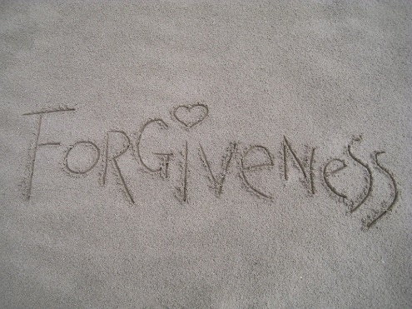
Some questions for discussion or self-examination: 1. What sorts of hurts are hardest for you to forgive? Why? 2. To what degree have you lived according to the Law of Lamech (“if anyone inflicts pain on me, I must make them pay”)? Can you think of someone whom you have held captive in the little prison of your mind with a desire to get even? What is keeping you from giving up your right to hurt them back? 3. How do you distinguish between forgiving, forgetting, and excusing? 4. How easy or difficult is it for you to experience a sense of God’s forgiveness in your life? Why? 5. How can you forgive someone when reconciliation does not seem possible? 6. What are the effects on you when you hang onto resentment and withhold forgiveness? 7. Is there anyone you need to offer forgiveness to? Anyone you need to seek forgiveness from?

Slide 16
A friend loves at all times

