Slide 1
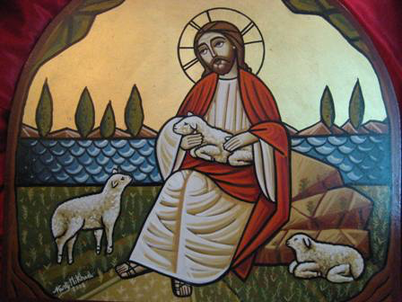
LAMBS AMONG WOLVES
1st Sunday of Abib

Slide 2
1. The Mission
Go your way; behold, I send you out as lambs among wolves. Lk 10:3

Slide 3
St Cyril of Alexandria Commentary on Luke, Homily 61
How then does he command the holy apostles, who are innocent men and “sheep,” to seek the company of wolves, and go to them of their own will? Is not the danger apparent? Are they not set up as ready prey for their attacks? How can a sheep prevail over a wolf? How can one so peaceful conquer the savageness of beasts of prey? “Yes,” he says, “for they all have me as their Shepherd:

Slide 4
St Cyril of Alexandria Commentary on Luke, Homily 61
small and great, people and princes, teachers and students. I will be with you, help you, and deliver you from all evil. I will tame the savage beasts. I will change wolves into sheep, and I will make the persecutors become the helpers of the persecuted. I will make those who wrong my ministers to be sharers in their pious designs. I make and unmake all things, and nothing can resist my will.”

Slide 5
2. What is “my Peace”?
Peace I leave with you, My peace I give to you; not as the world gives do I give to you. Let not your heart be troubled, neither let it be afraid. Jn 14:27

Slide 6
St Cyril the Great On Jn 14:27
And now, He says, Peace I give unto you, not simply, but My peace. And this was clearly nothing else but saying: I will bring the Spirit, and of Myself will abide with those who receive Him. For that the peace of Christ is His Spirit, it needs no long argument to completely demonstrate. But I suppose one ought to say this, if He is peace in heaven and on the earth, how can it fail to be clear to everyone,

Slide 7
St Cyril the Great On Jn 14:27
that as we have said, the peace is certainly His Spirit? And indeed the inspired Paul said to some: and the peace of God, which surpasses all understanding, will guard your hearts and minds through Christ Jesus. Phil 4:7. And surely it is right to reflect, that it is not about that peace which has reference to common thought and action that He says this.

Slide 8
St Cyril the Great On Jn 14:27
For that disposition which loathes dispute and strife has and works peace, so far as its own waverings and inclinations will allow it. And we shall not think that the peace which is here meant is something which has not a real and independent existence; but we must suppose that it is found in the temper of those who love it.

Slide 9
3. The Authority
He who hears you hears Me, he who rejects you rejects Me, and he who rejects Me rejects Him who sent Me.” Lk 10:16

Slide 10
St Cyril the Great Commentary on Luke, Homily 63.
Cyril of Alexandria: Christ gives those who love instruction the assurance that whatever is said concerning him by the holy apostles or evangelists is to be received necessarily without any doubt and to be crowned with the words of truth. He who hears them, hears Christ. For the blessed Paul also said, “You desire proof that Christ is speaking in me.” [2Co 13:3.]

Slide 11
St Cyril the Great Commentary on Luke, Homily 63.
Christ himself somewhere also said to the holy disciples, “For it is not you that speak, but the Spirit of your Father that speaks in you.” [Mat 10:20.] Christ speaks in them by the consubstantial Spirit. If it is true, and plainly it is, that they speak by Christ, how can they err? He affirms that he who does not hear them, does not hear Christ, and that he who rejects them rejects Christ, and with him the Father.

Slide 12
4. Our Reactions?
6 And if a son of peace is there, your peace will rest on it; if not, it will return to you. … But whatever city you enter, and they do not receive you, go out into its streets and say, 11 ‘The very dust of your city which clings to us we wipe off against you. Nevertheless know this, that the kingdom of God has come near you.’ 12 But I say to you that it will be more tolerable in that Day for Sodom than for that city. Lk 10:6,10-12

Slide 13
John Chrysostom
“The flock is God’s fellow workers (1 Cor. 3:9) The flock belongs to its owner; the flock is the building of God who belongs to its owner¹.” Therefore, the wise flock is the one who does not get attached to the shepherd personally, but to the Lord as a good Shepherd.
¹ Pastoral Love, p. 14.

