Slide 1
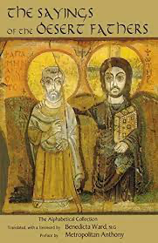
Gleanings from the Desert
PART 3: The Tongue

Slide 2
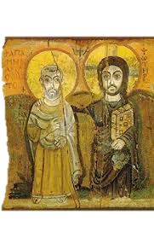
Theme Verse
“Thus says the Lord: “Stand in the ways and see, And ask for the old paths, where the good way is, And walk in it; Then you will find rest for your souls. But they said, ‘We will not walk in it.” Jeremiah 6:16

Slide 3
Death and Life
Death and life are in the power of the tongue: and they that love it shall eat the fruit thereof. Proverbs 18:21
If anyone among you thinks he is religious, and does not bridle his tongue but deceives his own heart, this one’s religion is useless. ” James 1:26‬

Slide 4
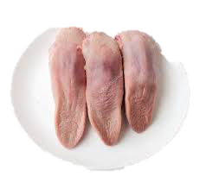
Tongue Dish
Best Dish: “It is the best of all dishes, because with it we may bless and communicate happiness, dispel sorrow, remove despair, cheer the fainthearted, inspire the discouraged, and say a hundred other things to uplift mankind.”
Worst Dish:. A dish of tongue appeared on the table. The servant said, “It is the worst, because with it we may curse and break human hearts; destroy reputations; promote discord and strife; set families, communities, and nations at war with each other.” He was a wise servant.

Slide 5
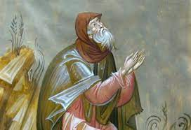
The Mother of All Passions
No passion is worse than an uncontrolled tongue, because it is the mother of all the passions.
- Abba Agathon

Slide 6
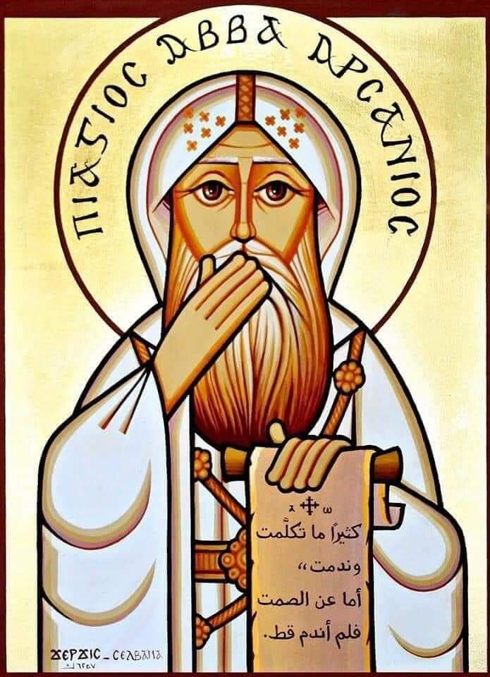
The Way Forward is Backward
“While still living in the palace, Abba Arsenius prayed to God in these words, “Lord, lead me in the way of salvation.” And a voice came saying to him, “Arsenius, flee from men and you will be saved.” And then, Having withdrawn to the solitary life, he made the same prayer again and he heard a voice saying to him, “Arsenius, flee, be silent, pray always, for these are the sources of sinlessness.”

Slide 7
We Need a Speech Overhaul
To everything there is a season, A time for every purpose under heaven. A time to kill, And a time to heal; A time to break down, And a time to build up Ecc 3:1,3
Notes:
“Flee” is followed hard on the heels by the disciplines of silence and prayer. Silence tells the tongue where to halt. Prayer reorients it Godward.
For the fathers and mothers of the desert, the transformation of human speech begins there. They teach us that if our lives are going to go right, there must be a retraining of the lips in righteousness
Sometimes you have to break a thing down to its most elemental

Slide 8
Before being able to speak again…..
We Need to learn to be SILENT
“I have often repented of having spoken, but never of having remained silent.” - St Arsenius
Silence is the prerequisite for inner stillness, and only inner stillness enables us truly to listen to God, to hear His voice, and to commune with Him in the depths of our being. Fr John Breck

Slide 9
Silence Teaches us
Silence Makes Us Pilgrims.
“Abba Tithoes once said, “Pilgrimage means that a man should control his tongue.” The expression “To be on pilgrimage is to be silent”, expresses the conviction of the Desert Fathers that silence is the best anticipation of the future world.
Silence Teaches Us To Speak.
Silence Guards The Fire Within

Slide 10
Acknowledging the Power of the Tongue
Indeed, we put bits in horses’ mouths that they may obey us, and we turn their whole body. Look also at ships: although they are so large and are driven by fierce winds, they are turned by a very small rudder wherever the pilot desires. Even so the tongue is a little member and boasts great things. See how great a forest a little fire (spark)kindles! And the tongue is a fire, a world of iniquity. The tongue is so set among our members that it defiles the whole body, and sets on fire the course of nature; and it is set on fire by hell. James 3:3-6

Slide 11
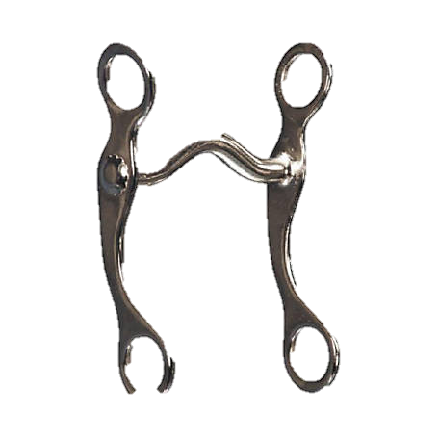
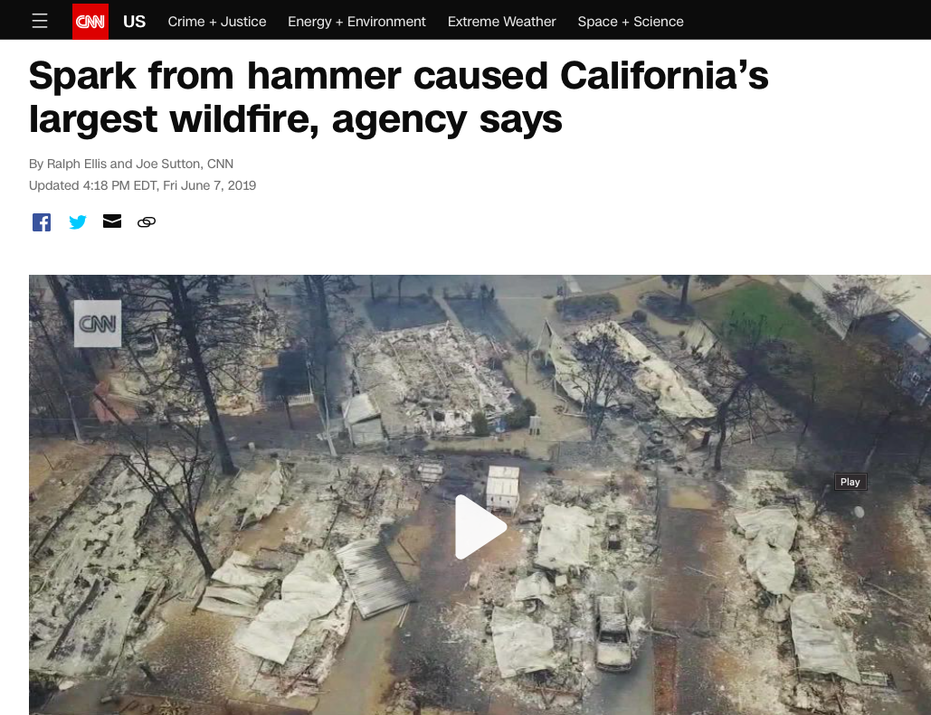
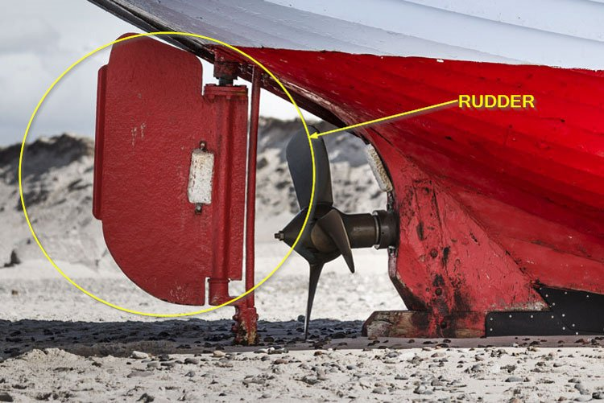
Powerful Imagery
A Bit
Rudder
A Spark

Slide 12
Flee!
A brother questioned Abba Matoes saying, 'What am I to do? My tongue makes me suffer, and every time I go among men, I cannot control it, but I condemn them in all the good they are doing and reproach them with it. What am I to do?' The old man replied, 'If you cannot contain yourself, flee into solitude. For this is a sickness. He who dwells with brethren must not be square, but round, so as to turn himself towards all.' He went on, 'It is not through virtue that I live in solitude, but through weakness; those who live in the midst of men are the strong ones.'

Slide 13
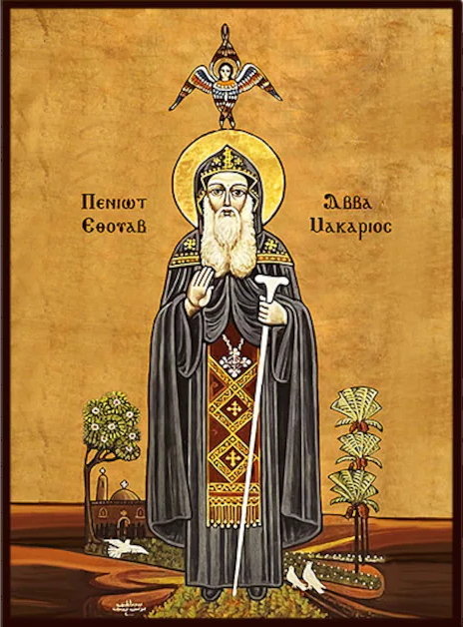
Flee
“Abba Macarius was dismissing some brothers from the assembly when he said, “Flee, my brothers.” Confused, one of them returned, “Where could we flee to beyond this desert?” Macarius “put his finger on his lips and said, ‘Flee that.”

Slide 14
Modern Day Fleeing
Not Always Needing to Give Your Opinion
Reduce Complaining at Every Opportunity
Not Speaking Evil of My Brother/Sister
Disengaging from Arguing on Social Media

Slide 15
Not Always Needing to Give Your Opinion
“Hyperichius said, ‘He who teaches others by his life and not his speech is truly wise.” Abba Joseph said to Abba Nisterus,
'What should I do about my tongue, for I cannot control it?' The old man said to him, 'When you speak, do you find peace?' He replied 'No.' The old man said, 'If you do not find peace, why do you speak? Be silent and when a conversation takes place, it is better to listen than to speak.'

Slide 16
Reduce Complaining At Every Opportunity
Human Level: you tend to attract people who are like you.
Story of realtor: family looking for house picky asked realtor? What are people like in this area? Then he asked what their old home was like and he responded they were terrible picky tough people. He said they will probably be just like the people you had in your old home.

Slide 17
Not Speaking Evil Of My Brother/Sister
²⁹ Do not let any unwholesome talk come out of your mouths, but only what is helpful for building others up according to their needs, that it may benefit those who listen. Eph 4:29
“When you think something good, say it. When you live with it for 30 seconds, you get used to it!”

Slide 18
Turn the Heart Toward God
The same amma was asked about the conversations one hears; 'If one is habitually listening to secular speech, how can one yet live for God alone, as you suggest?' She said, 'Just as when you are sitting at table and there are many courses, you take some but without pleasure, so when secular conversations come your way, have your heart turned towards God, and thanks to this disposition, you will hear them without pleasure, and they will not do you any harm. -Amma Theodora

Slide 19
Disengaging From Arguing On Social Media
We do not need words only, for, at the present time, there are many words among men, but we need works, for this is what is required, not words which do not bear fruit.’ Abba James

Slide 20
Abba Sisois once said with confidence, ‘For thirty years I have not prayed to God without sin. When I pray, I say “Lord Jesus Christ, protect me from my tongue.” Even now, it causes me to fall every day

Slide 21
It’s a Marathon not a Sprint
Most people want to gain the kingdom without sweat and effort. They admire the saints and want their honor and gifts, but they don't want to share in the pains and torments they undergo. Everybody, including harlots, publicans and every other person, wants the kingdom, which is why there are trials and temptations: to show those who truly love the Lord and who have justly joined the Kingdom of heaven. - St Macarius

